Slide 1
Privately Initiated Text Amendment
Public Information Meeting
July 26, 2021
Presented by Ricky Peterika

Slide 2
27-43
27-211.13
27-283.16
27-284.1.2
27-284.3.1
27-284.3.3

Slide 3
27-43
DEFINITIONS
Modifies the definition of a “grand tree”

Slide 4
27-43
DEFINITIONS
Modifies the definition of a “grand tree”
Grand tree: A species of tree and its root system, with crown spread, and DBH of at least thirty-two (32) inches, and a condition rating of “A”, “B”, or C,” which are of the identity, size, and character, as set forth in section 27-284.1.2. Any tree designated as a Challenger or Champion tree by the State of Florida is considered a grand tree.

Slide 5
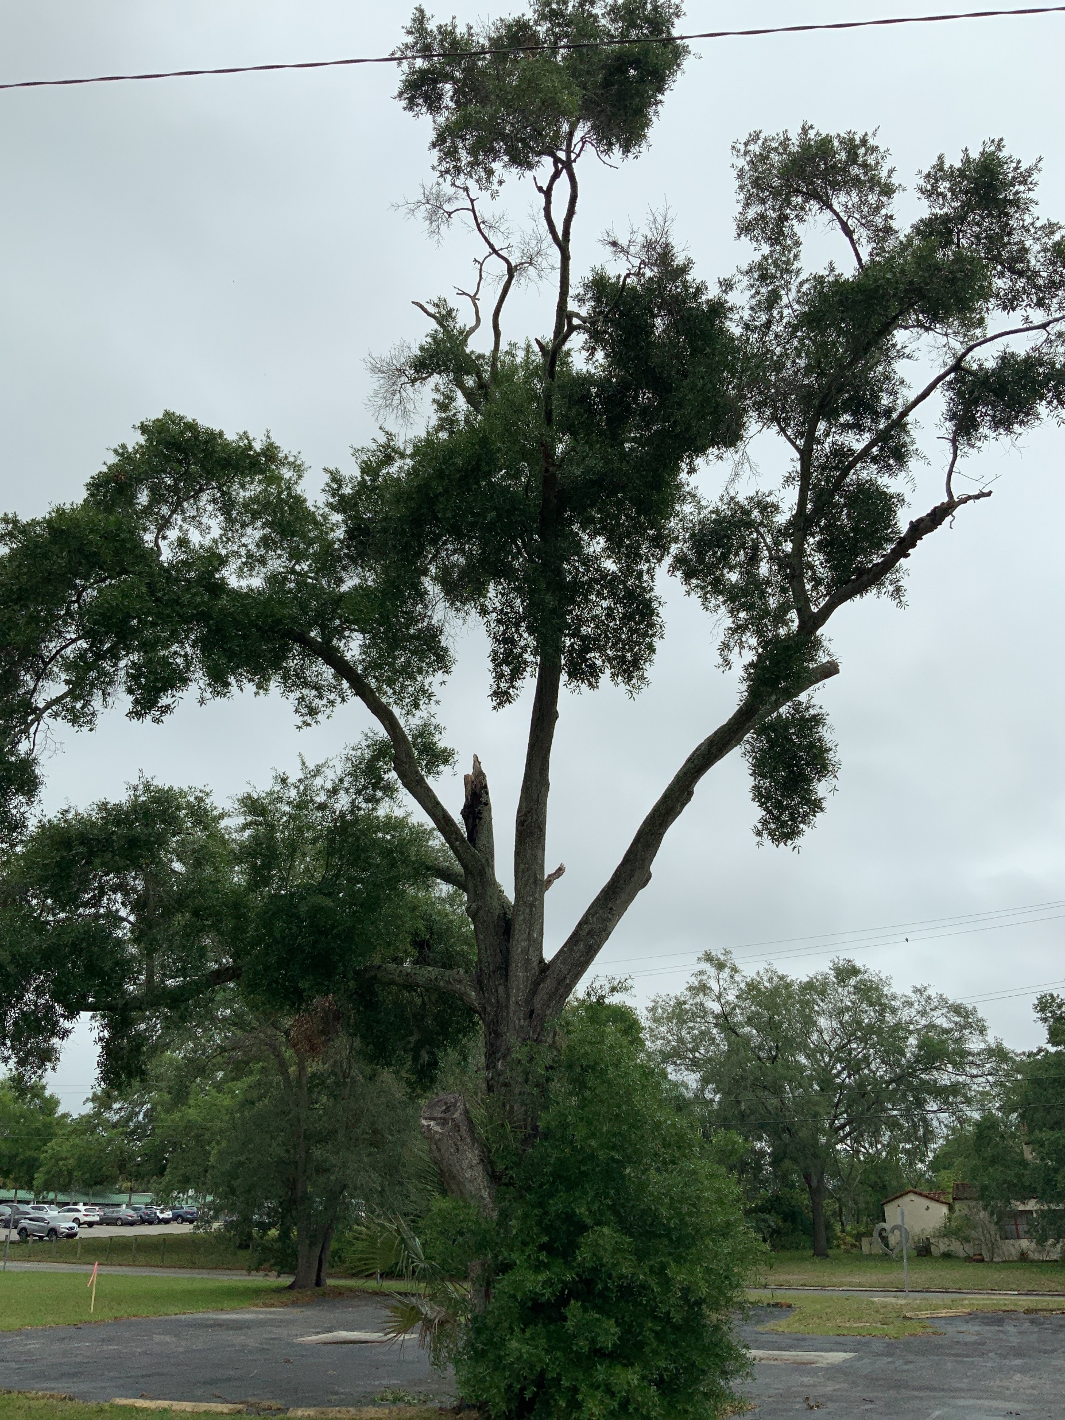
27-43
DEFINITIONS
Modifies the definition of a “grand tree”
Grand tree: A species of tree and its root system, with crown spread, and DBH of at least thirty-two (32) inches, and a condition rating of “A”, “B”, or C,” which are of the identity, size, and character, as set forth in section 27-284.1.2. Any tree designated as a Challenger or Champion tree by the State of Florida is considered a grand tree.

Slide 6
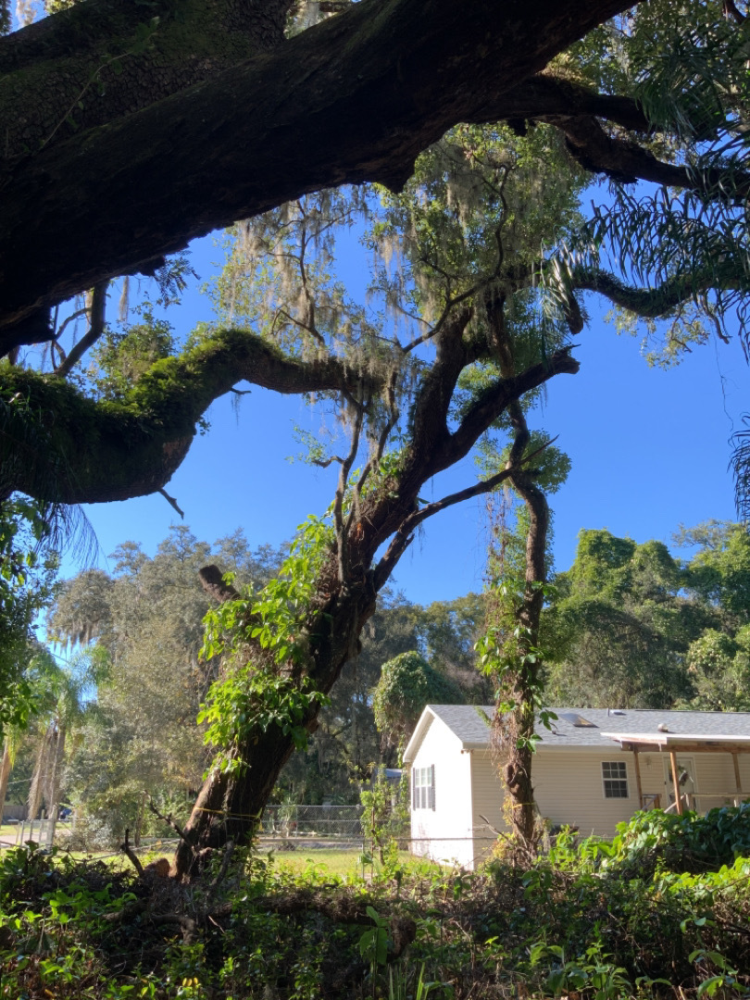
27-43
DEFINITIONS
Modifies the definition of a “grand tree”
Grand tree: A species of tree and its root system, with crown spread, and DBH of at least thirty-two (32) inches, and a condition rating of “A”, “B”, or C,” which are of the identity, size, and character, as set forth in section 27-284.1.2. Any tree designated as a Challenger or Champion tree by the State of Florida is considered a grand tree.

Slide 7
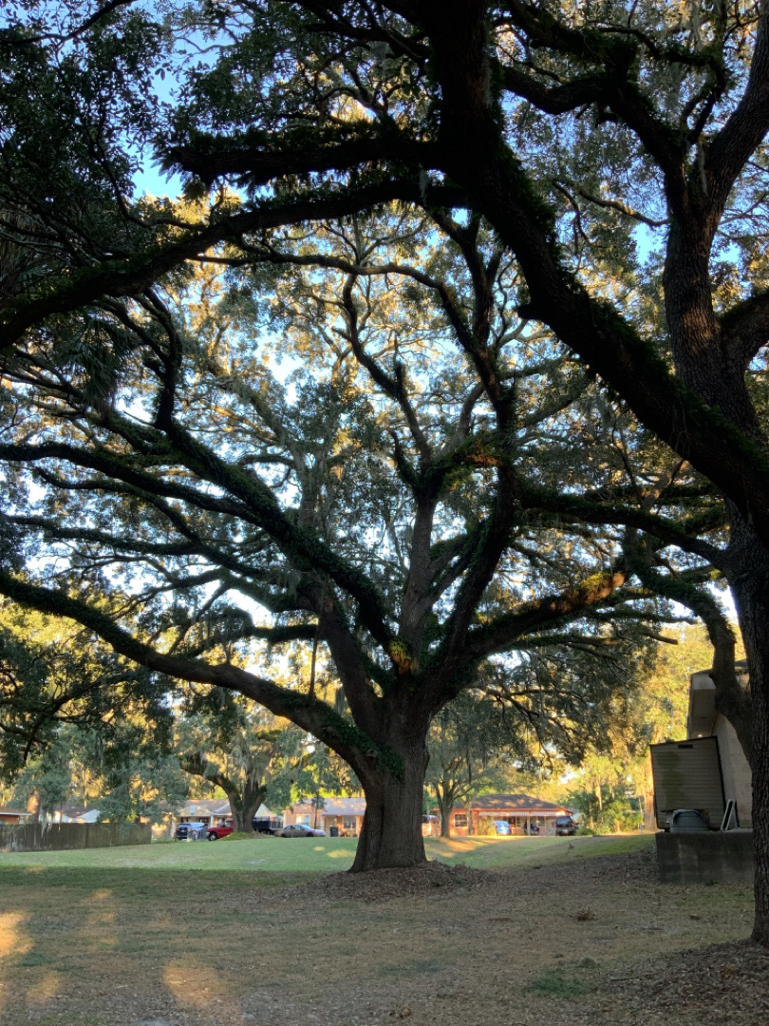
27-43
DEFINITIONS
Modifies the definition of a “grand tree”
Grand tree: A species of tree and its root system, with crown spread, and DBH of at least thirty-two (32) inches, and a condition rating of “A”, “B”, or C,” which are of the identity, size, and character, as set forth in section 27-284.1.2. Any tree designated as a Challenger or Champion tree by the State of Florida is considered a grand tree.

Slide 8
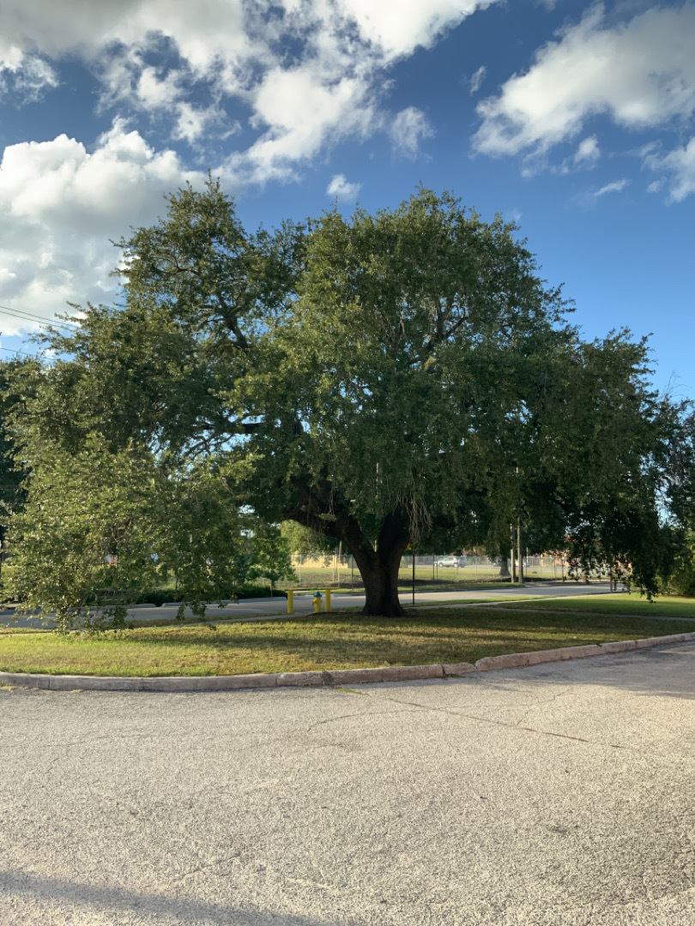
27-43
DEFINITIONS
Modifies the definition of a “grand tree”
Grand tree: A species of tree and its root system, with crown spread, and DBH of at least thirty-two (32) inches, and a condition rating of “A”, “B”, or C,” which are of the identity, size, and character, as set forth in section 27-284.1.2. Any tree designated as a Challenger or Champion tree by the State of Florida is considered a grand tree.

Slide 9
27-211.13
LANDSCAPING (SEMINOLE HEIGHTS)
Corrects a scrivener’s error

Slide 10
27-211.13
LANDSCAPING (SEMINOLE HEIGHTS)
Corrects a scrivener’s error
Acceptable planting materials. Tree selection shall be made from the City Tree Matrix (refer to section 27-284.1.1).
Shade species planting standards:
Shall comply with applicable standards set forth in article VI, division 4;
Minimum four-inch foot caliper at time of planting.
Understory species planting standards (refer to section 27-284.3.3 for specific requirements for trees and above ground electrical lines):
Shall comply with applicable standards set forth in article VI, division 4;
Minimum three-inch foot caliper at time of planting.

Slide 11
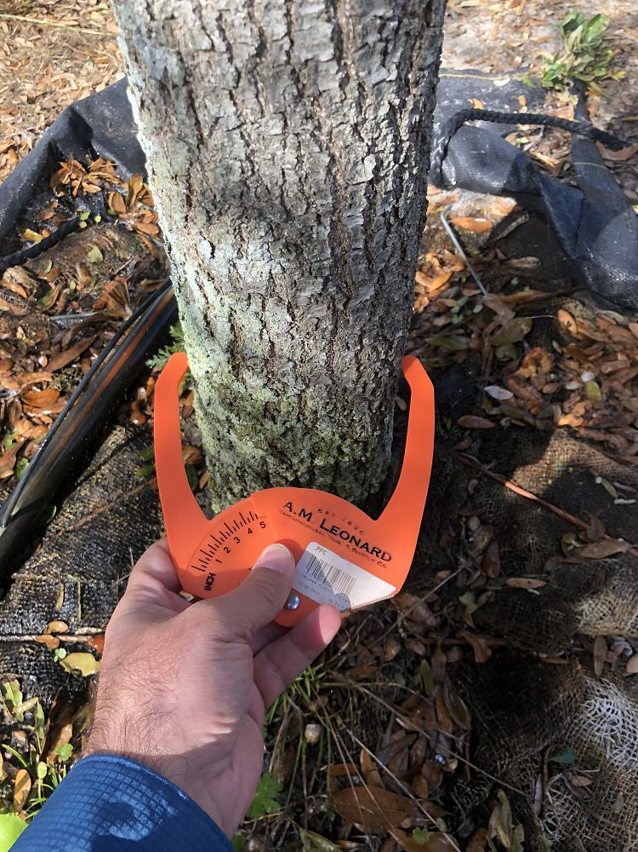
27-211.13
LANDSCAPING (SEMINOLE HEIGHTS)
Corrects a scrivener’s error
Acceptable planting materials. Tree selection shall be made from the City Tree Matrix (refer to section 27-284.1.1).
Shade species planting standards:
Shall comply with applicable standards set forth in article VI, division 4;
Minimum four-inch foot caliper at time of planting.
Understory species planting standards (refer to section 27-284.3.3 for specific requirements for trees and above ground electrical lines):
Shall comply with applicable standards set forth in article VI, division 4;
Minimum three-inch foot caliper at time of planting.

Slide 12
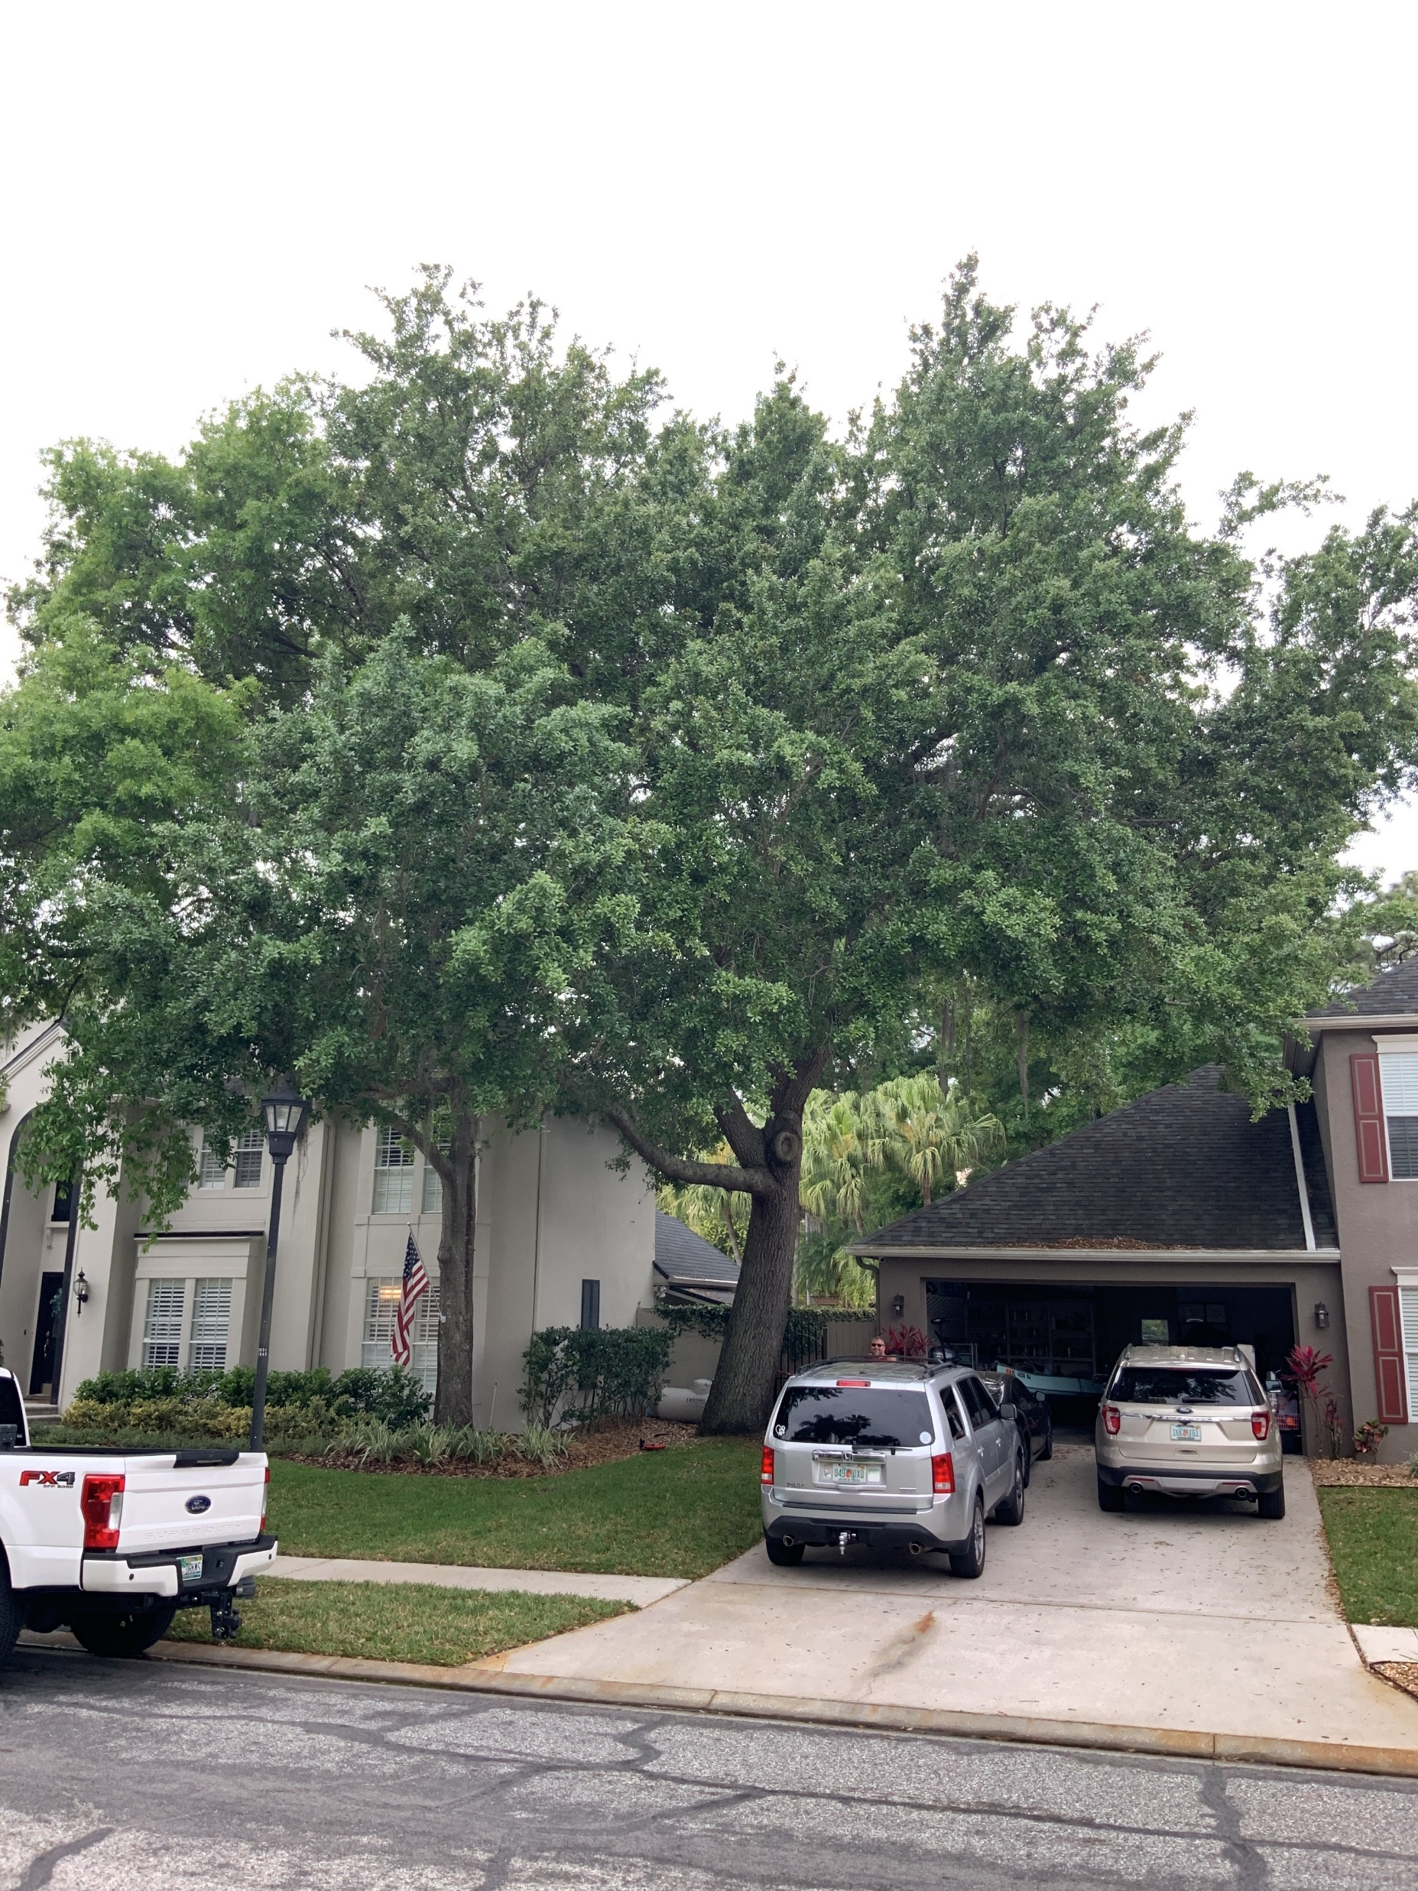
27-211.13
LANDSCAPING (SEMINOLE HEIGHTS)
Corrects a scrivener’s error
Acceptable planting materials. Tree selection shall be made from the City Tree Matrix (refer to section 27-284.1.1).
Shade species planting standards:
Shall comply with applicable standards set forth in article VI, division 4;
Minimum four-inch foot caliper at time of planting.
Understory species planting standards (refer to section 27-284.3.3 for specific requirements for trees and above ground electrical lines):
Shall comply with applicable standards set forth in article VI, division 4;
Minimum three-inch foot caliper at time of planting.

Slide 13
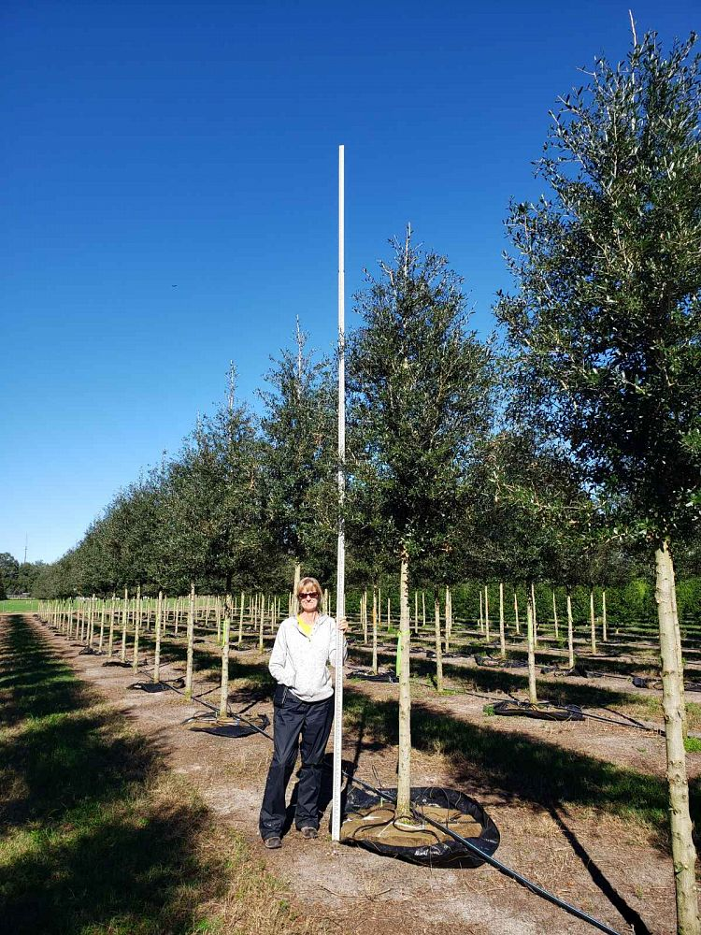
27-211.13
LANDSCAPING (SEMINOLE HEIGHTS)
Corrects a scrivener’s error
Acceptable planting materials. Tree selection shall be made from the City Tree Matrix (refer to section 27-284.1.1).
Shade species planting standards:
Shall comply with applicable standards set forth in article VI, division 4;
Minimum four-inch foot caliper at time of planting.
Understory species planting standards (refer to section 27-284.3.3 for specific requirements for trees and above ground electrical lines):
Shall comply with applicable standards set forth in article VI, division 4;
Minimum three-inch foot caliper at time of planting.

Slide 14
27-283.16
BICYCLE PARKING STANDARDS
Defines when bicycle parking is required
(anytime when vehicle parking is required)

Slide 15
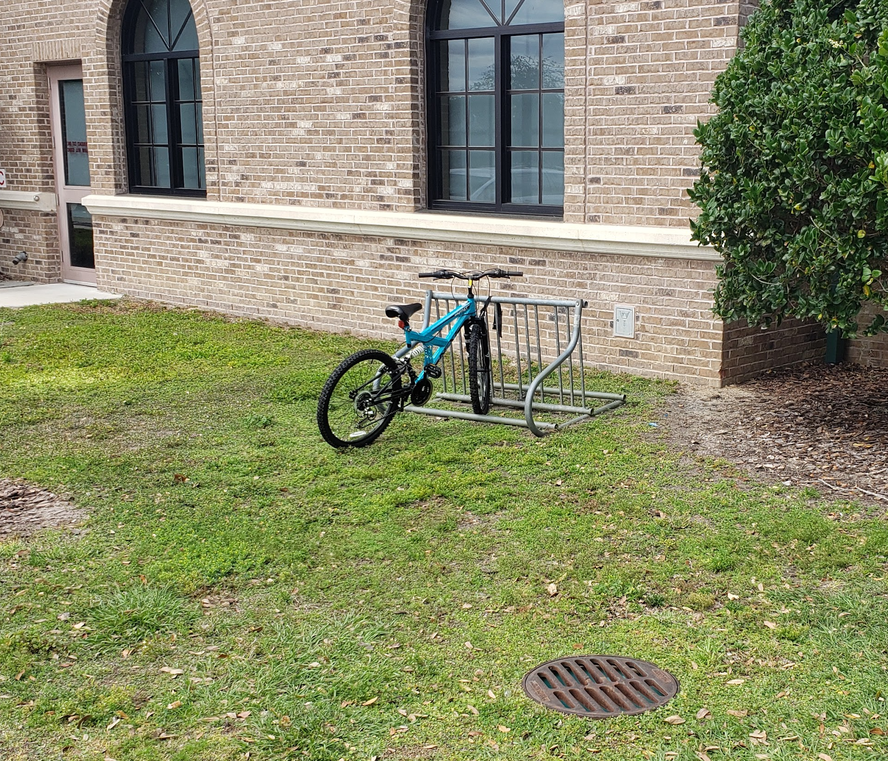
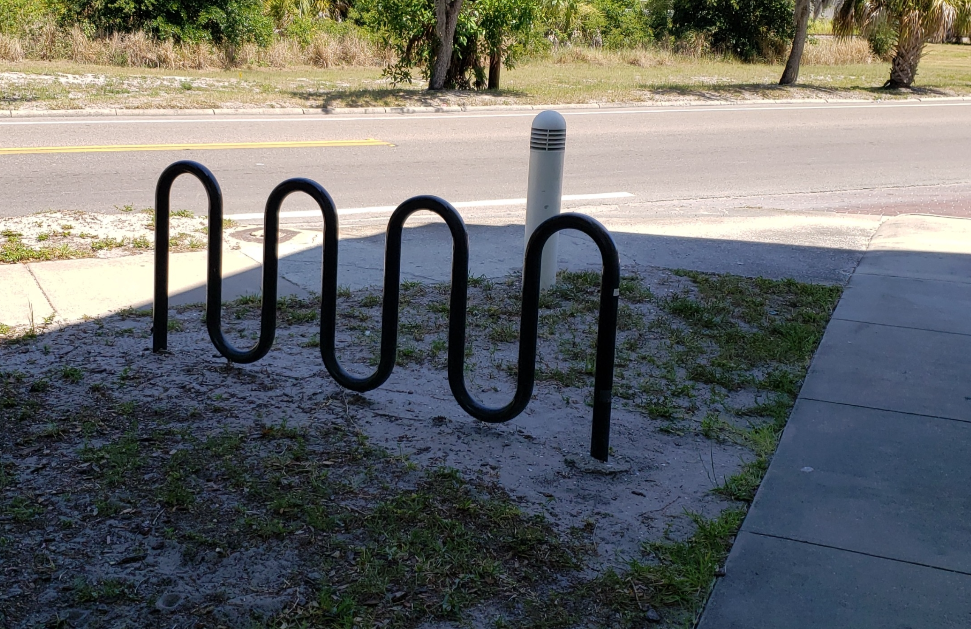
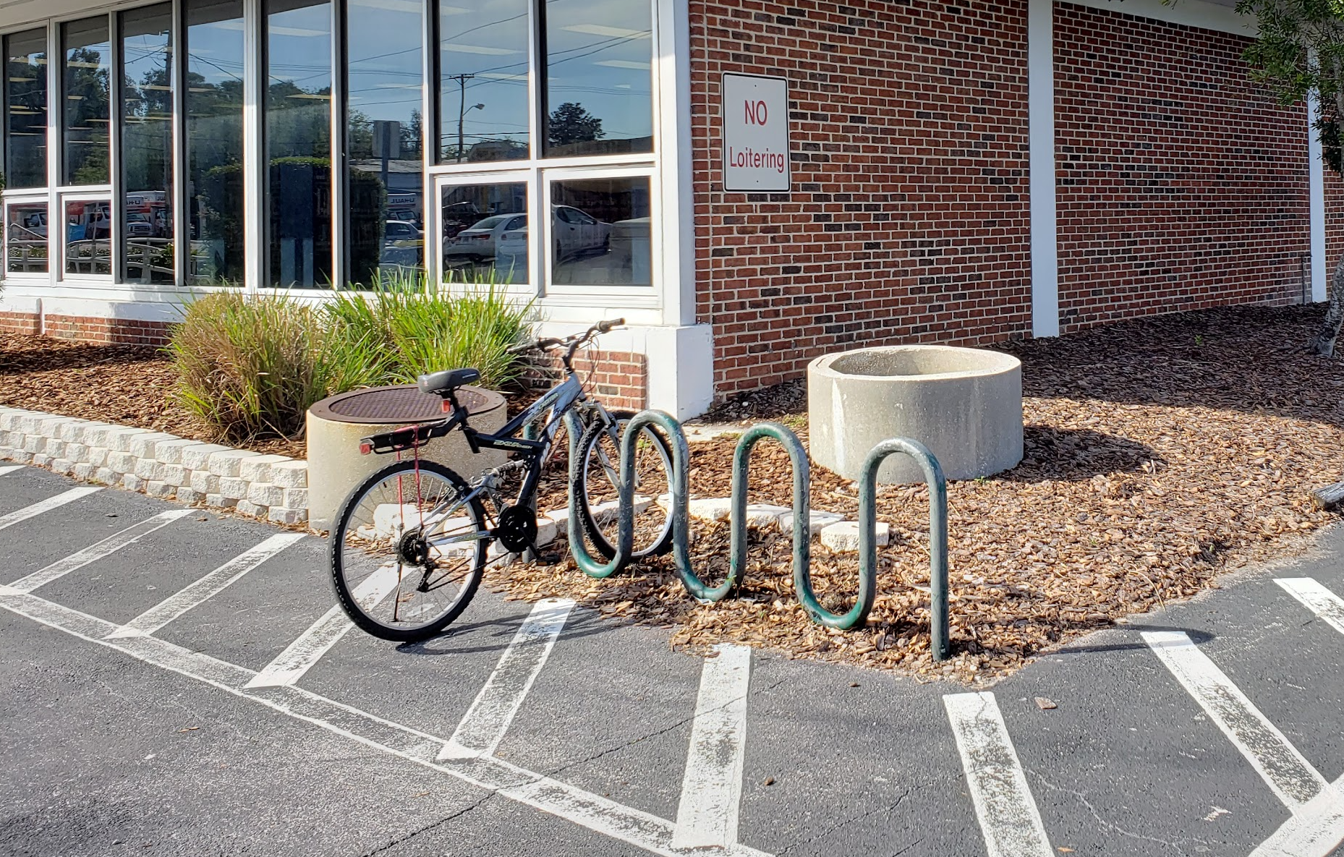
27-283.16
BICYCLE PARKING STANDARDS
Defines when bicycle parking is required
(anytime when vehicle parking is required)
Defines bicycle parking standards
Location of bicycle parking facilities relative to uses
Minimum clear space and construction standards

Slide 16
27-283.16
BICYCLE PARKING STANDARDS
Defines when bicycle parking is required
(anytime when vehicle parking is required)
Defines bicycle parking standards
Location of bicycle parking facilities relative to uses
Minimum clear space and construction standards

Slide 17
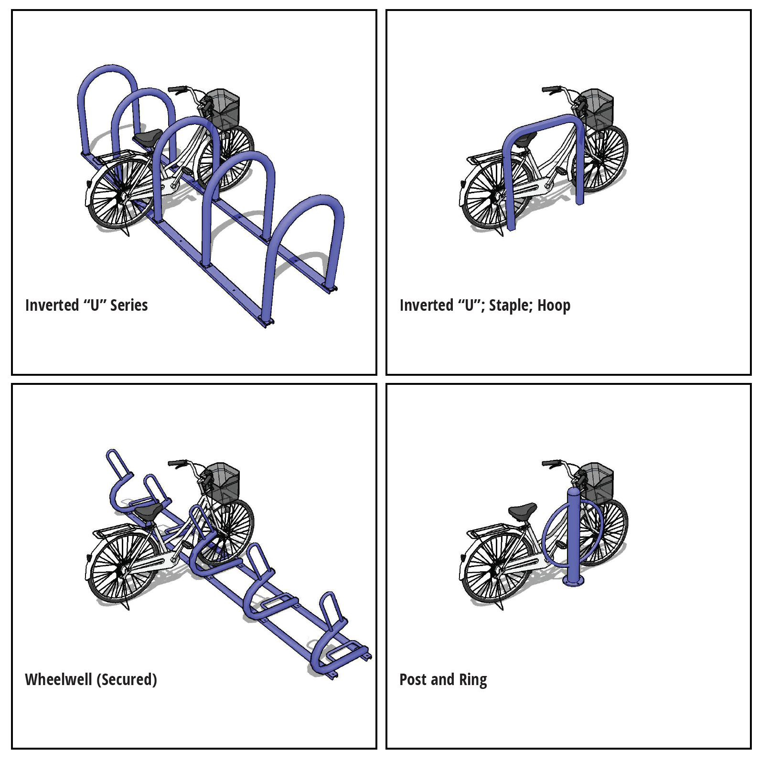
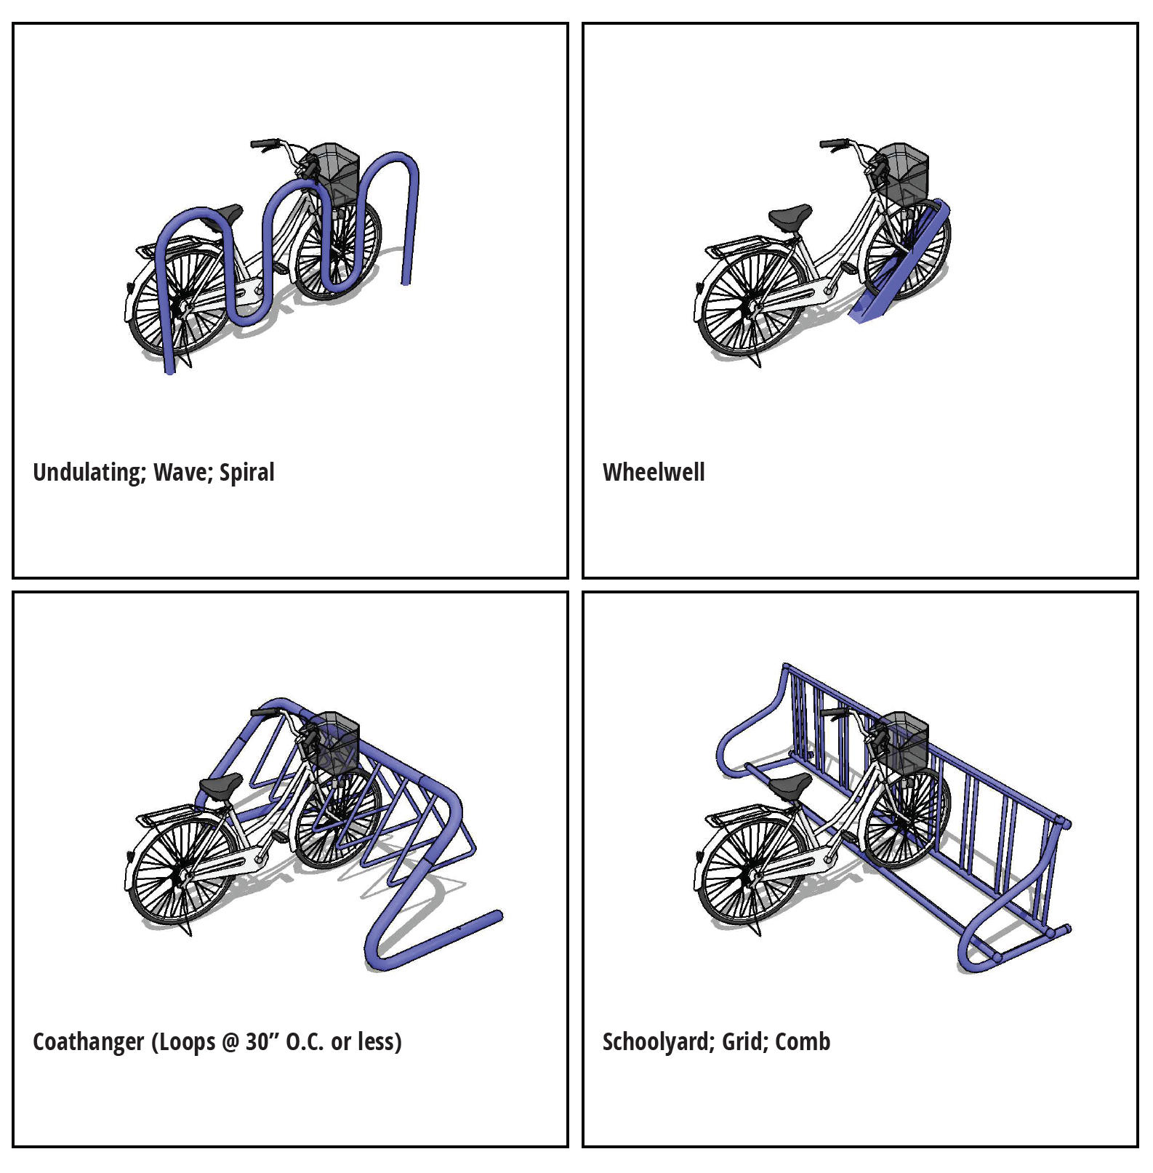
27-283.16
BICYCLE PARKING STANDARDS
Defines when bicycle parking is required
(anytime when vehicle parking is required)
Defines bicycle parking standards
Location of bicycle parking facilities relative to uses
Minimum clear space and construction standards
Approved bicycle rack designs
Conditional bicycle rack designs
APPROVED
CONDITIONAL

Slide 18
27-283.16
BPKG Table 1
Table of Required Bicycle Parking Spaces
 | USE |  | Spaces | Per Unit
1 | Commercial/retail uses:
 | a. | Adult uses | 0.5 | employee [3]
 | b. | Restaurant | 0.5 | 1,000 SF GFA
 | c. | Sidewalk Café | none
 | d. | Theatre | 0.02 | occupant
 | e. | Any other Commercial/retail use | 0.83 | 1,000 SF GFA
2 | Industrial/warehouse uses: | Any Industrial/warehouse use | 0.5 | employee [3]
3 | Interment uses: | Any internment use | 2 | minimum
4 | Medical uses: | Any medical use | 0.05 | employee [3]
5 | Office uses: | Any office use | 0.1 | 1,000 SF GFA
6 | Public or nonprofit uses:
 | a. | Airports, International | [1]
 | b. | Airports, Local | 0.05 | employee [3]
 | c. | Community garden, private | none
 | d. | Temporary Special Events | [2]
 | e. | Other public or nonprofit use | 0.05 | employee [3]
7 | Residential uses:
 | a. | Fraternity, Sorority | 0.1 | student
 | b. | Single-family or two-family dwelling, house-boat | none
 | c. | Triplex or quadplex | none
 | d. | Any other residential use | 0.1 | bedroom
8 | School uses:
 | a. | Colleges and Trade Schools | 0.05 | student
 | b. | Senior High | 0.05 | student
 | c. | Any other school use | 0.05 | student
 | Footnotes
 | [1]: as determined by site specific study
 | [2]: Refer to Section 27-282.16(c)
 | [3]: Within this table “employee” shall mean “employee on the largest shift.”
BICYCLE PARKING STANDARDS
Defines when bicycle parking is required
(anytime when vehicle parking is required)
Defines bicycle parking standards
Location of bicycle parking facilities relative to uses
Minimum clear space and construction standards
Approved bicycle rack designs
Conditional bicycle rack designs
Minimum number of spaces required

Slide 19
27-284.1.2
TREES—PROTECTED, GRAND, AND EXEMPT TREES; MEASUREMENT METHODS
Disincentivizes the use and preservation of camphor trees
Camphors are a Category 1 invasive species
Rectifies the mitigation requirements for camphor trees

Slide 20
27-284.1.2
TREES—PROTECTED, GRAND, AND EXEMPT TREES; MEASUREMENT METHODS
Disincentivizes the use and preservation of camphor trees
Camphors are a Category 1 invasive species
Rectifies the mitigation requirements for camphor trees
The camphor tree (Cinnamomum camphora) is classified as a Category I invasive species, according to the Florida Exotic Pest Plant Council's 2017 List of Invasive Plant Species. This tree species, however, has been successfully planted and maintained, under certain conditions, throughout the city. With strict adherence to the following criteria and conditions, the camphor tree provides benefits and ample crown footprint to the overall city urban forest canopy, and shall be deemed "protected" for purposes of mitigation (replacement) calculation and can reach 'grand' status for same, subject to the following:
Standard No"credit" awarded for retaining any camphor tree rated in excellent or good condition (protected, specimen or grand), that is not located within or proximate to (within fifty (50) feet of) any environmentally sensitive land (i.e. river, lake, bay, wetland, upland habitat, or significant wildlife corridor);
Standard "credit" awarded for planting any camphor tree (Florida Grade No. 1), that is not located within or proximate to (within fifty (50) feet of) any environmentally sensitive land (i.e. river, lake, bay, wetland, upland habitat, or significant wildlife corridor);
Any camphor tree that is located within or proximate to such environmentally sensitive lands shall be required to be removed, and shall be factored into Tree Retention-Mitigation Equivalency Tables, as set forth in section 27-284.4.1, as a "debit"; and shall be mitigated according to the camphor mitigation requirements
Regardless of size or location, camphor trees can be removed without performing any applicable public notice or any site development redesign, but shall adhere to the camphor mitigation requirements.
Camphor mitigation requirements: each Grand camphor tree shall be replaced with four 2.5-inch caliper trees; each Specimen camphor tree shall be replaced with three 2.5-inch caliper trees; each Protected camphor tree shall be replaced with two 2.5-inch caliper trees. For the purposes of this paragraph, all replacement trees shall be Type 1 trees unless exchanged for an equivalent rate of other Tree Types as noted in Table 27-284.4.1-B.
Camphor trees shall not be included or considered in tree preservation (retention) requirements provided in Table 284.3.1.

Slide 21
27-284.1.2
TREES—PROTECTED, GRAND, AND EXEMPT TREES; MEASUREMENT METHODS
Disincentivizes the use and preservation of camphor trees
Camphors are a Category 1 invasive species
Rectifies the mitigation requirements for camphor trees
The camphor tree (Cinnamomum camphora) is classified as a Category I invasive species, according to the Florida Exotic Pest Plant Council's 2017 List of Invasive Plant Species. This tree species, however, has been successfully planted and maintained, under certain conditions, throughout the city. With strict adherence to the following criteria and conditions, the camphor tree provides benefits and ample crown footprint to the overall city urban forest canopy, and shall be deemed "protected" for purposes of mitigation (replacement) calculation and can reach 'grand' status for same, subject to the following:
Standard No"credit" awarded for retaining any camphor tree rated in excellent or good condition (protected, specimen or grand), that is not located within or proximate to (within fifty (50) feet of) any environmentally sensitive land (i.e. river, lake, bay, wetland, upland habitat, or significant wildlife corridor);
Standard "credit" awarded for planting any camphor tree (Florida Grade No. 1), that is not located within or proximate to (within fifty (50) feet of) any environmentally sensitive land (i.e. river, lake, bay, wetland, upland habitat, or significant wildlife corridor);
Any camphor tree that is located within or proximate to such environmentally sensitive lands shall be required to be removed, and shall be factored into Tree Retention-Mitigation Equivalency Tables, as set forth in section 27-284.4.1, as a "debit"; and shall be mitigated according to the camphor mitigation requirements
Regardless of size or location, camphor trees can be removed without performing any applicable public notice or any site development redesign, but shall adhere to the camphor mitigation requirements.
Camphor mitigation requirements: each Grand camphor tree shall be replaced with four 2.5-inch caliper trees; each Specimen camphor tree shall be replaced with three 2.5-inch caliper trees; each Protected camphor tree shall be replaced with two 2.5-inch caliper trees. For the purposes of this paragraph, all replacement trees shall be Type 1 trees unless exchanged for an equivalent rate of other Tree Types as noted in Table 27-284.4.1-B.
Camphor trees shall not be included or considered in tree preservation (retention) requirements provided in Table 284.3.1.

Slide 22
27-284.3.1
LANDSCAPE AND TREE PLANTING STANDARDS; TREE PRESERVATION (RETENTION) STANDARDS.
Clarify how which trees count towards retention percentages
tree condition (fair [C] or better trees)
Location (no right-of-way trees count)
tree type (palms do not count)
wind resistance (as noted in the Urban Forest Management Plan)

Slide 23
27-284.3.1
LANDSCAPE AND TREE PLANTING STANDARDS; TREE PRESERVATION (RETENTION) STANDARDS.
Clarify how which trees count towards retention percentages
tree condition (fair [C] or better trees)
Location (no right-of-way trees count)
tree type (palms do not count)
wind resistance (as noted in the Urban Forest Management Plan)
Refer to section 27-43 for defined terms; sections 27-181 through 185.3 for Central Business District; sections 27-196 through 27-206 for Channel District; sections 27-176 through 27-178 for Ybor City.
Any application that does not meet the minimum retention percentage shall be subject to the approval of the applicable city variance board or city council through the site plan rezoning process.
On site trees to be preserved/retained shall should be those that are in the best health and structural condition (rated "excellent" and/or "good" only - refer to section 27-284.1.1(c)), subject to the review criteria set forth in Tables 284.2.4 and 284.2.5.
Minimum retention percentages are based on total count of protected and grand trees on site. Any protected palm species counts towards the minimum retention requirement, at a ratio of 1:1 (1 palm = 1 tree), for no more than seventy-five (75) percent of the required mitigation percentage. No credit shall be for Off-site trees, right of way trees, or dangerous/dead, palms, trees in poor (D) or worse condition, exempt, invasive, or noxious species (refer to section 27-284.1.2(d)),species that are unsuitable for Tampa’s climate zones, and species in the lowest category of wind resistance (Carya illinoensis, Jacaranda mimosifolia, Juniperus virginiana, Pinus clausa, Quercus nigra, and Ulmus parvifolia)
Minimum retention percentages shall not apply in cases where there are not an adequate number of onsite trees, which are determined to be in "excellent" or "good" (i.e. "A" or "B") condition based on city's standard tree condition evaluation method (refer to section 27-284.1.1 and the Technical Manual), to achieve said percentages.
Refer to section 27-284.4 and 27-284.4.1 for tree mitigation requirements.
Trees within the jurisdictional wetland boundary shall not count towards the minimum retention requirement. Trees within a wetland setback or buffer may be counted toward minimum retention requirement (refer to notes [3] and [4] above regarding tree condition and palms).

Slide 24
27-284.3.1
LANDSCAPE AND TREE PLANTING STANDARDS; TREE PRESERVATION (RETENTION) STANDARDS.
Clarify how which trees count towards retention percentages
tree condition (fair [C] or better trees)
Location (no right-of-way trees count)
tree type (palms do not count)
wind resistance (as noted in the Urban Forest Management Plan)
Refer to section 27-43 for defined terms; sections 27-181 through 185.3 for Central Business District; sections 27-196 through 27-206 for Channel District; sections 27-176 through 27-178 for Ybor City.
Any application that does not meet the minimum retention percentage shall be subject to the approval of the applicable city variance board or city council through the site plan rezoning process.
On site trees to be preserved/retained shall should be those that are in the best health and structural condition (rated "excellent" and/or "good" only - refer to section 27-284.1.1(c)), subject to the review criteria set forth in Tables 284.2.4 and 284.2.5.
Minimum retention percentages are based on total count of protected and grand trees on site. Any protected palm species counts towards the minimum retention requirement, at a ratio of 1:1 (1 palm = 1 tree), for no more than seventy-five (75) percent of the required mitigation percentage. No credit shall be for Off-site trees, right of way trees, or dangerous/dead, palms, trees in poor (D) or worse condition, exempt, invasive, or noxious species (refer to section 27-284.1.2(d)), species that are unsuitable for Tampa’s climate zones, and species in the lowest category of wind resistance (Carya illinoensis, Jacaranda mimosifolia, Juniperus virginiana, Pinus clausa, Quercus nigra, and Ulmus parvifolia)
Minimum retention percentages shall not apply in cases where there are not an adequate number of onsite trees, which are determined to be in "excellent" or "good" (i.e. "A" or "B") condition based on city's standard tree condition evaluation method (refer to section 27-284.1.1 and the Technical Manual), to achieve said percentages.
Refer to section 27-284.4 and 27-284.4.1 for tree mitigation requirements.
Trees within the jurisdictional wetland boundary shall not count towards the minimum retention requirement. Trees within a wetland setback or buffer may be counted toward minimum retention requirement (refer to notes [3] and [4] above regarding tree condition and palms).

Slide 25
27-284.3.1
LANDSCAPE AND TREE PLANTING STANDARDS; TREE PRESERVATION (RETENTION) STANDARDS.
Clarify how which trees count towards retention percentages
tree condition (fair [C] or better trees)
Location (no right-of-way trees count)
tree type (palms do not count)
wind resistance (as noted in the Urban Forest Management Plan)
Provides a secondary route to conformance by providing a weighted retention percentage
To assign a higher value to larger and better trees
Refer to section 27-43 for defined terms; sections 27-181 through 185.3 for Central Business District; sections 27-196 through 27-206 for Channel District; sections 27-176 through 27-178 for Ybor City.
Any application that does not meet the minimum retention percentage shall be subject to the approval of the applicable city variance board or city council through the site plan rezoning process.
On site trees to be preserved/retained shall should be those that are in the best health and structural condition (rated "excellent" and/or "good" only - refer to section 27-284.1.1(c)), subject to the review criteria set forth in Tables 284.2.4 and 284.2.5.
Minimum retention percentages are based on total count of protected and grand trees on site. Any protected palm species counts towards the minimum retention requirement, at a ratio of 1:1 (1 palm = 1 tree), for no more than seventy-five (75) percent of the required mitigation percentage. No credit shall be for Off-site trees, right of way trees, or dangerous/dead, palms, trees in poor (D) or worse condition, exempt, invasive, or noxious species (refer to section 27-284.1.2(d)), species that are unsuitable for Tampa’s climate zones, and species in the lowest category of wind resistance (Carya illinoensis, Jacaranda mimosifolia, Juniperus virginiana, Pinus clausa, Quercus nigra, and Ulmus parvifolia)
Minimum retention percentages shall not apply in cases where there are not an adequate number of onsite trees, which are determined to be in "excellent" or "good" (i.e. "A" or "B") condition based on city's standard tree condition evaluation method (refer to section 27-284.1.1 and the Technical Manual), to achieve said percentages.
Refer to section 27-284.4 and 27-284.4.1 for tree mitigation requirements.
Trees within the jurisdictional wetland boundary shall not count towards the minimum retention requirement. Trees within a wetland setback or buffer may be counted toward minimum retention requirement (refer to notes [3] and [4] above regarding tree condition and palms).
In lieu of a strict ratio of the total trees retained and trees removed, an applicant may elect to use a weighted retention percentage as described below: The “Weighted Tree Points” for each tree shall be the product of the “Type Points” and the “Condition Points.” Type Points shall be three (3) points for Type 1 trees, two (2) points for Type 2 trees, and one (1) point for Type 3 trees. The Condition Points shall be three (3) points for “excellent” or “A” condition, two (2) points for “good” or “B” condition, one (1) point for “fair” or “C” condition, and zero points to “poor” or worse condition ratings. The total Weighted Tree Points of trees to be retained shall be divided by the total Weighted Tree Points of all on-site trees to determine the weighted minimum retention percentage. The weighted minimum retention percentage required shall match the unweighted minimum retention percentage for all types of land.

Slide 26
27-284.3.3
LANDSCAPED AREAS, PLANTINGS, BUFFERS AND SCREENING
Restructures the buffer table to improve legibility

Slide 27
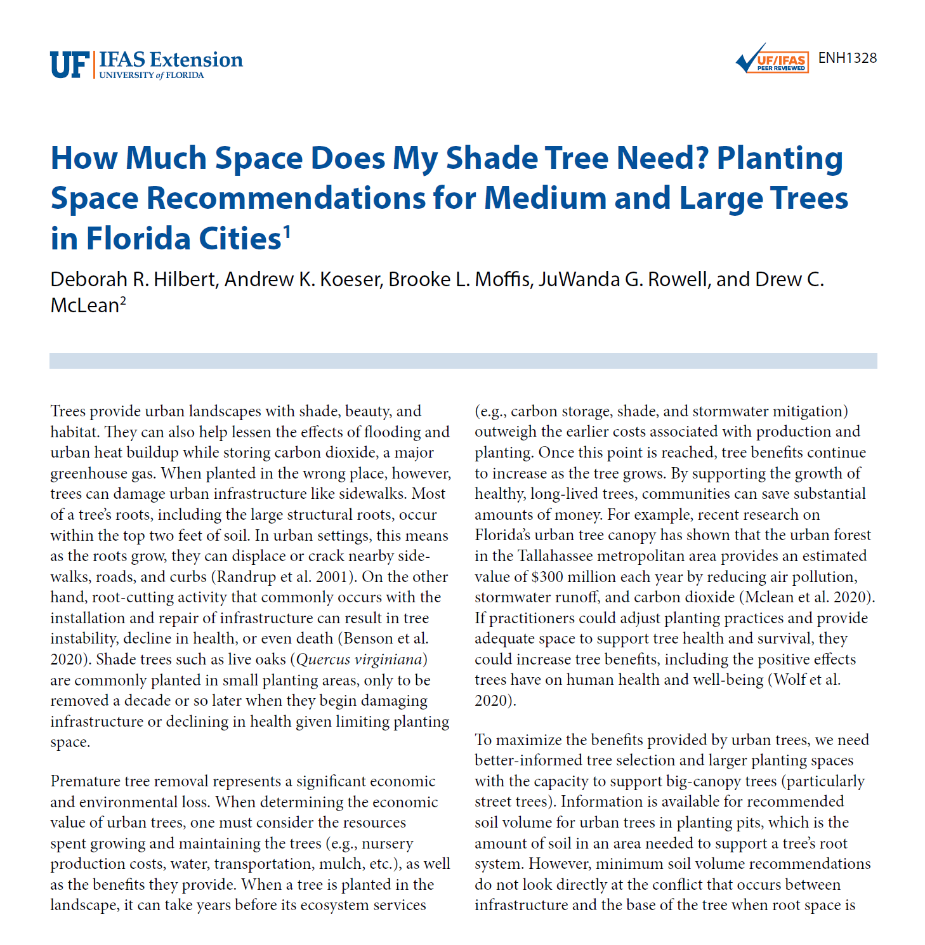
27-284.3.3
LANDSCAPED AREAS, PLANTINGS, BUFFERS AND SCREENING
Restructures the buffer table to improve legibility
Clarifies a staff interpretation on parking island widths

Slide 28
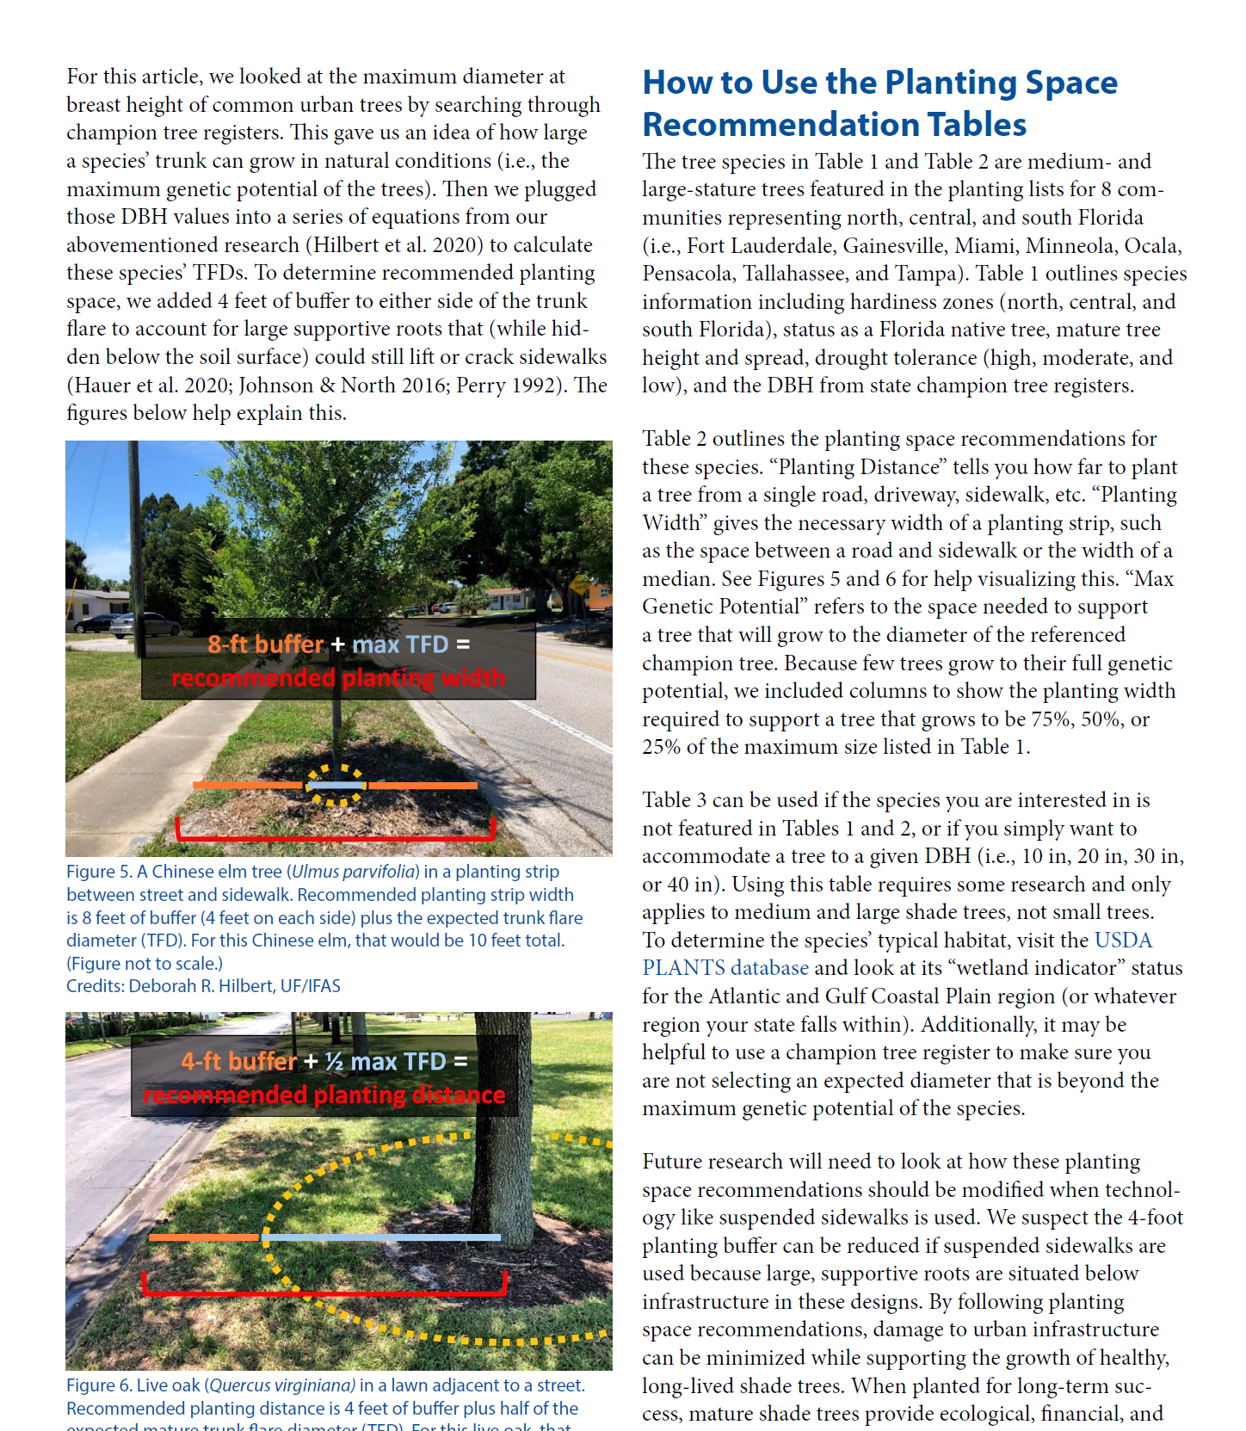
27-284.3.3
LANDSCAPED AREAS, PLANTINGS, BUFFERS AND SCREENING
Restructures the buffer table to improve legibility
Clarifies a staff interpretation on parking island widths

Slide 29
27-284.3.3
LANDSCAPED AREAS, PLANTINGS, BUFFERS AND SCREENING
Restructures the buffer table to improve legibility
Clarifies a staff interpretation on parking island widths
Provides design flexibility for buffer standards
Appropriately sized trees
Appropriately sized shrubs

