Slide 1
Text Amendments
April 28, 2022, City Council Workshop
Agenda Item Number - ; File Number – E2022-48
Notes:
For full section of Slide Options, click “New Slide” dropdown menu under the Home tab.

Slide 2
City Council Motion
Original motion was made on January 27, 2022 – Item #8
File No. E2022-48
Motion: (Maniscalco-Miranda) That said agenda item be continued to April 28, 2022, to include the Privately Initiated Text Amendments and the Publicly initiated Text Amendments. Motion carried unanimously with Dingfelder being absent.

Slide 3
Agenda
Present privately-initiated and publicly-initiated text amendments
Provide an overview of the privately-initiated text amendment request
Review processing schedules
Present an overview of the Mayor’s T3 initiatives relating to the Parking Master Plan – Vik Bhide
Applicant presentation of privately initiated text amendment – Karen Kress
Present publicly-initiated text amendments
Q & A

Slide 4
Privately-Initiated Text Amendment

Slide 5
Privately-Initiated Text Amendment
Amendment Cycle:
January 2021 – Part 2
Applicant:
    Karen Kress
    Tampa Downtown Partnership
Request:
    Amend three (3) sections of Chapter 27 Zoning Code
27-181 – 27-185 Central Business District (CBD) Districts
2. 27-132 Regulations governing individual special uses
3. 27-196 – 27-210 Channel District (CD) Districts

Slide 6
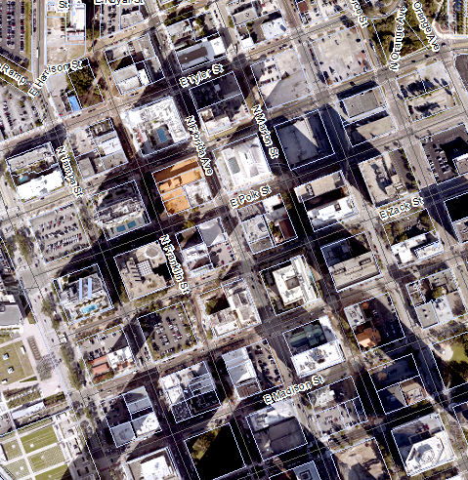
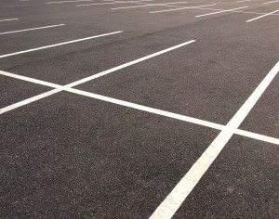
Central Business District (CBD) Districts
Code sections 27-181 – 27-185
Modifies vehicular access requirements on various street types
Reduction in required parking ratios; and
Addition of miscellaneous use standards and alternative transportation modes

Slide 7

Regulations governing individual special uses
Removal of CBD bank drive in window standards
Place those standards in CBD section of the code
Create uniformity in the code

Slide 8
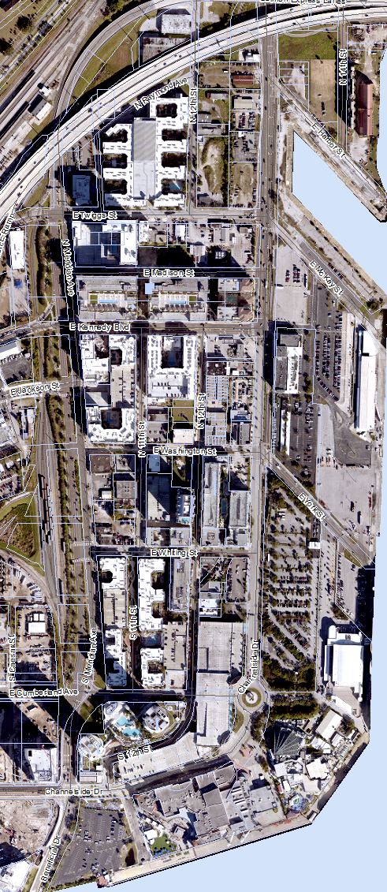
Channel District (CD) Districts
Code Sections 27-196 – 27-210
Consolidates the Channel District schedule of permitted use table with the parking requirements
Reduces required parking ratios for majority of uses in Channel District

Slide 9
Process and Next Steps
MEETING TYPE | TENTATIVE DATES
Public Information Meeting | July 26, 2021, 
City Council Workshop | February 24, 2022 (Item not heard), April 28, 2022 
Planning Commission Briefing | May 9, 2022
Planning Commission Public Hearing | June 13, 2022
City Council – 1st Reading | July 14, 2022 Or July 28, 2022
City Council – 2nd Reading | July 28, 2022 Or August 25, 2022

Slide 10

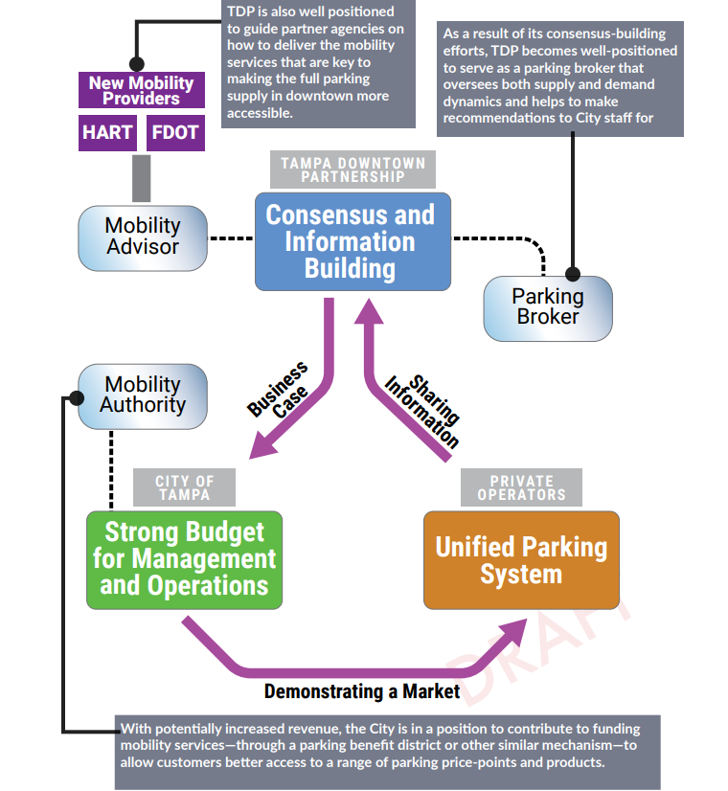
Downtown Parking Master Plan
Presented on March 31st
Comprehensive approach – inventory and management & policy recommendations.
Actions taken to date by COT
  Provides Mobility options
  Pricing adjustment
  Technology advancement
Downtown Partnership Privately Initiated Text Amendment Ch 27
  April 28 Council Workshop
Source: Tampa Downtown Partnership Parking Plan

Slide 11

Elements of a Parking Master Plan
Citywide vision for urban parking
Community engagement: listening sessions & knowledge sharing
Policies tailored to needs of Tampa’s unique neighborhoods
Comprehensive approach to parking
Long-term implementation plan:
  Goals, objectives, policies, cross-departmental coordination (SOPs)
  Actions by implementing department:
    Chapter 15, residential parking permit program
    Reusable garages and lots
    Adaptive facility design
    Chapter 27, LDC refresh phase 3, offsets and minimums, etc.
Parking Outcomes
Management & Operations
Community expectations
Development Regulations

Slide 12
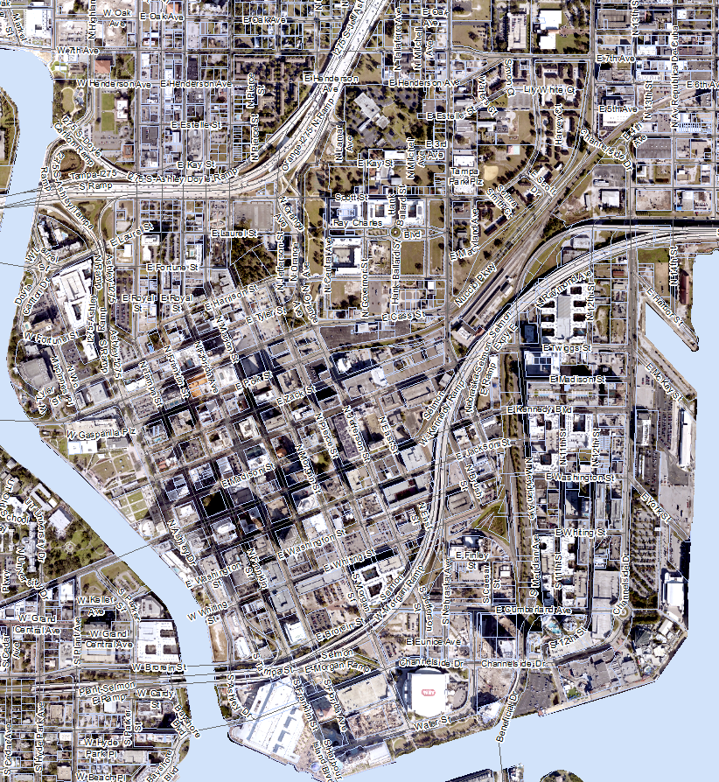
Privately-Initiated Text Amendment
Applicant: Karen Kress
Tampa Downtown Partnership

Slide 13
Privately-Initiated Text Amendment
Applicant: Tampa Downtown Partnership

Slide 14
Publicly Initiated Text Amendment
April 28, 2022 City Council Workshop

Slide 15
Agenda
Introduction to changes proposed
Review text amendments
  Commercial Vehicles in Residential Districts
  2. Food Trucks
  3. Alcoholic Beverage Sales Enforcement
  4. Bonus Provision for Graywater
  5. Home Based Business
  6. Development Review Compliance
  7. Transfer of Development Rights
  8. Street Cafés
  9. Storefront Residential Parking
  10. Formal Decision
Review process schedule / timeline
Q & A

Slide 16
Introduction
January 2022 amendment cycle
This request contains a total of ten (10) changes to the zoning code
  Five of the items are in direct response to recent changes in State Statutes
  Five items relate to process modifications
Changes proposed which address legislative approvals are to ensure consistency in the zoning code with State law.

Slide 17
List of Publicly-Initiated Text Amendments
1. Commercial Vehicles in Residential Districts
27-43
27-283.11
2. Food Trucks
23.5-5 | 27-198
27-43 | 27-211.8
27-156 | 27-212.4
27-171 | 27-282.30
27-184
3. Alcoholic Beverage Sales Enforcement
27-318 (2) & (d)
4. Bonus Provision for Graywater
27-140
5. Home Based Business
27-43 | 27-198
27-132 | 27-211.8
27-156 | 27-212.4
27-177 | 27-282.5
27-184 | 27-283.7
6. Development Review Compliance (DRC) definition
27-43
27-66
27-67
7. Transfer of Development Rights (TDR)
27-132
8. Street Café
27-43
27-127
9. Storefront Residential Parking
27-283 10. Formal Decision 27-11

Slide 18
1. Commercial vehicles in residential districts
27-43 | Definitions
27-283.11 | Vehicle Parking
Amends the definition of commercial equipment adding commercial containers, including trailers and box trucks.
Adds the definition of personal vehicle.
Allows temporary parking of commercial equipment in residential districts.

Slide 19
2. Food Trucks
23.5-5 | Schedule of violations and penalties
27-43 | Definitions
27-156 | Official schedule of district regulations
27-171 | District regulations for M-AP airport compatibility districts
27-184 | Official schedule of permitted principal, accessory and special uses; required off-street parking ratios by use
27-198 | Official schedule of permitted principal, accessory and special uses
27-211.8 | Schedule of permitted uses by district
27-212.4 | Schedule of allowable, permitted, and prohibited uses by district
27-282.30 | Food Trucks
Add a definition of food truck
Add as a permitted use in the use table
Adding use criteria in ‘Regulations regarding specified uses’ section of the zoning code

Slide 20
3. Alcoholic Beverage Sales Enforcement
27-318 (2) & (d) | Expiration, suspension, and revocation of approvals for alcoholic beverage sales; posting of notice for discontinuance of sales; evidence of resumption of sales
Currently thirty (30) days notice is required for enforcement action for possible AB sales revocation or suspension.
Adds the ability for City Council, in emergency situations, to determine notice shall be provided no less than fifteen (15) days from the date of notice.

Slide 21
4. Bonus provision for Graywater
27-140 | Bonus provisions
Adds Graywater as a bonus incentive
Incentive is based on the amount of Graywater provided.
  Can achieve a maximum bonus density/intensity of 25% if at least seventy-five (75) percent of a proposed or existing development will have a graywater system installed.
  Can achieve a maximum bonus density/intensity of 30% if one-hundred (100) percent of a proposed or existing development will have a graywater system installed.

Slide 22
5. Home Based Business
27-43 | Definitions
27-132 | Regulations governing individual special uses
27-156 | Official schedule of district regulations
27-177 | Historic district established
27-184 | Official schedule of permitted principal, accessory and special uses; required off-street parking ratios by use
27-198 | Official schedule of permitted principal, accessory and special uses
27-211.8 | Schedule of permitted uses by district
27-212.4 | Schedule of allowable, permitted, and prohibited uses by district
27-282.5 | Home occupations
27-283.7 | Number of off-street parking spaces
Amend the home occupation definition
Amend all code sections relating to home occupation

Slide 23
6. Development Review Compliance (DRC)
27-43 | Definitions
27-66 | Intent and purpose
27-67 | Duties
Amend three sections of the zoning code to address State legislative changes recently approved.

Slide 24
7. Transfer of Development Rights (TDR)
27-132 | Regulations regarding special uses
Remove incorrect code reference
Add correct code section reference to 27-54 process for written formal decisions

Slide 25
8. Street Café
27-43 | Definitions
27-127 | Classes of special use permits; agent or body responsible for each general procedure
Given the recent success of Lift Up Local, the use of Street Café is proposed and will be defined in the code as an extension of an approved Sidewalk Café.
Code changes are also required to Chapter 22 Streets and sidewalks, soon staff will present those changes.
Goal to have Street Café permits active as of July 1, 2022.

Slide 26
9. Storefront Residential Parking Requirement
27-283 | Parking table 1. Table of required parking spaces
Storefront residential currently exists in the following locations in Chapter 27 Zoning code:
  Definitions section of the code, Section 27-43;
  Seminole Heights District, Section 27-211.8; and
  Neighborhood Mixed Use District, Section 27-212.4
Adds Storefront Residential use to the general parking table.
Eliminates confusion in determining parking required when the use is proposed outside the special districts listed above.

Slide 27
10. Formal Decision
27-11 | Creation of new lots; reduction of lot or yard dimensions below minimum requirements
Recognize existing conditions that are nonconforming
No need to pursue a variance, PD or design exception
Reduce processing times and costs (no additional applications or public hearings)

Slide 28
Publicly Initiated Text Amendments

Slide 29
Process and Next Steps
MEETING TYPE | TENTATIVE DATES
City Council Workshop | February 24, 2022, (item not heard) April 28, 2022 
Public Information Meeting | May 2022
Planning Commission Briefing | May 9, 2022
Planning Commission Public Hearing | June 13, 2022
City Council – 1st Reading | July 11, 2022
City Council – 2nd Reading | TBD

Slide 31
What’s on deck for June 23rd Workshop
Workshop Items
- Affordable Housing Incentives/AHAC Recommendations
- Bonus Density
- Electric Vehicle Parking – Land Development Code
- Accessory Dwelling Units
Publicly Initiated Text Amendments
- Downtown Development Review Process
- Local DRI Process
Privately Initiated Amendments
- Channel District Bonus Provisions - Andrew Mayts
- Natural Resources and Bicycle Parking Standards - Ricky Peterika
- Tampa Heights Design Standards – Brian Seel
- Central Business District Signs – Angela Rauber

