Slide 1
City of Tampa
Central Business District Sign Code
Proposed Text Amendment
Virtual Public Presentation
May 17, 2022

Slide 2
Goals of Proposed Text Amendment
Current CBD sign regulations generally allow for building signs to be placed:
At the ground level to support retail establishments and define primary building entrances; and
At the upper level for downtown commercial and residential occupying upper stories mid- to high-rise buildings.
Proposed updates provide sign regulations that are more carefully tailored to a downtown, rather than to suburban areas by:
Promoting walkability with more options for pedestrian-scaled signage vs. current regulations designed for car-scaled signage.
Adding to the vibrancy of the street scene.
Enhancing retail storefronts and supporting the commercial success of downtown businesses.

Slide 3
Proposed Amendment #1
Clarify that signs within the CBD may be oriented towards any building frontage, regardless of where the business entrance is located.
Currently, the CBD Code allows signs on the first floor of the building and on the face of the highest floor, but does not provide clarity regarding the orientation of building signs. For ground level retail signs, it makes sense that signs would be placed at ground level entrances. The primary building entrance for upper story businesses is the primary entrance of the building. It is unclear whether this means that all upper story signs must be placed on the primary façade of the building. Requiring all upper story signs to be placed at the primary façade of the building limits the design options that would otherwise be available in a downtown setting, such as designing the front façade of the building as the focal point.

Slide 4
Proposed Amendment #2
Projecting signs are allowed in the CBD as long as they meet the requirements set out in Division 6, Sec. 27-289.3(7). The proposed amendment would adjust two of the six (6) requirements:
6(a) – (d) – No proposed changes but adds them to the CBD section to clarify continued application to projecting signs in the CBD.
6(e) - The proposed amendment would allow projecting signs located on a corner to be closer than 10 feet from each other as long as they are located on different sides of the building.
6(f) – The proposed amendment would allow projecting signs to be elevated at a minimum of 9 feet above a pedestrian way where 10 feet is otherwise required. The lower elevation is more fitting within an urban, pedestrian-scaled setting.

Slide 5
Proposed Amendment #3
The proposed amendment:
allows each establishment with a front door facing a public street to have a combination of building, projecting, and awning or canopy sign;
allows a hanging awning/canopy sign projecting sign per frontage (for corner establishments or other situations where an establishment has more than one frontage)
allows tenants to have flexibility concerning the design of their signage to accommodate logos, etc., subject to the maximum size and other design standards set out in Code.

Slide 6
Proposed Amendment #3 - Comparison
Limited Sign Types under Existing Code
Additional Pedestrian Scaled Signs Proposed

Slide 7
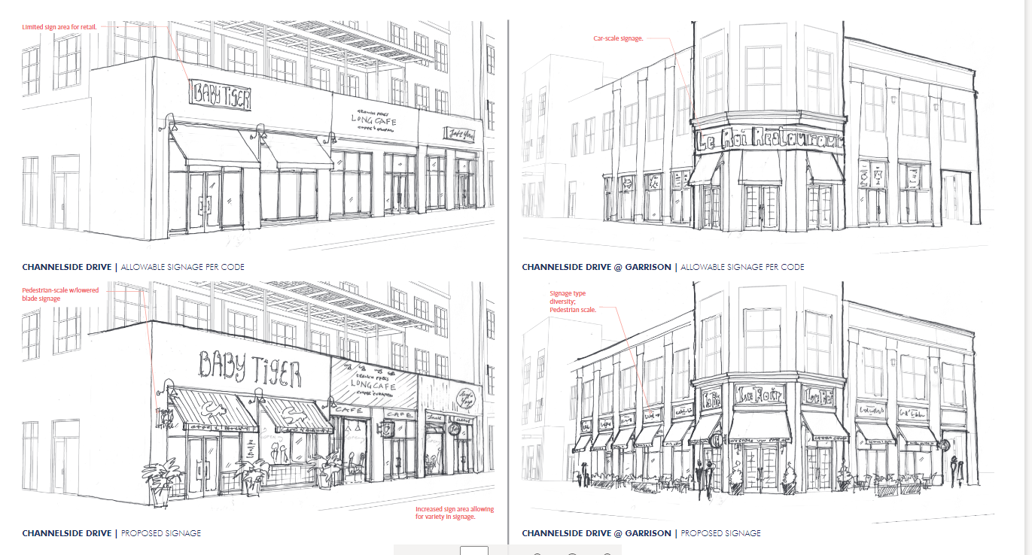

Slide 8
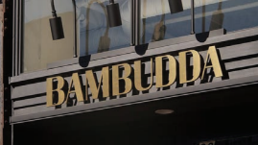
Building/Wall Sign
Defined as any sign displayed upon or attached to any part of the exterior of a building. included within this definition are wall signs. wall signs also include the painting of a sign on a wall surface.

Slide 9
Projecting/Blade Sign
Defined as any sign which is attached to or projects from the outside wall of any building or structure, excluding wall signs, as defined herein. sign area is counted once per side.

Slide 10
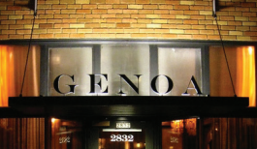
Marquee Sign
Defined as any sign which is attached to, or hung from, a permanent, roof-like structure which is supported by a building wall and which projects out from the building line usually but not necessarily over a public right-of-way such as a sidewalk.

Slide 11
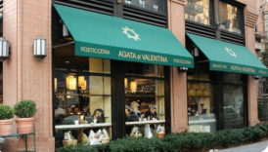
Awning Sign
Any sign that indelibly marks, attaches to, or hangs from an awning. an awning is an architectural projection that is partially or wholly supported by the building to which it is attached. an awning is comprised of a lightweight frame structure over which a covering is attached.

Slide 12
Canopy Sign
Any sign that indelibly marks, attaches to, hangs from, or is mounted on the top of a canopy. a canopy is a permanent structure or architectural projection of rigid construction.

