Slide 1
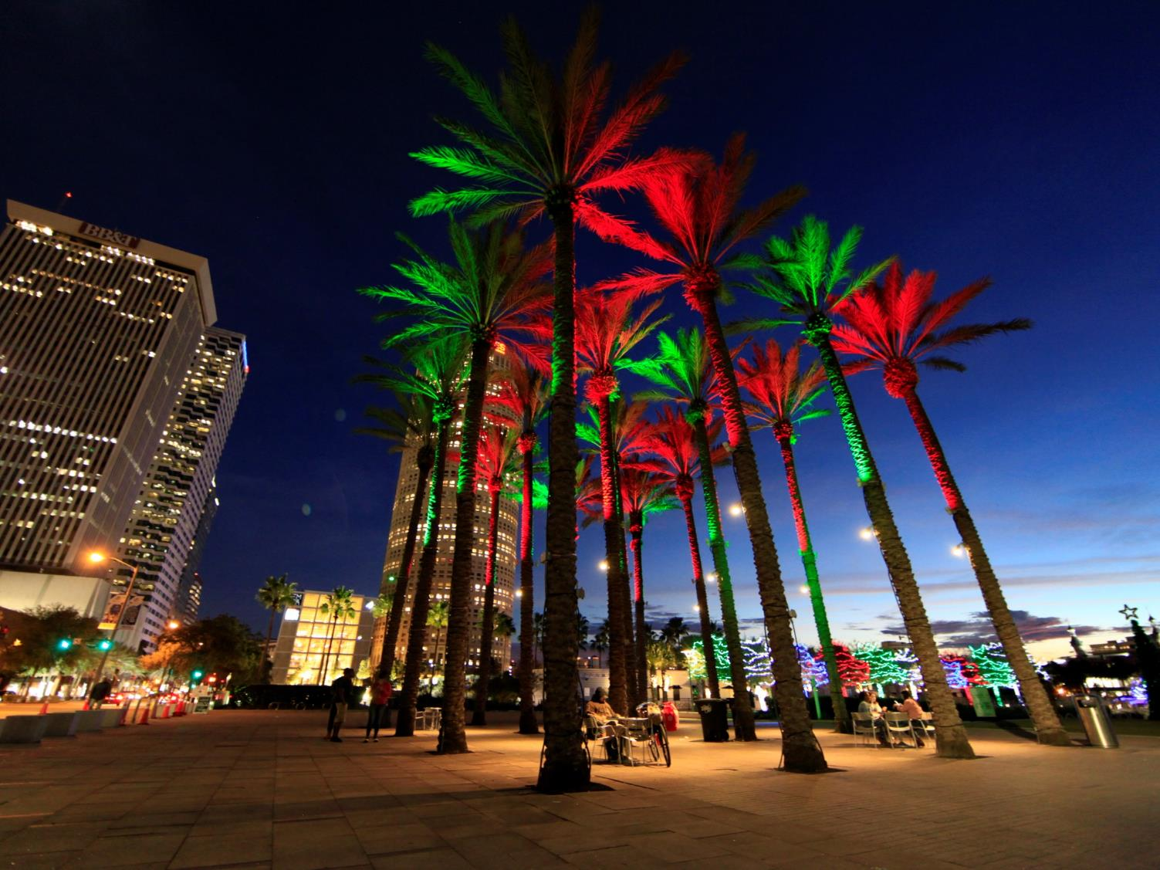
PRIVATELY-INITIATED TEXT AMENDMENT REQUEST
Downtown Tampa
Parking Study
Findings and Observations
completed January 2019
Notes:
This was a fun project that included extensive stakeholder outreach and consensus building.

Slide 2
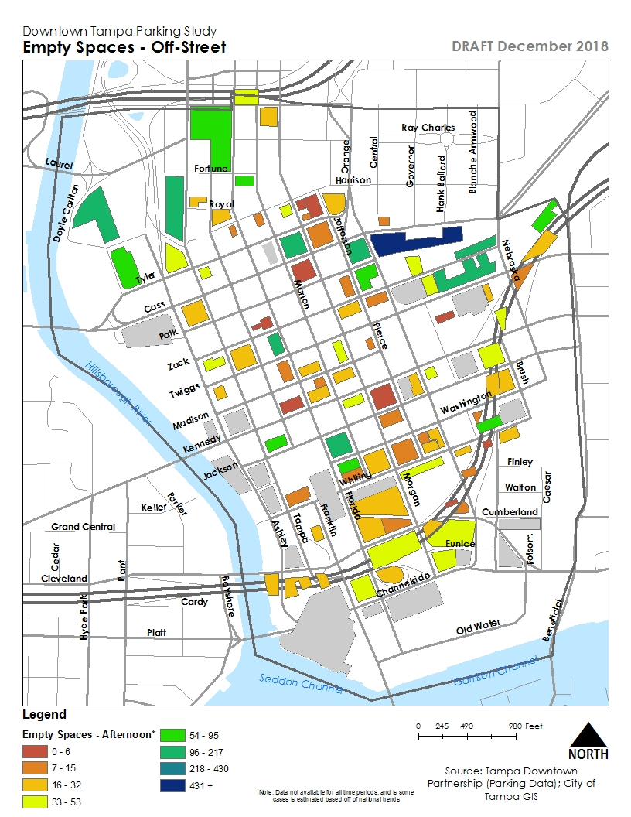
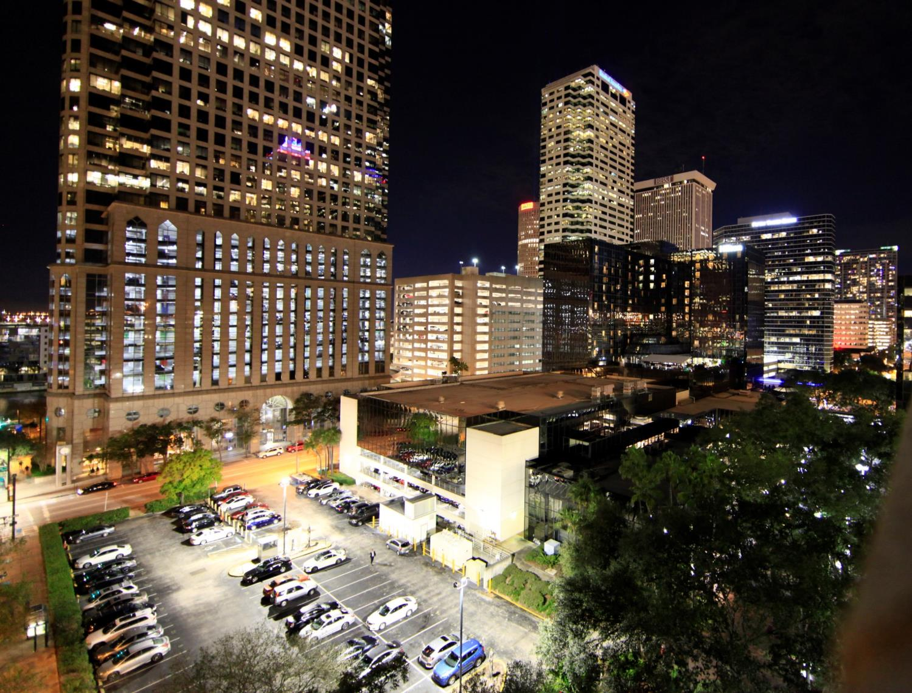
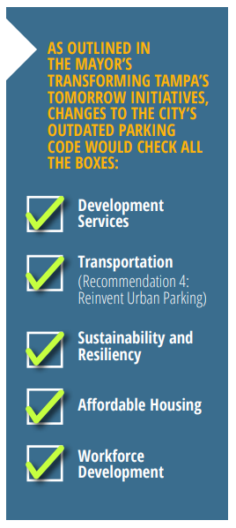
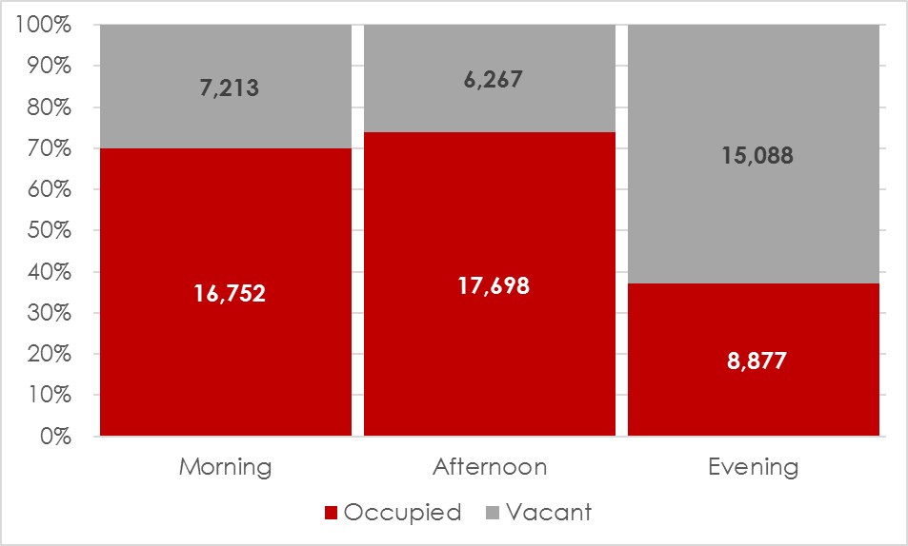
Parking Strategies Check all the Boxes
Availability off-street near courthouse
Ample availability north of core
Some core availability in select facilities
Some under/near highway (non-event days)
Notes:
I believe there is an appetite for wider-spread solutions but we limited our request to the Central Business District and Channel District.

Slide 3
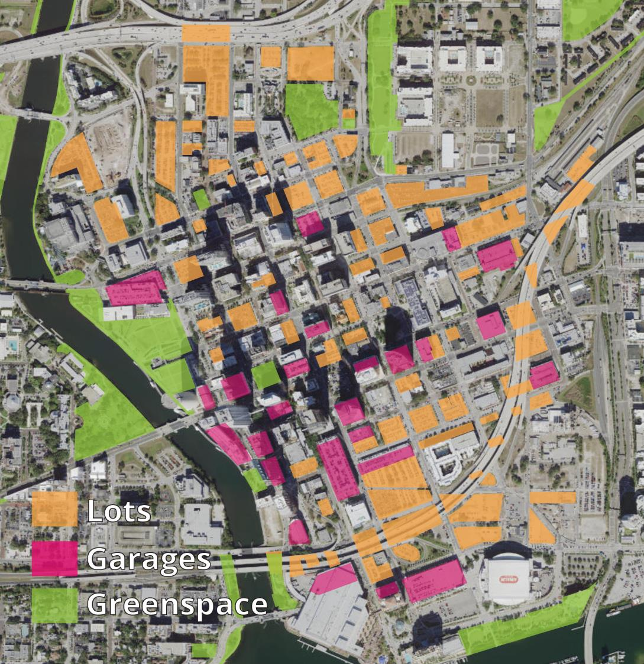
Notes:
Over half of downtown land is dedicated to cars.

Slide 4
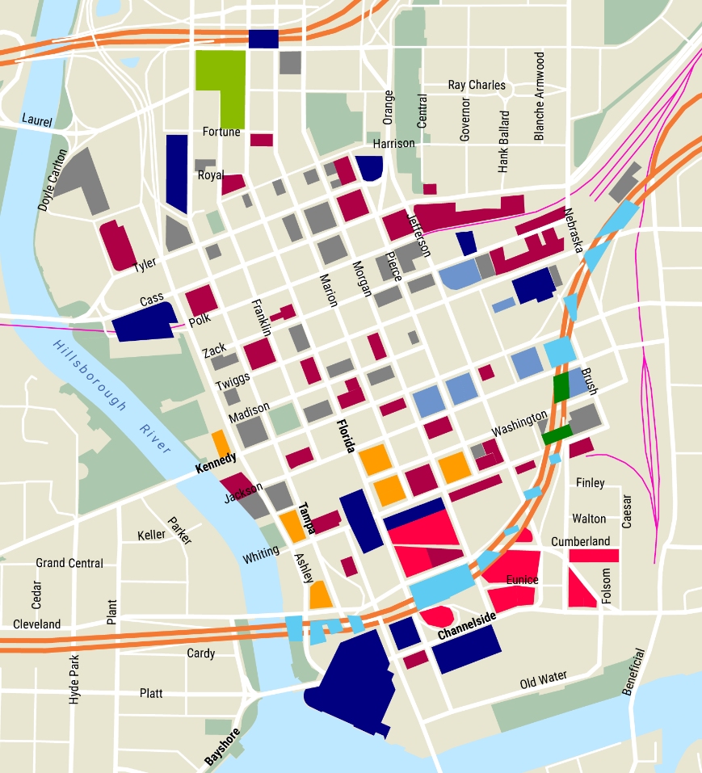
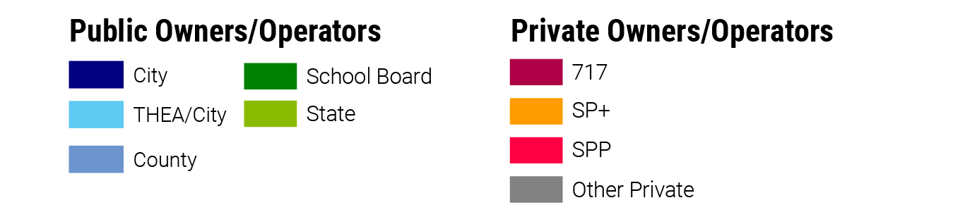
Inventory
As of December 2018
Off-Street: 22,000 spaces
On-Street: 1,600 spaces
Total: around 24,000 spaces
City operates:
1,600 on-street spaces
~7,500 off-street spaces
Other large operators include:
717: ~4,000 spaces
SP+: ~2,200 spaces
County: ~1,600 spaces
Notes:
We started with the basic question “Where is the parking and who owns it?”

Slide 5
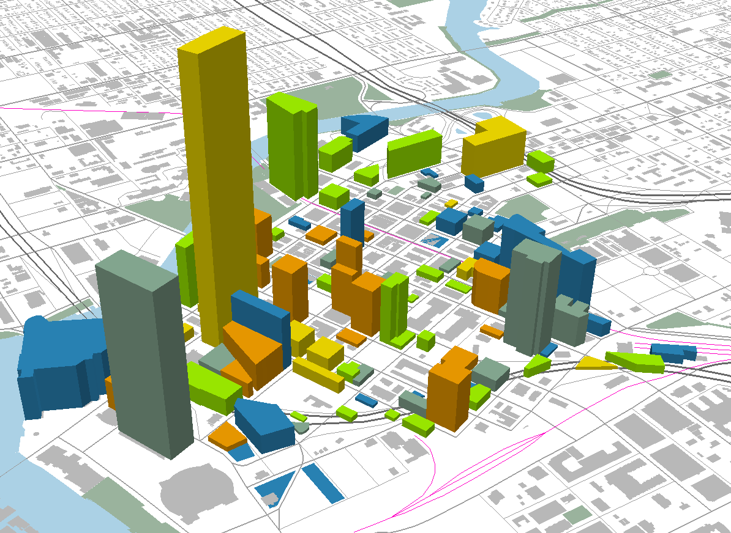
Parking by supply and peak utilization
As of December 2018
Poe
Primary facility for Straz events
Royal Regional
Low-price monthly permits
Fort Brooke
Monthly permits and other special uses
South Regional
Highly driven by events
Peak levels of parking utilization by garage/lot
Under 30% | 30-60% | 60-80% | 80-90% | 90-100% | Over 100%
Notes:
This graphic shows where parking is heavily used. Still, all those have availability.

Slide 6
Finding
There is available parking.
Notes:
Most people suggested the best way to solve the “parking problem” is for the City to build more garages. And of course they’d need to pay low prices.

Slide 7
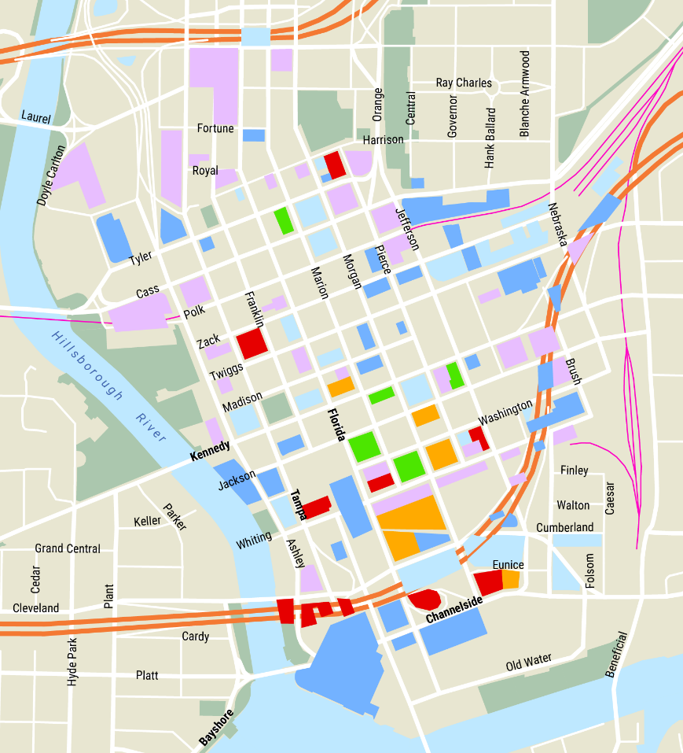
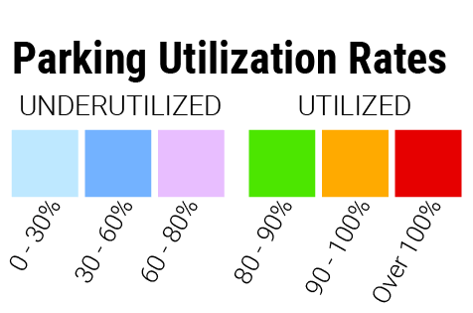
Utilization by Garage/Lot
6,000 spaces available
at the peak time of day
Notes:
We all need to learn to share. A lot of parking is either not accessible or more than a few blocks away.

Slide 8
Study Observation
The walking problem might have a price solution.

Slide 9
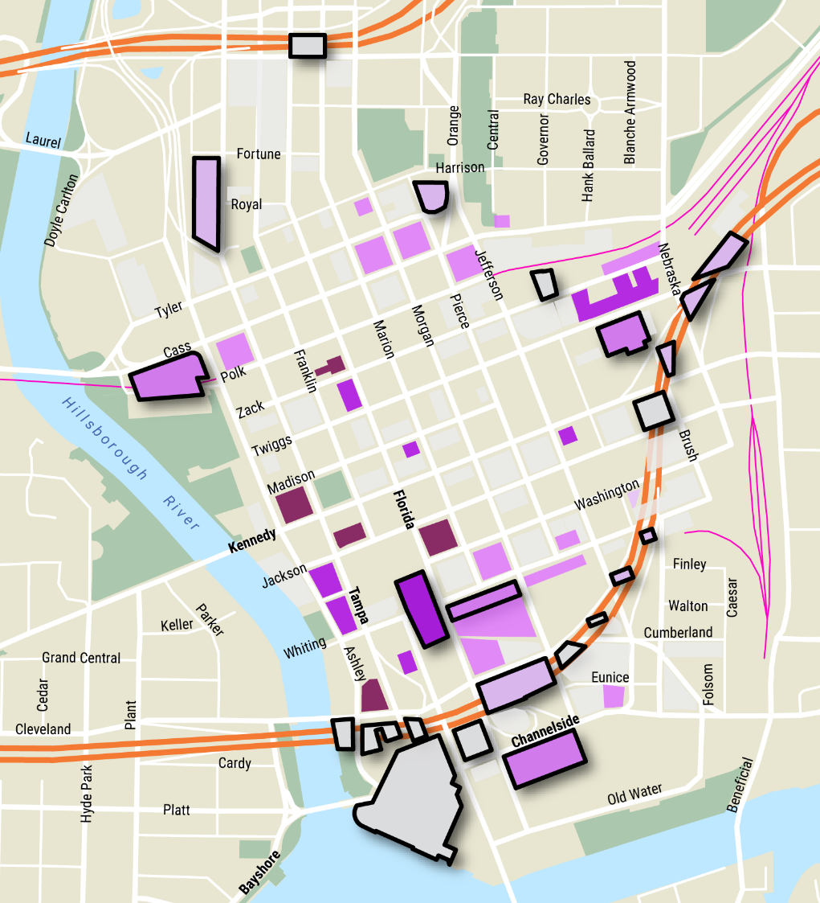

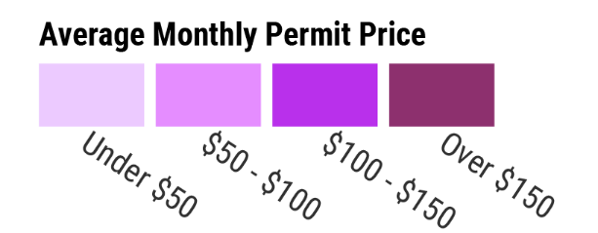
Sample walk distances
10 min walk
(Off-Street)
12 min walk
Notes:
Its important to preserve a variety of parking pricing. Most places are within a 10-minute walk in our compact downtown.

Slide 10
Finding
Customers have no incentive to ask for anything different.

Slide 11
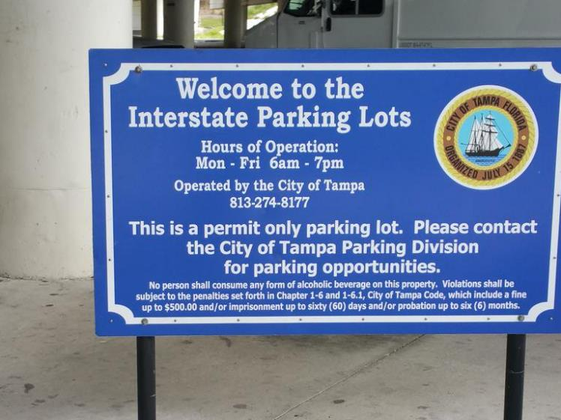
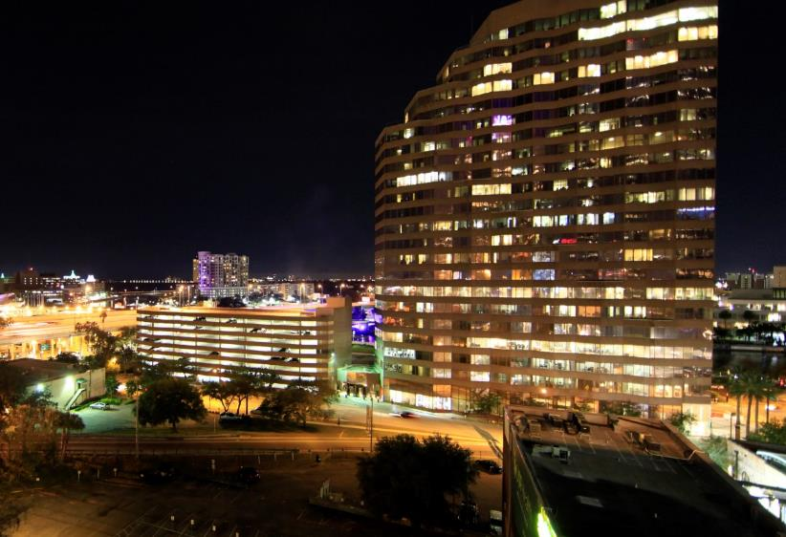
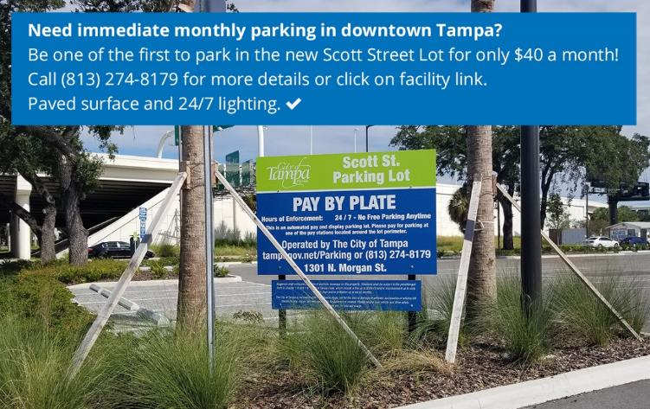
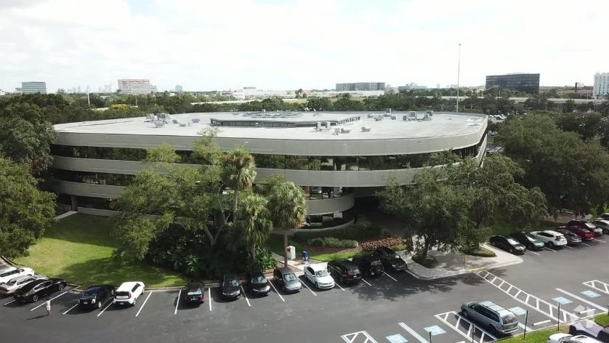
Market is set up for monthly permit-access parking
The Downtown office real estate market
continues to compete with Westshore
Notes:
We need a wider variety of ways to pay for parking and to know where its available.

Slide 12
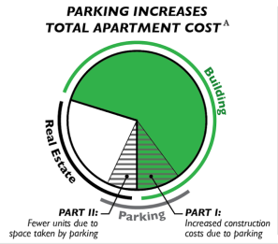
What is Parking Doing to Affordability?

Slide 13
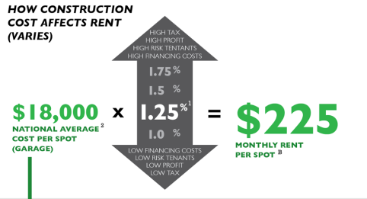
What is Parking Doing to Affordability?

Slide 14
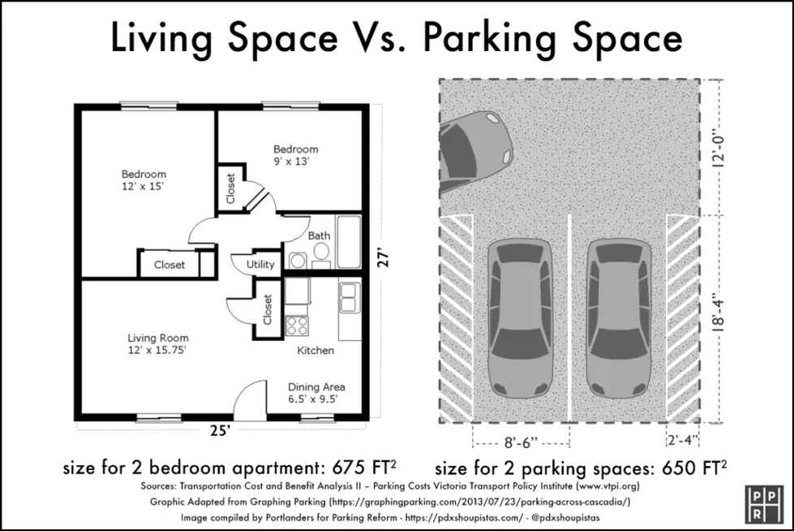
What is Parking Doing to Affordability?

Slide 15
Market is set up for monthly permit-access parking
This has all contributed to a trend toward overbuilding and not using parking efficiently.
Starting to address this will require multiple tools, including changing the minimum that zoning requires.

Slide 16
Study Observation
This involves everyone– in public AND private sectors.

Slide 17
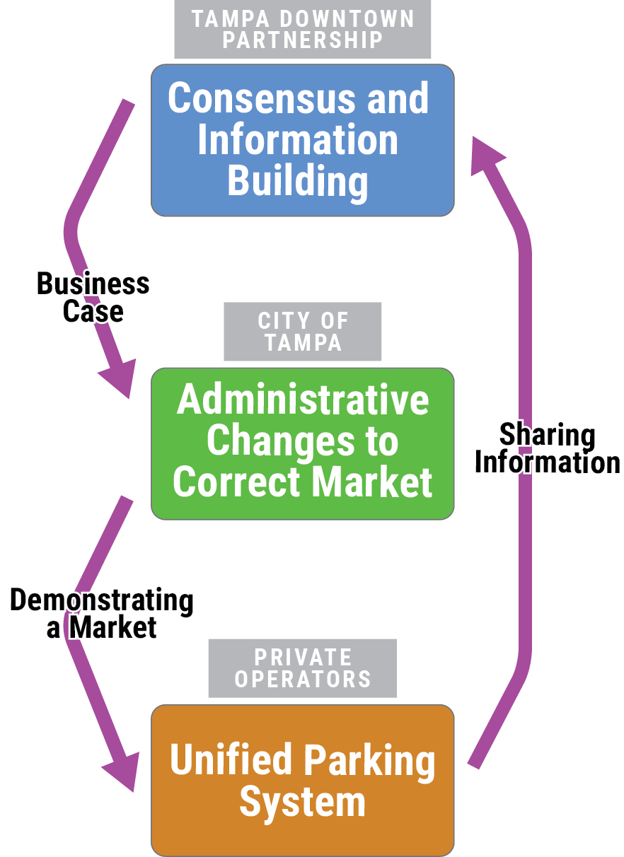
Management Recommendations of the Parking Study and Plan
Partnership: Well positioned to build stakeholder support, make a business case, and track parking needs
City: The administrator/operator of the largest share of parking in the system
Private Operators: The balance of the system, with smaller facilities but more downtown coverage
Notes:
This study involved extensive stakeholder outreach – both public and private.

Slide 18
Zoning Changes Complement the Parking Study and Plan
TDP: Well positioned to build stakeholder support, make a business case, and track parking needs
The supply side matters too: if we force too much parking to be built, the same mismatches will continue.
City: The administrator/operator of the largest share of parking in the system
Private Operators: The balance of the system, with smaller facilities but more downtown coverage
Notes:
We submitted these changes 1 ½ years ago. At the time, and even more so now, these are baby steps in the right direction. The current code seems overly complex but it wasn’t our charge to simplify/update it.

Slide 19
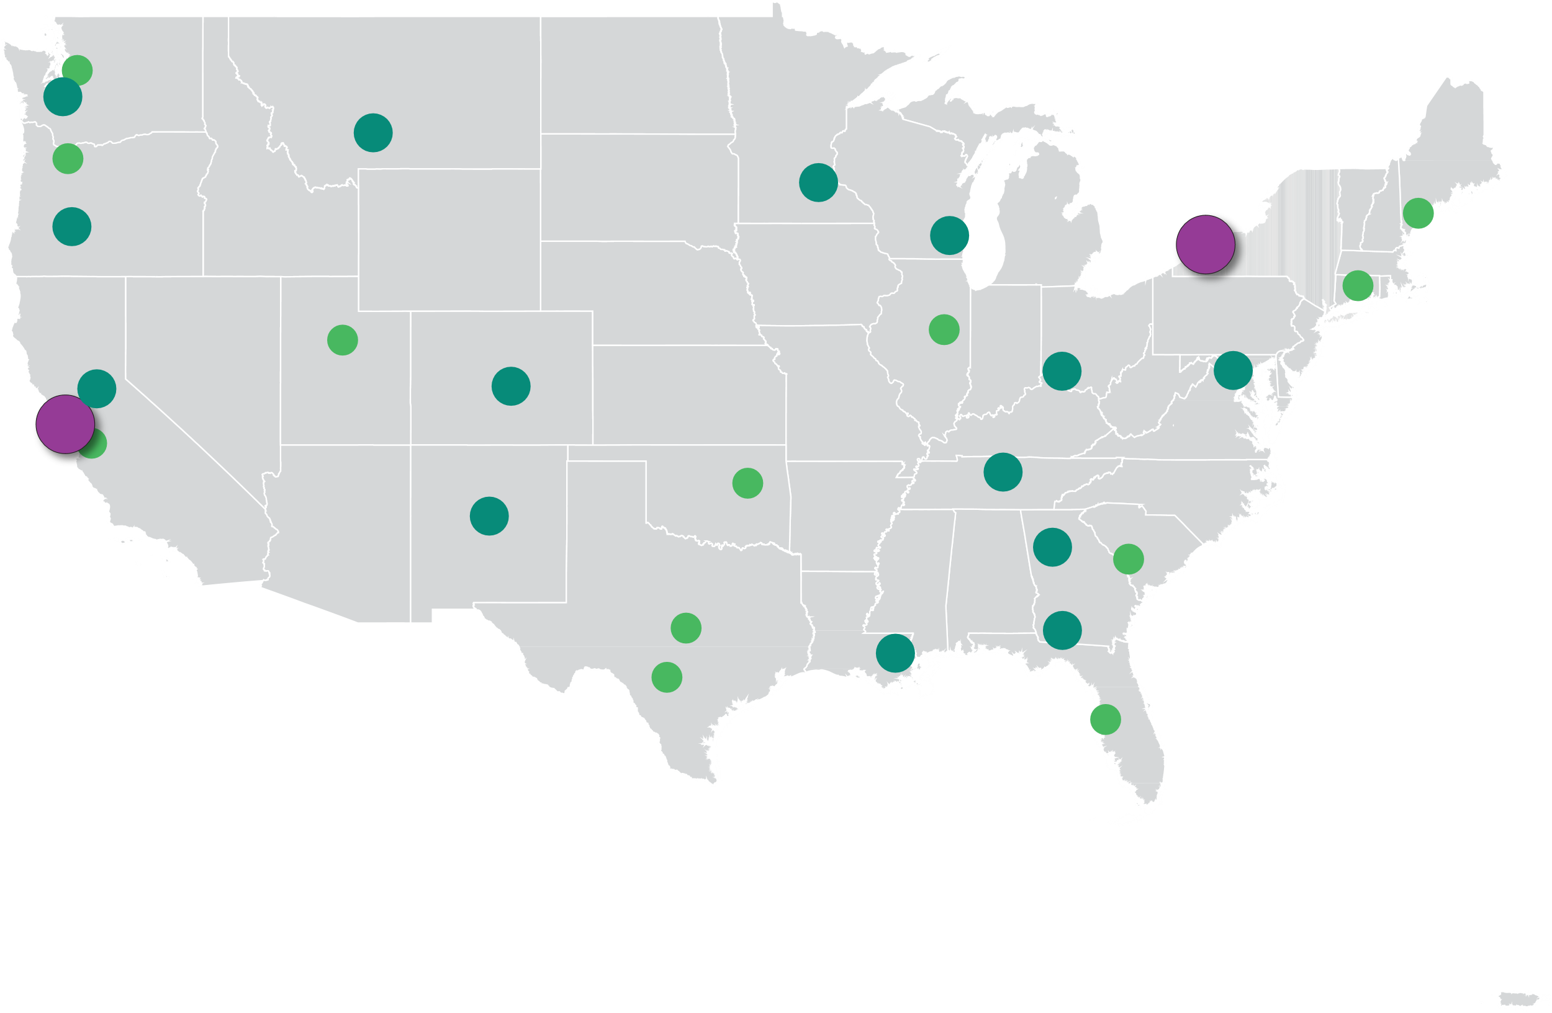
Intent/Purpose of Code Changes
Parking regulations are trending in this direction anyway.
Buffalo, NY
Eliminated all parking requirements citywide
Tacoma
Minneapolis
Eugene
Milwaukee
Sacramento
Cincinnati
Washington, DC
Nashville
Albuquerque
Atlanta
San Francisco, CA
Eliminated all parking requirements citywide
New Orleans
Eliminated all citywide requirements
Eliminated all downtown requirements (all land uses)
Eliminated or reduced for selected uses or with conditions (e.g. near transit)

Slide 20







Intent/Purpose of Code Changes
We don’t propose an entirely new system before Tampa is ready for one. (e.g. maximums or eliminating all requirements)
Use | Current Minimum | Proposed Minimum
Multi-family | 1 space/unit | 0.75 spaces/unit
Student Housing | Not defined | 0.25 spaces/unit
Hotel/Motel | 1 space/4 rooms | 1 space/8 rooms
RESIDENTIAL/HOTEL
Use | Current Minimum | Proposed Minimum
General office | 1 space/1000 SF | 0.5 spaces/1000 SF
Bank | 2 spaces/1000 SF | 0.5 spaces/1000 SF
Medical office | 1.2 spaces/doctor | 0.75 spaces/doctor
OFFICE/EMPLOYMENT
Use | Current Minimum | Proposed Minimum
Regular retail | 1 space/1000 SF | 0.5 spaces/1000 SF
Convenience retail | 1 space/1000 SF | No minimum
Personal Services | 1 space/1000 SF | No minimum
RETAIL/SERVICES

Slide 21




Intent/Purpose of Code Changes
These changes position Tampa for a more resilient and multimodal future.
City code already recognizes tradeoffs in certain special districts and for special events.
1 vehicle parking space
Typically carries between 1 and 2 people
CAN SUBSTITUTE WITH
2 motorcycle parking spaces
4 bicycle/scooter parking spaces
OR
Carries 2 people
Carries 4 people
More people served in CBD and Channel Districts with the same space for parking.

Slide 22
Intent/Purpose of Code Changes
Collaboration with Staff and community members resulted in one streamlined request.
Community Advocates: Eliminate/Reduce Minimums Citywide
Engaged Assistance with Code Drafting
TDP: Combine Data and Findings of Downtown Parking Study
Sought input from City Staff
Community Advocates: Modernize Bicycle Parking
Submitted PITA Application

Slide 23
Summary of Major Proposed Changes
Minimum requirements: Reduced generally by 50%, only for CBD and Channel District, and selectively (parking requirements are not eliminated)
Developers are not ‘capped’ in how much they provide (no maximum) and continue to respond to their market demands
Eliminated minimums for service uses such as retail, pharmacies and restaurants.

Slide 24
Summary of Major Proposed Changes
Adding alternative methods to meet parking requirements, including provide general public parking instead of restricted to single use.
Recognizing other modes: Bike parking, scooters, motorcycles and ride-hail/rideshare vehicles– all have a formal way to offset car requirements if these are more appropriate
Adding flexibility to make a special case: Applicants may use alternative parking studies that City must approve to show parking need

Slide 25
Other Proposed Changes (incorporated into a single request)
Administrative streamlining of terms and references to make code interpretation easier for staff and applicants.
Consolidation of Channel District parking requirements table into CBD table: puts all reduced requirements in a single place.
Renumbering and reorganization: Simplifies this section of the code overall

Slide 26
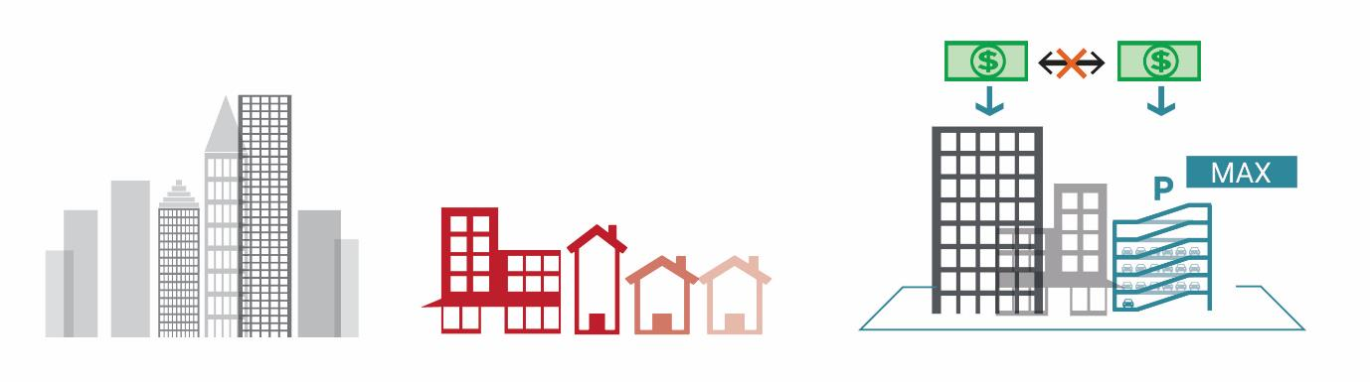
Future Steps for the City to Consider
We are here
2
Reduce minimum requirements in mixed-use neighborhoods
3
Require parking to be charged separately from leases (unbundling)
1
Reduce minimum requirements in CBD/high density districts
6
Set parking maximums, either specific districts or citywide
4
Increase reductions in minimums or eliminate them throughout more of the City
5
Allow different travel modes to help offset parking provided and meet requirements

