Slide 1
2022 Community Values Survey Created for the City of Tampa by HCP Associates

Slide 2
Introduction
Third iteration of study for the City of Tampa’s strategic priorities for the community
Can trend metrics from previous studies conducted in 2020 and 2021
Goal: to obtain statistically valid information that is reflective of the diverse demographics of the City and its various communities
Additionally, the survey explored topics pertaining to Transforming Tampa’s Tomorrow (T3):
Transportation
Workforce Development
Housing Affordability
Sustainability and Resilience

Slide 3
Methodology
Total respondents: 1,300 City of Tampa residents aged 18+
Margin of error: ±2.71% at a 95% confidence level
Data collection: April 14, 2022, through May 26, 2022
Telephonic survey using both landlines and cellphones
Average length of survey: 16 minutes
Five respondent demographics were controlled: age, gender, race/ethnicity, educational attainment, and homeownership status

Slide 4
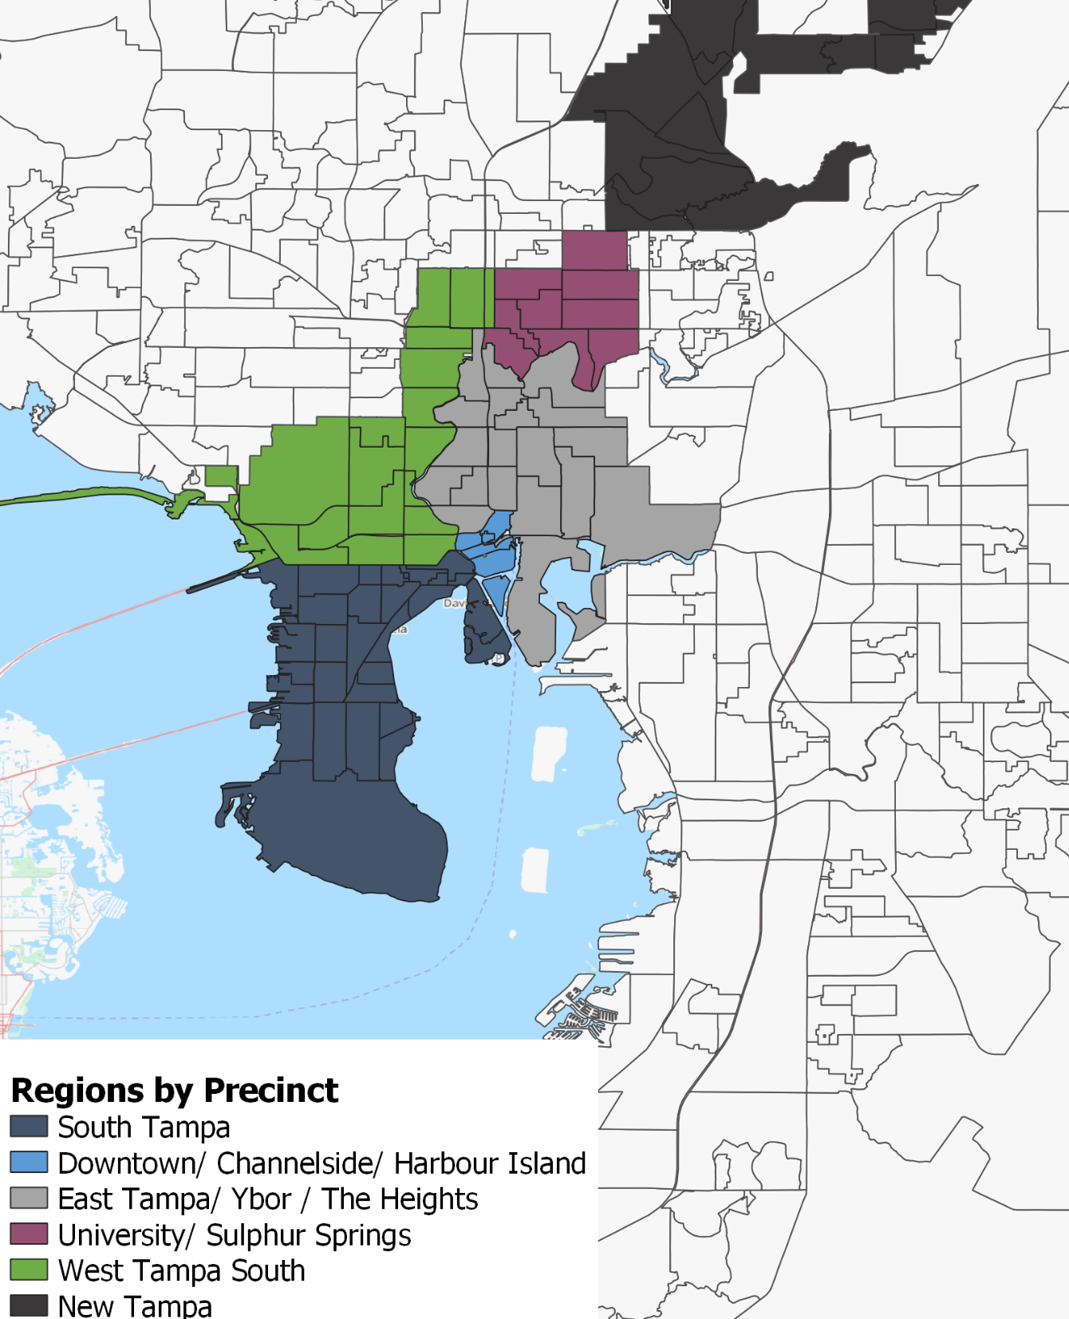
Study Regions
Data was segmented into six regions to provide analysis of different parts of the city

Slide 5
Respondent Profile

Slide 6
Respondent Profile

Slide 7
Top-line Approval

Slide 8
Trusting Local Government
*Gallup’s question asked respondents how much trust they had in their local government.

Slide 9
Recommending Tampa

Slide 10
Recommending Tampa

Slide 11
Handling Community Items
2020 Mean: 3.75
2021 Mean: 3.84
2022 Mean: 3.85

Slide 12
Community Characteristics
Affordable housing choices
Housing options near where I work
K-12 education
After-school and childcare programs
Sense of personal safety
Diversity, equity and inclusion
Sense of community
Cleanliness of public spaces
Events, social activities, and recreation opportunities
Greenspaces, parks, and public spaces
Accessible and timely waste management
Flood prevention
Bicyclist and pedestrian safety
Quality roads
Public transit options
Smooth traffic flow on major roads
Parking availability
Availability of jobs for my skillset
Career opportunities for the next generation
Arts and culture institutions
Question Phrasing: How important is it to you personally, that your community possesses the following characteristics? Use a 10-point scale where 10 represents the highest importance, and 1 represents the lowest.
Experience
Question Phrasing: In your personal experience, how has the City of Tampa delivered on these characteristics? Use a 10-point scale where 10 represents very well, and 1 represents not well at all.
Expectation Gap
Calculated as (Importance – Experience)
The average score is 8.58 among all categories
The average score is 7.42 among all categories
The average expectation gap is 1.16
A higher expectation gap is a bad thing
Importance

Slide 13
Expectation Gaps Ranked

Slide 14
Expectation Gaps: 2020 - 2022

Slide 15
Expectations by Region
2021 Expectations
2022 Expectations
 | Largest | Second Largest | Third Largest
South Tampa | Smooth traffic flow on major roads | Affordable housing choices | Flood prevention
Downtown | Smooth traffic flow on major roads | Quality roads | Affordable housing choices
East Tampa | Smooth traffic flow on major roads | Quality roads | Flood prevention
University | Smooth traffic flow on major roads | Quality roads | Flood prevention
West Tampa | Smooth traffic flow on major roads | Quality roads | Parking availability
New Tampa | Smooth traffic flow on major roads | Parking availability | Quality roads
 | Largest | Second Largest | Third Largest
South Tampa | Affordable housing choices | Smooth traffic flows on major roads | Quality roads
Downtown | Affordable housing choices | Quality roads | Smooth traffic flow on major roads
East Tampa | Smooth traffic flow on major roads | Quality roads | Affordable housing choices
University | Affordable housing choices | Smooth traffic flow on major roads | Quality roads
West Tampa | Affordable housing choices | Quality roads | Smooth traffic flow on major roads
New Tampa | Affordable housing choices | Smooth traffic flow on major roads | Quality roads

Slide 16
Affordable Housing

Slide 17
Housing Factors

Slide 18
Housing Factors

Slide 19
Housing Factors

Slide 20
Housing Expenses
Geography | Average Monthly Housing Expenses (Self-reported)
South Tampa | $1,914
Downtown / Channelside / Harbor Island | $1,651
East Tampa / Ybor / Heights | $1,707
University / Sulphur Springs | $1,593
West Tampa | $1,582
New Tampa | $1,639

Slide 21
Housing Choices

Slide 22
Transportation

Slide 23
Walkability and Two Wheels

Slide 24
Improvements
 | 2022 | 2021 Walk | 2021 Bike
Don't know | 36.2% | 45% | 53%
Less Traffic | 26.0% | 9% | 7%
Nothing | 8.9% | 8% | 6%
Improved Bike Lanes/Sidewalks | 6.3% | 5% | 7%
More Traffic Enforcement | 4.8% | 10% | 9%
Improve Overcrowdedness | 3.7% | 0% | 0%
More Bike Lanes/Sidewalks | 3.4% | 6% | 4%
More Personal Safety | 2.1% | 4% | 1%
Other | 2.0% | 2% | 2%
More Shade | 1.9% | 5% | 1%
Improved Parking | 1.8% | 0% | 0%
Incentives | 1.7% | 0.5% | 0%
More Lighting | 0.6% | 0.5% | 1%
Better Lighting | 0.5% | 0% | 0%
Improved Personal Safety | 0.0% | 0% | 0%
Walking/Biking oriented design | 0.0% | 2% | 1%
Separate Bike Lanes/Sidewalks | 0.0% | 1% | 6%
The number one suggestion – beyond “don’t know” – is to reduce the amount of traffic in the city.
Over a quarter (26 percent) of responses indicate that problems with traffic created a barrier for many citizens to walk or bike regularly.
This category increased by about 18-points from 2021
More traffic enforcement has noticeably decreased from 2021 with less than 5% of respondents indicating this would encourage more walking, biking, and scooting.

Slide 25
Transit Factors

Slide 26
Sustainability & Resiliency | Workforce Development

Slide 27
Sustainability & Resiliency
2021 Mean: 3.69
2022 Mean: 3.76

Slide 28
Workforce Development
For approximately how many months have you been looking for a job?
 | Length of Unemployment (in Months)
Mean | 8.62
Median | 3

Slide 29
Final Thoughts

Slide 30
Conclusion
Trust in the City of Tampa remained high from 2021 to 2022
Levels of recommendation for all categories are consistently high
Residents continue to report high positive levels of trust and confidence in the city’s handling of general issues; they also continue to feel that the city is prepared for hurricanes, floods, and other natural disasters
There have been noticeable changes in some expectation gaps
“Flood prevention” fell seven places between 2020 and 2021 compared to 2022
“Diversity, equity, and inclusion” and “Sense of personal safety” have moved up eight spots since 2020
Affordable housing has moved up rapidly to the largest expectation gap in three years
Number 12 in 2020 to Number 1 in 2022
Homeowners in Tampa prioritize the size of their home, while renters place more importance on housing affordability
However, both groups ranked the length of their commute as the least important issue when choosing where to live
The number one improvement that residents believe would encourage more walking and biking is less traffic in the city
Only category besides “Don’t Know” to be reported by more than a quarter of respondents

