Slide 1
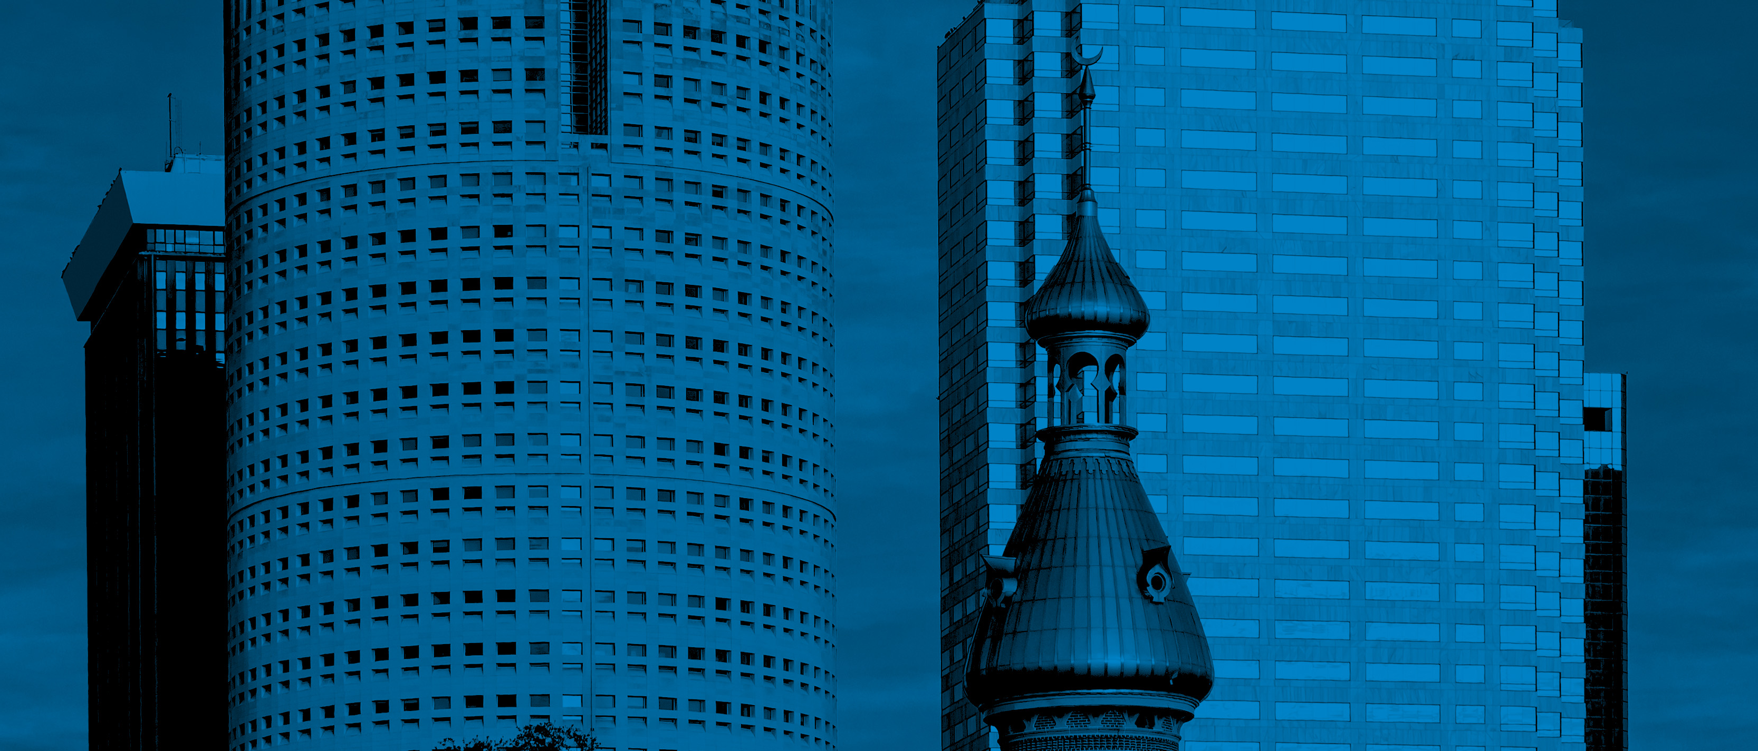
Privately Initiated Text Amendment
Central Business District (CBD) Periphery
Tampa City Council Workshop
November 17, 2022

Slide 2
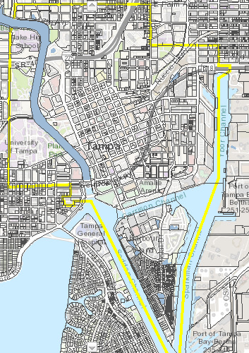
Location
Eastern Boundary = Nebraska Ave / 15th St / Ybor Channel
Western Boundary = N. Blvd.
Northern Boundary = Palm Ave
Southern Boundary = South end of Harbor Island
*CBD Periphery projects are permitted to double density
(i.e. 3.5 FAR → 7.0 FAR)
November 17, 2022

Slide 3
Proposed Amendments
Parking
Loading
Greenspace
Buffering

Slide 4
Parking
Multiple-family residential projects within the Central Business District (CBD) Periphery shall adhere to Section 27-184 Official schedule of permitted principal, accessory and special uses; required off-street parking ratios by use as outlined for projects within the Central Business District (CBD)
CBD
CBD Periphery

Slide 5
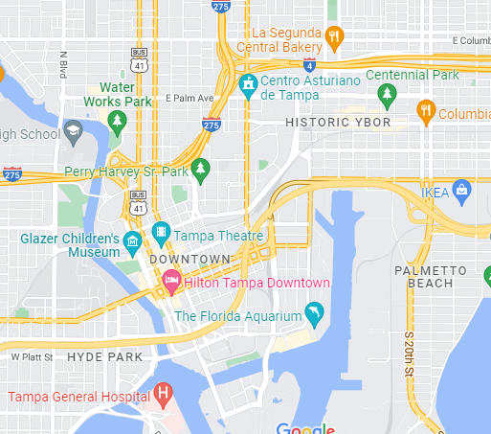
Parking
Visitor parking requirement does not apply to multiple-family residential projects within the Central Business District (CBD) Periphery

Slide 6
Parking
On-Street Parking
Traffic calming
Buffering for sidewalks
Reduced garage sizing
Easier access to ground-floors
For all developments within the Central Business District (CBD) Periphery, on-street parking (non-dedicated & within the public right-of-way) provided immediately adjacent to subject property shall count for up to 25% of required spaces

Slide 7
Loading
Developments within the Central Business District (CBD) Periphery shall not be required to have more than a single loading berth
Off-street loading spaces shall be located and arranged so that a semitrailer truck (WB 50 class) shall be able to gain access to and use such spaces by means of one (1) continuous parking maneuver, except for those developments located within the Central Business District (CBD) Periphery, for which this requirement shall not apply

Slide 8
Greenspace
Multiple-family residential developments located within the Central Business District (CBD) Periphery shall be permitted to adhere to the Multiple-family (≥6 stories) minimum landscaped area requirements, applying a calculation based on percentage of parcel area in lieu of a square footage/unit provision.
Parcel area
Parcel area – building footprint
(Parcel area – building footprint) X 30%
= Total required greenspace

Slide 9
Greenspace
Per Unit Calculation
Multiple-family residential developments located within the Central Business District (CBD) Periphery shall be permitted to adhere to the Multiple-family (≥6 stories) minimum landscaped area requirements, applying a calculation based on percentage of parcel area in lieu of a square footage/unit provision.
Development Size | Required Greenspace | Acres
100 units | 75,000 SF | 1.72 acres
200 units | 150,000 SF | 3.44 acres
300 units | 225,000 SF | 5.16 acres
Percentage Calculation*
Development Size | Required Greenspace | Acres
54 units | 5,898 SF | 0.14 acres
236 units | 5,810 SF | 0.13 acres
532 units | 5,036 SF | 0.12 acres
*Based on example projects

Slide 10
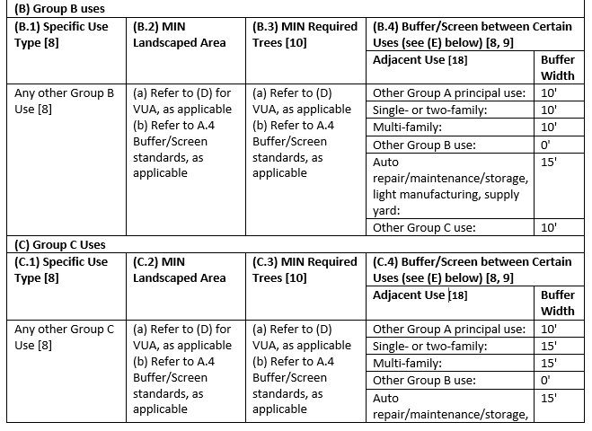
Buffering
“Adjacent Use” merely means the actual use then-existing on the adjacent property, if any, and not permitted uses allowable in the applicable zoning district.
Zoning District (CG, CN, RM, etc.)
Allowable uses (daycare, restaurant, multi-family)

Slide 11
Questions?

