Slide 1
Progress Meetings in Calendar Module
Notes:
For full section of Slide Options, click “New Slide” dropdown menu under the Home tab.

Slide 2
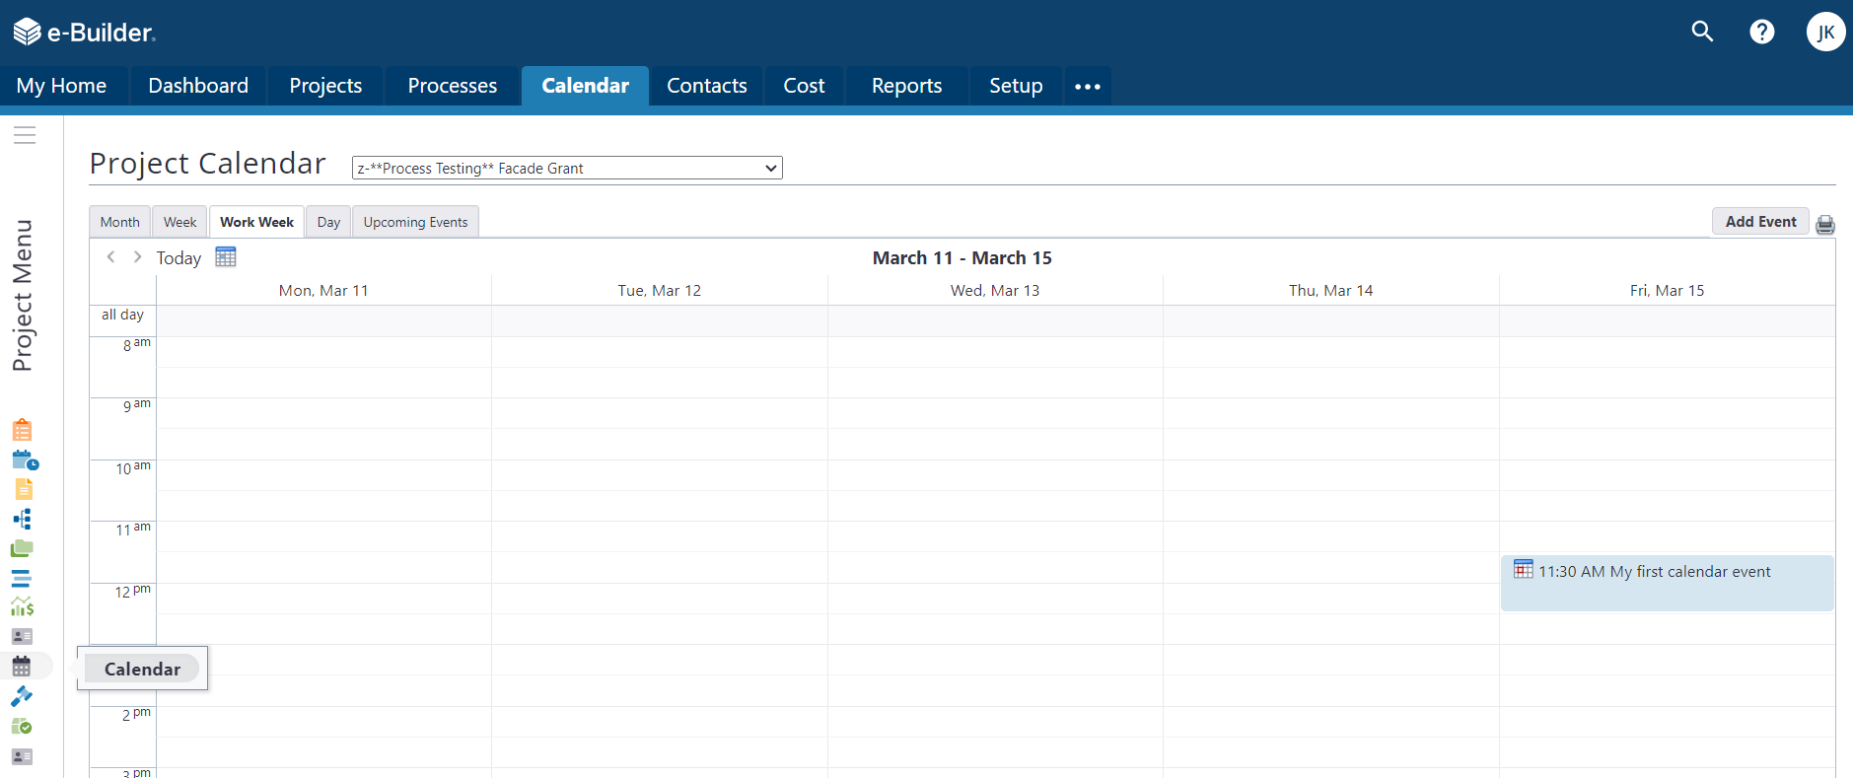
Progress Meeting in Calendar Module
Go to “Project” from global project tabs then Select Calander from left vertical menu
The page layout will change to the calendar background and the global “calendar” tab will show
Your “active” project will be displayed in the dropdown menu
The background will now show the “created” or sent calendar events for shown period
To create a new meeting select “add event” button on top right

Slide 3
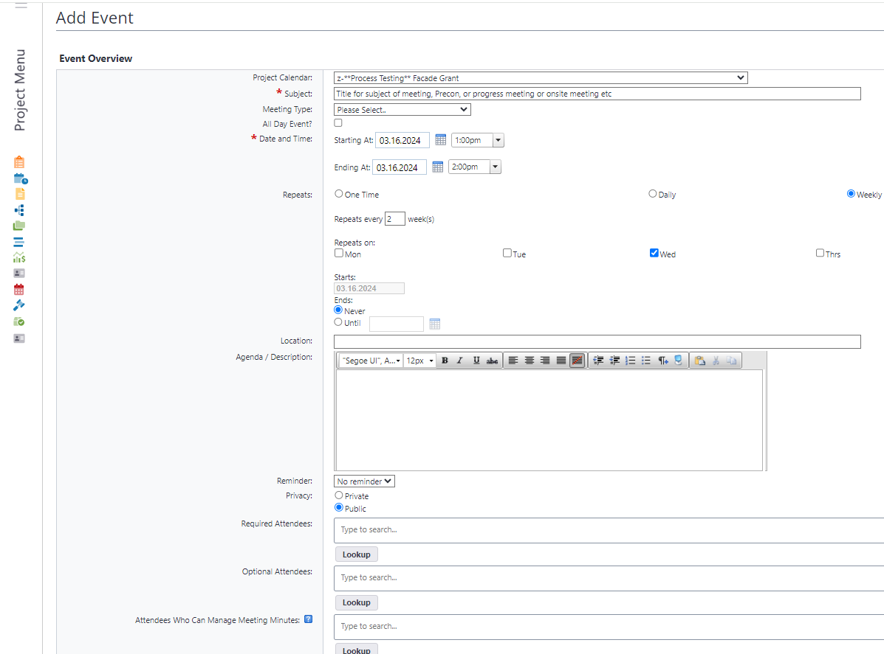
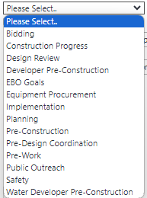
The Entry Form: Subject and Meeting Type
Start filling all fields from top down
Subject field: Title of your precon, progress meetings, site visits etc
Meeting Type: Use dropdown to pick from predefined list
This is a category of meeting so many different people can start and or pull data from types of meetings
Important for when or if the city or company changes a PM who created the meetings. This feature allows new meetings to be started and all data pulled into new event created by new PM

Slide 4
Entry Form: Date, Time and Frequency
Date and Time
The start and end time and date establishes the time of day for the first meeting
Repeats is the “reoccurring feature”
Options for one time through monthly
Repeats very will change based on first selection. This options shows a meeting occurring every 2 weeks on Wednesday starting on March 16th.
Caveat, if you need to change the frequency, this event will have to end and a new event must be created (importance for the meeting type)
Choose when to end meeting
Location: examples are “TEAMS” or CAD/CEI 1st floor main conference room

Slide 5
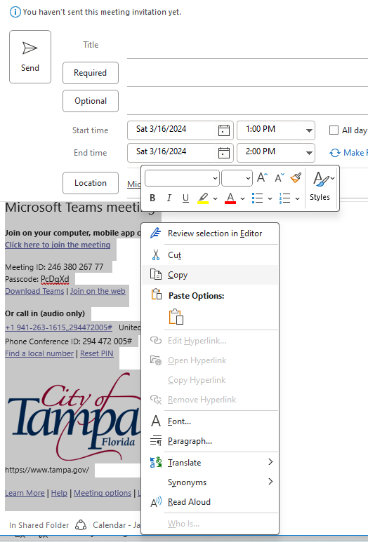
The Agenda/Description Text Box
Agenda: Type in agenda or copy the video conferencing program link created in another program.
Use outlook to open a new meeting invite, pick day and time and then create TEAMS message with link and copy the link to the agenda field in eBuilder
DELETE the
Outlook invite
after copying info
We want to send
invite from e-Builder

Slide 6
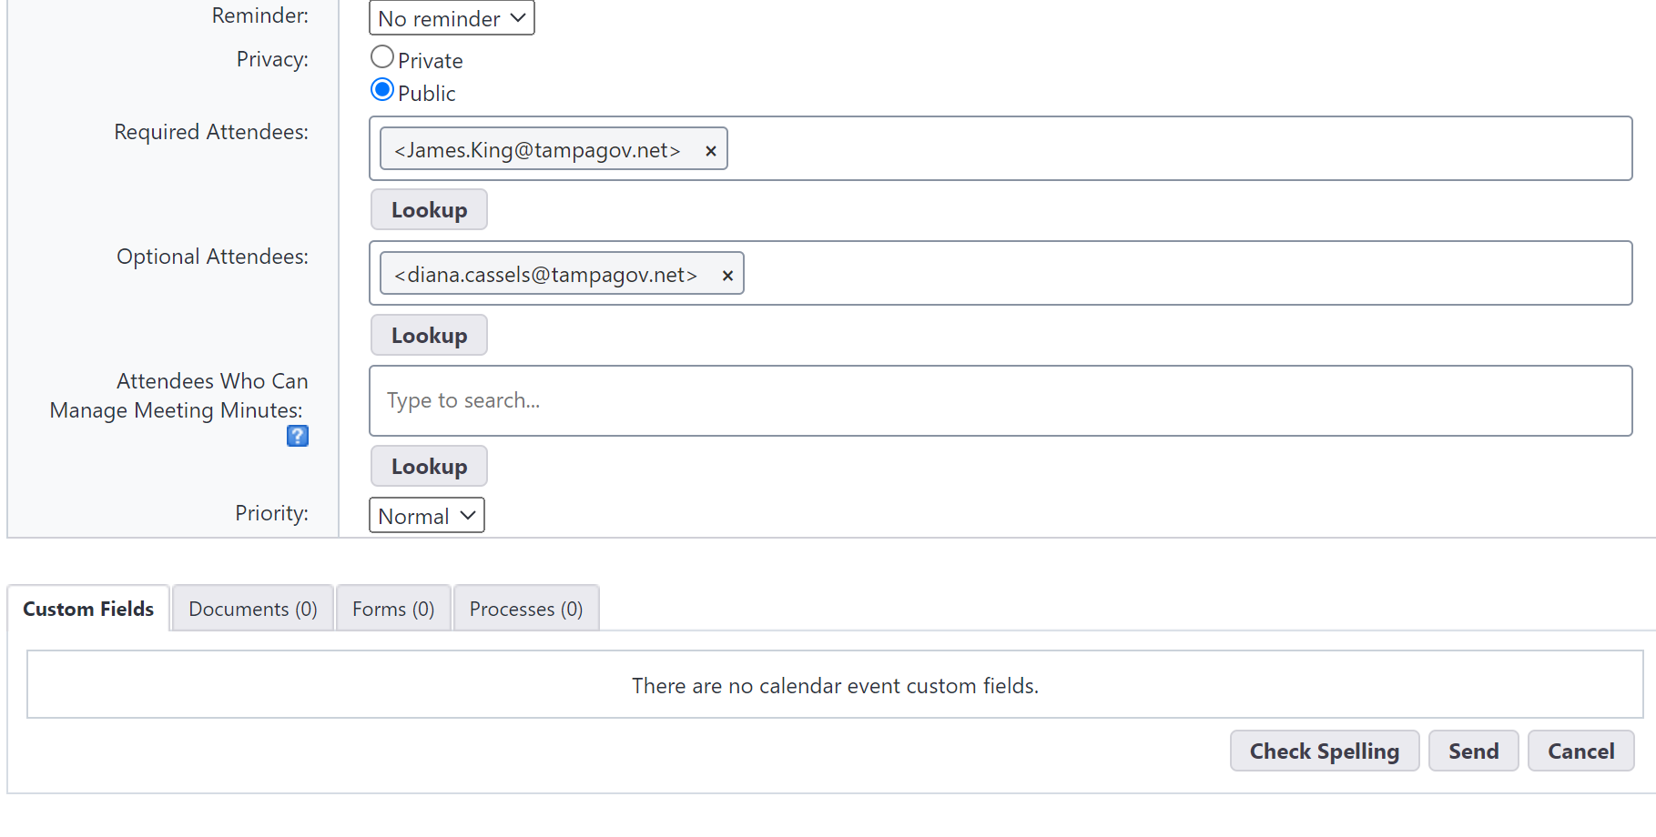
Adding Invitees and Sending Invite
Be sure to add yourself to the required attendees
Choose a backup to be able to manage the meeting.
If Contractor is running meeting, make sure both City PMs can manage
And then send invite

Slide 7
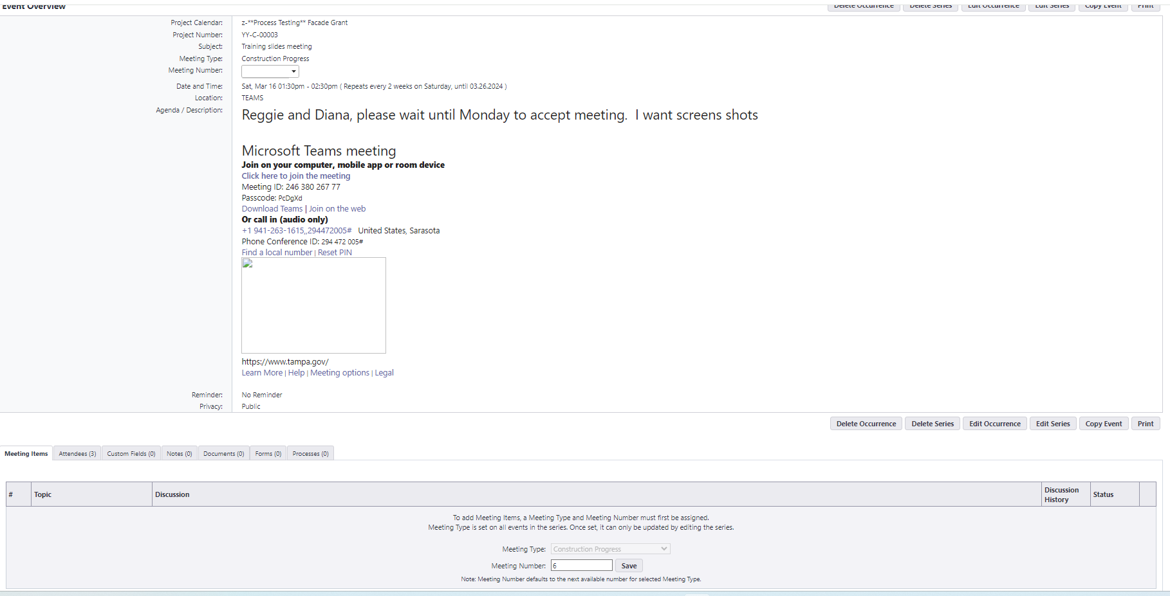
Creating the event to enable tracking topics
Open the event from calendar view
Organizer will have this view with six operator buttons
To create the next (or first event agenda items)
The number is sequential number of meetings and you can change is desired
Hit save on bottom portion of the page.

Slide 8
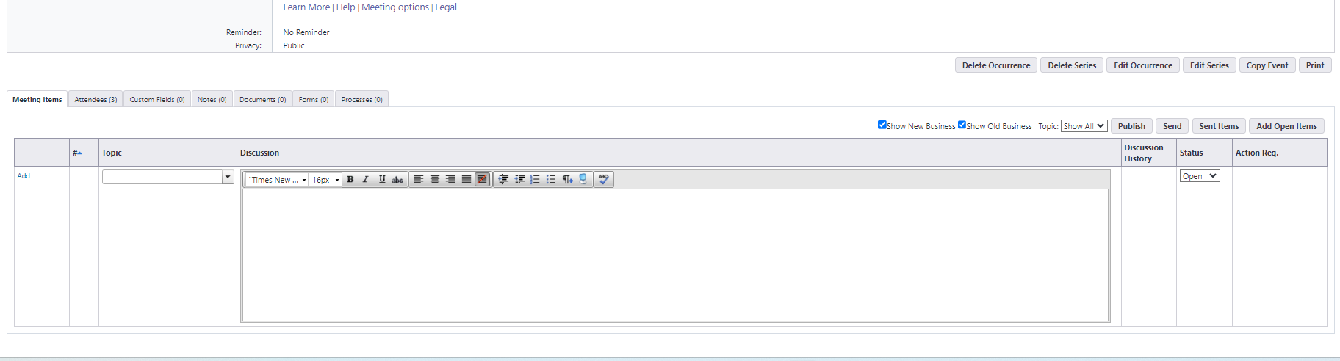
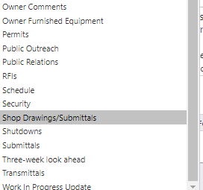
Creating Agenda Topics in the Event
This is a rich text box field with some formatting capabilities
Will not always copy formatting correctly from word or PDF
Now to add topics:
Use dropdown menu to choose preformatted or type in specific to meeting/contract
Number is auto generated and not editable after assigned
Number starts with meeting number and then 1, 2 etc for each topic added
Must select add to save the info
Bring Items from previous meetings
Select “Add open items” button
The dropdown will show all open items to choose, use the check boxes to select topics to bring forward

Slide 9
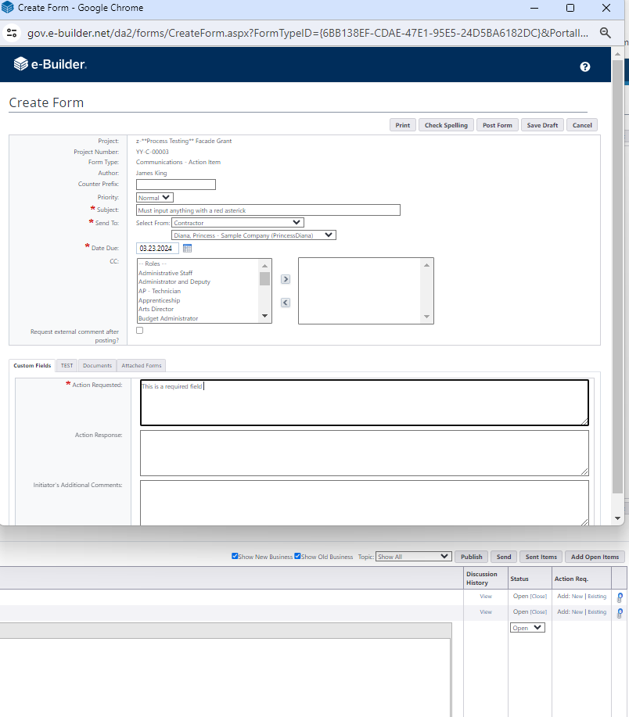
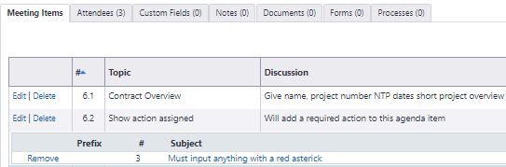
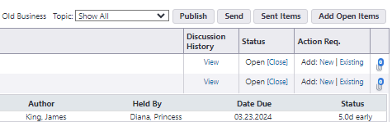
Assign task to individuals or person in a role
Each agenda topic can track multiple subtasks using the Action Required Column
Can assign to a group of people in the same role or one person in that role

Slide 10
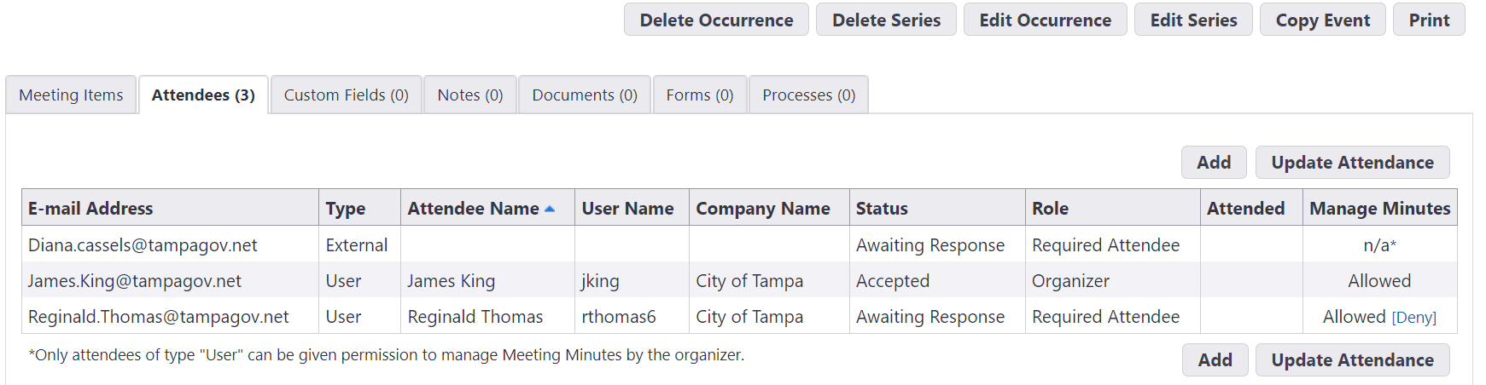
Track Attendees
Track attendance using the attendees tab. Only organizer or authorized meeting users can update or add persons to meeting.
Invitees with e-Builder user ID will have complete information displayed in the grid

Slide 11
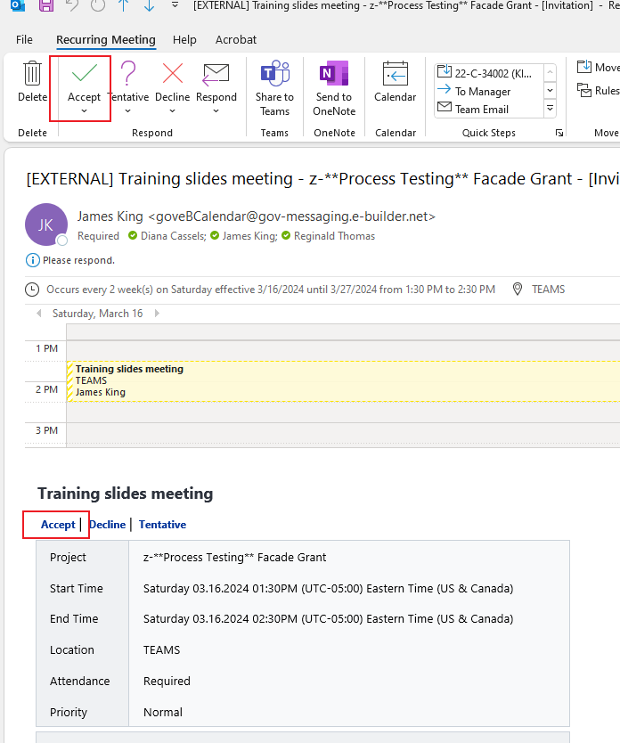
How to accept meeting in e-builder and outlook
Invitees will receive an email from e-Builder.
Example on right shows person must accept in two locations in an Outlook environment
Accept the meeting inside the email body first. This will update the e-Builder meeting
Accept the meeting in the outlook toolbar area second. This will update your email calendar.

Slide 12
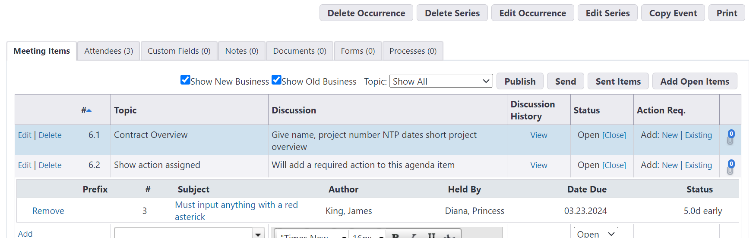
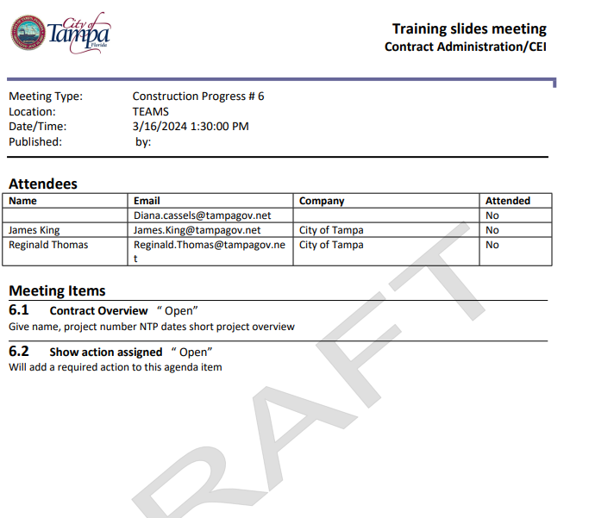
Print to review the meeting minutes
“Print” Button at top right of page will allow you save a PDF version and print if required.

Slide 13
Publish the Meeting
Publish the meeting using the “Publish” button. Will send email to all participants and then save PDF to the Documents \ 1 Project Management \ 1.3 Meeting Minutes documents

