Slide 1

Project Overview
Project Partner Workshop | May 29, 2026

Slide 2
PROJECT PARTNER WORKSHOP | May 29, 2026
Agenda
Project Context
Current Project Scope & Schedule
Alignment, Guideway & Stops
Approach to Traffic Analysis
Roll Plot Review
Partner Coordination
Next Steps

Slide 3
Project History

Slide 4
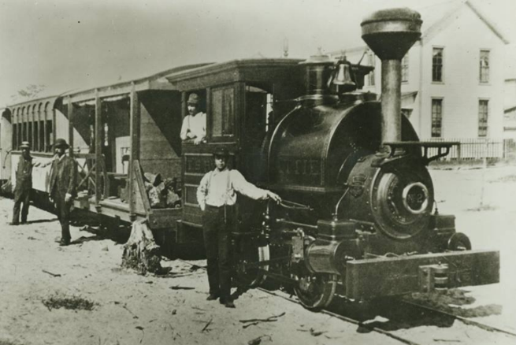
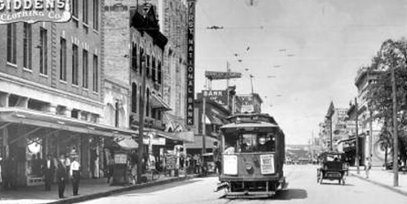
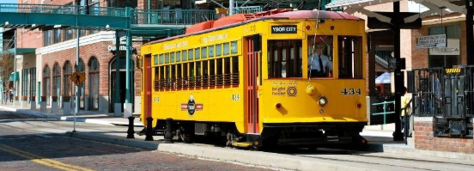
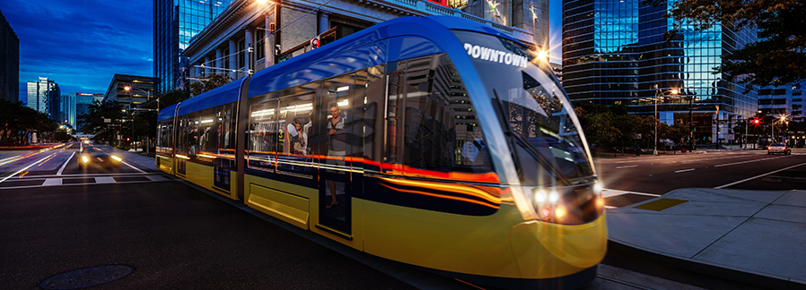
PROJECT CONTEXT 1
Streetcar History
  FIRST GENERATION
  1885 First generation wood-burning steam engines. Converted to electric power in 1893.
  1926 Carried 24 million passengers in 1926.
  1949 Last vehicles removed from service.
  SECOND GENERATION
  2002 Existing 2.4-mile system open.
  2010 Extension (0.33-mile) to Poe Garage completed.
  2014 HART explores extension and modernization alternatives.
  2017 City launches extension and modernization study.
  2018 Approved for Entry into FTA Small Starts Project Development (06.15.18).
  2020 FTA SSGA Ratings Request Submittal (08.28.20).
  2021 Local funding source (AFT surtax revenue) invalidated.
  2025 Removed from FTA Small Starts Project Development. City restarts project to explore extension alternatives, screen impacts, and prepare for reentry into FTA Small Starts Project Development.

Slide 5
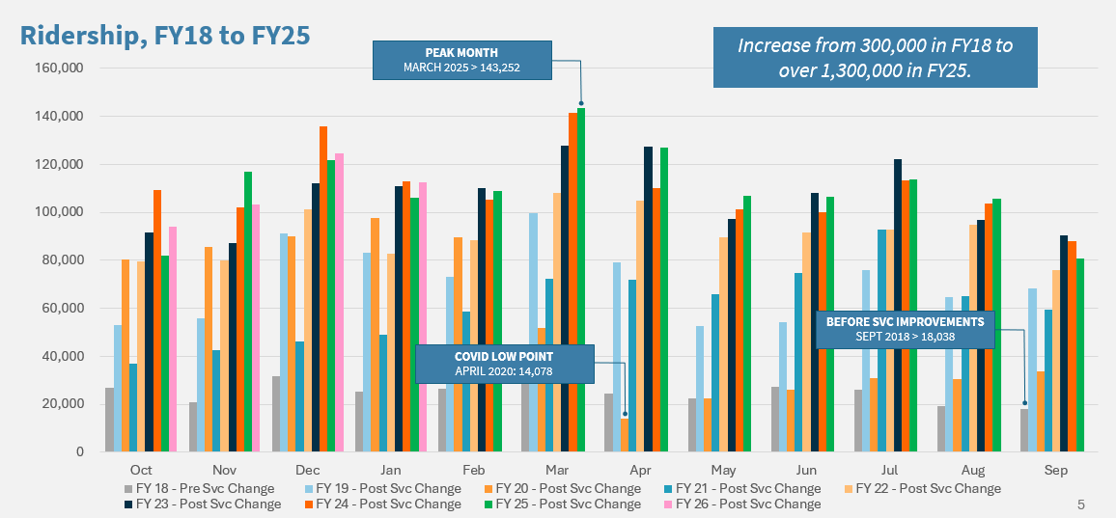
PROJECT CONTEXT 2
Notes:
1.3M in FY2025 with monthly average of 110,000. Almost 4 million over the last three fiscal years. Ridership of 4,257 per day.
Local Comparisons:
HART Route 1 hit 1.46M in calendar year 2025 or ~120,000 monthly.
PSTA SunRunner hit 550,000 from June 2024-June 2025 ~45,000 monthly.

Slide 6
Current Project Scope & Schedule

Slide 7
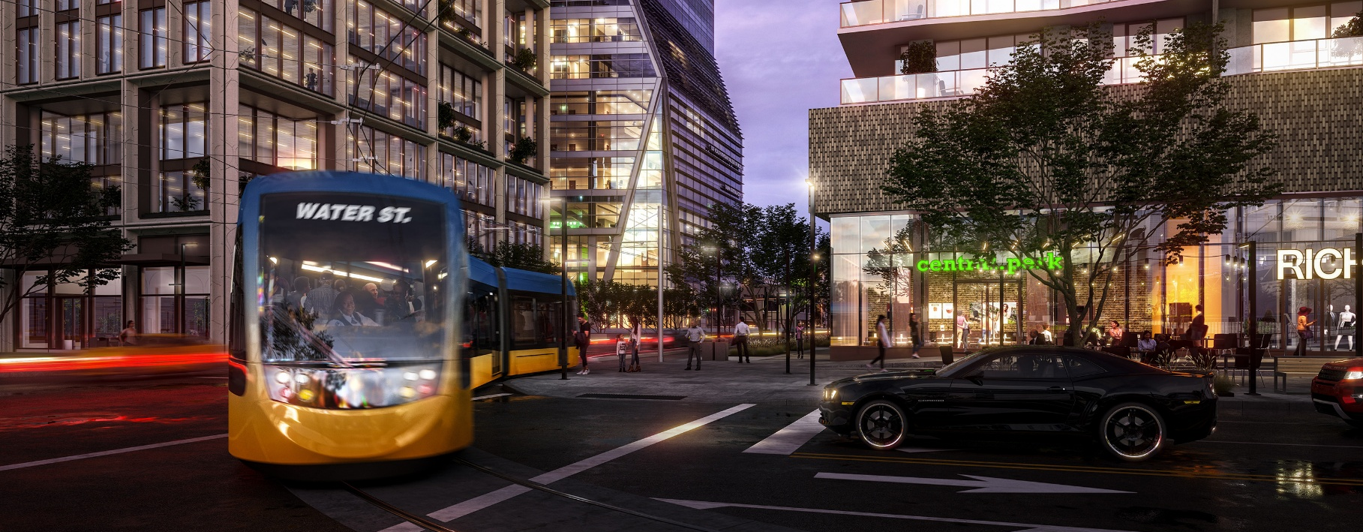
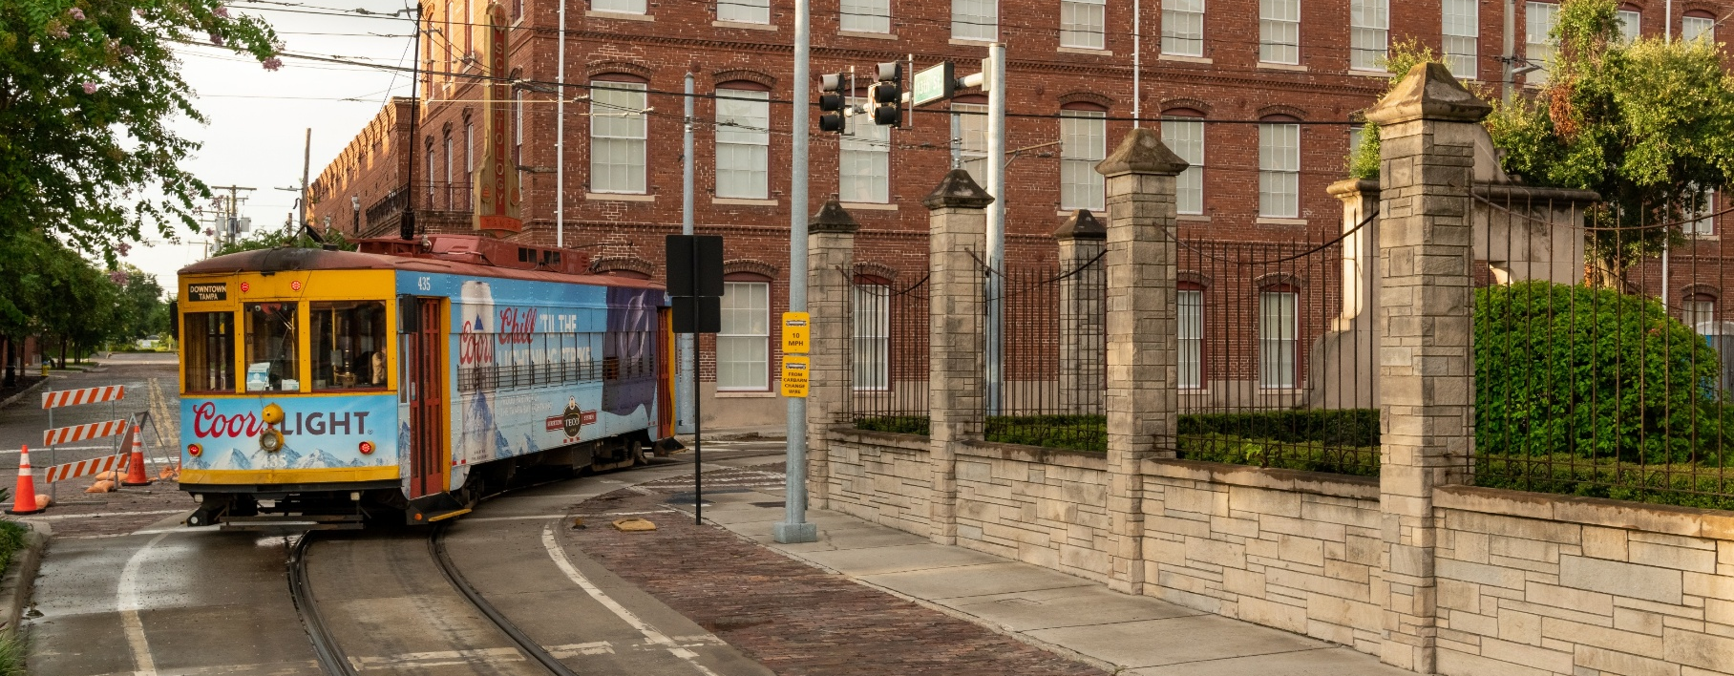
CURRENT PROJECT 1
What’s Changing & Why?
  Shift in Approach
    Move away from modernization of existing system and extension. Previous project called for new vehicles, reconstruction of stops, modification of maintenance facility, and extension to Palm Avenue.
  Cost-Factors Driving Change
    Leverage existing replica fleet and infrastructure to expand service and minimize costs per mile of service.
  Expand Reach
    With reduced costs, explore extending service north to Columbus Avenue.

Slide 8
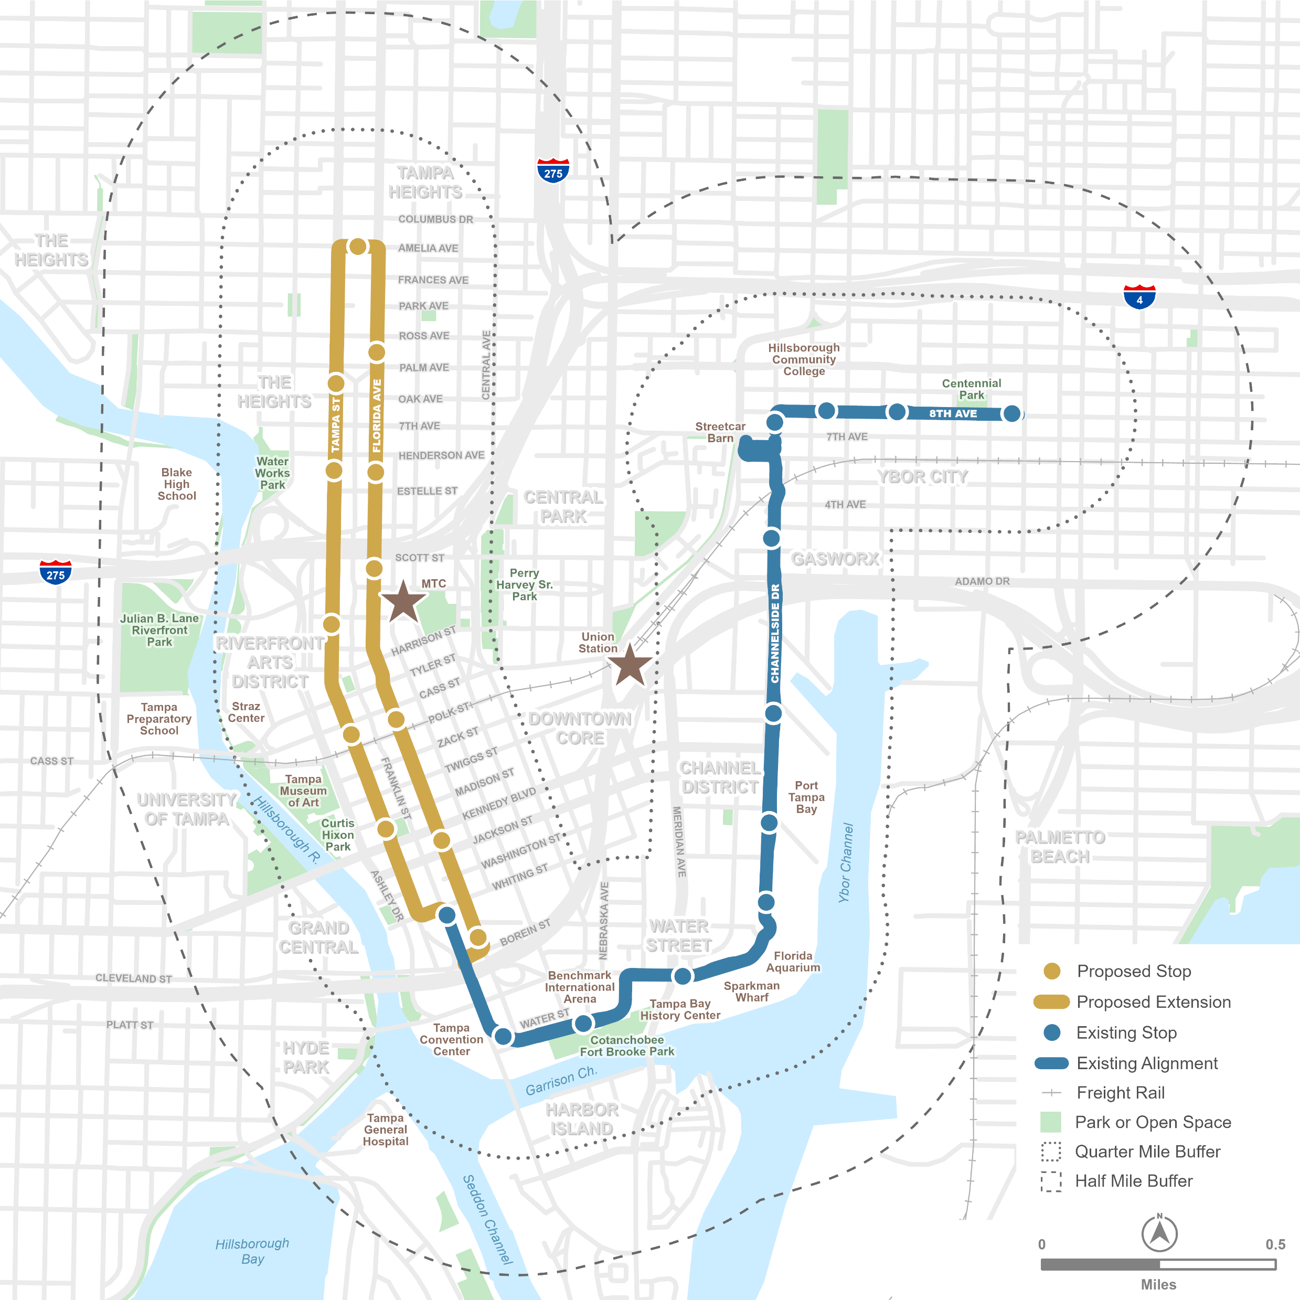
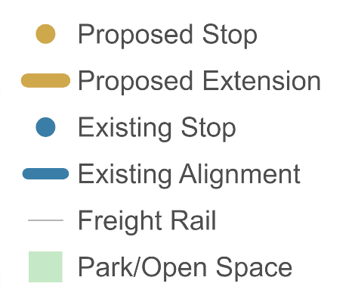

CURRENT PROJECT 2
Extension Objectives
  Connect Downtown Districts
    Bridge physical barriers restricting easy movement between key destinations across greater Downtown Tampa, Tampa Heights, and Ybor City.
  Expand Sustainable Transportation Choices
    Provide new mobility alternative to ease the burden on congested streets and better serve rapid increases in population, jobs, and visitors.
  Improve First/Last Mile Service
    Connect critical regional transportation hubs, including Marion Transit Center and Union Station, and address the absence of reliable short distance mobility options.
  Support Economic Development
    Unlock the value of strategically located but underdeveloped districts by connecting key destinations and parking resources across greater Downtown.

Slide 9
CURRENT PROJECT 3
Preliminary Schedule
2026
2027
2028-2031*
Revised Project
Definition
Alignment & Stop Concepts
Vehicle Modifications
Traffic Analysis
Transit Operations
Communications & Traction Power
Ridership Projections
Cost Estimates
Impact Screening
Preliminary Funding & Finance
Management & Governance Strategies
Project Delivery Alternatives
Project Development & Preliminary Engineering
FTA Project Development Re-Entry
Preferred Alternative Refinement & Confirmation
Preliminary Engineering
  Guideway & Stops
  Transit Systems & Power
  Roadway & Utilities
Natural & Cultural Resource Assessment
State & Local Funding Commitment
FTA Ratings Request Submittal
FTA Readiness Documents
FTA SSGA Application & Execution
Final Design, Construction & Start of Service
Final Design & Engineering
Transit & Roadway Construction
Service Testing
Start of Service (2030-31)
*Timing contingent on funding, approvals,
and delivery method.
We are here

Slide 10
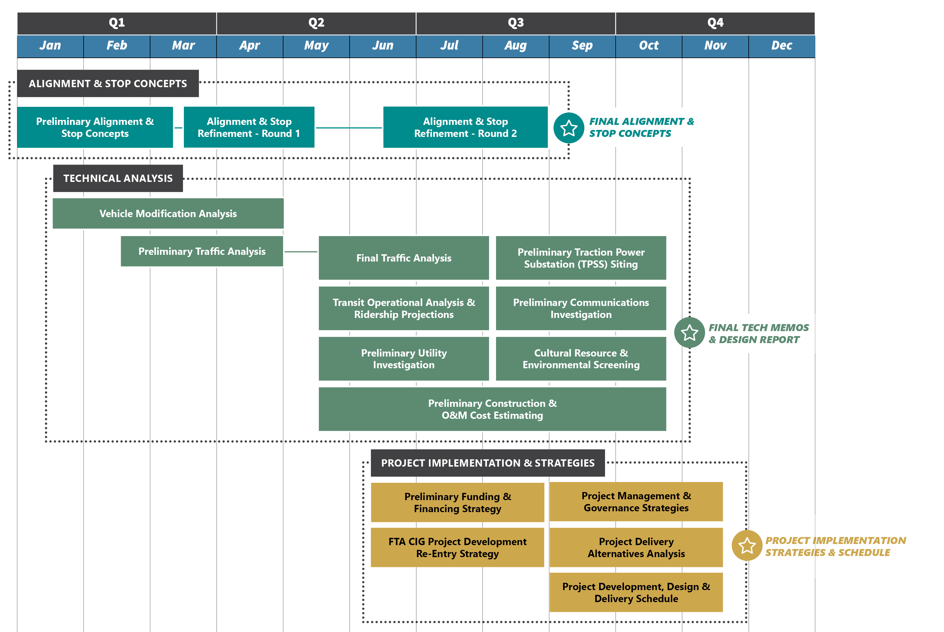
CURRENT PROJECT 4
WO1 Scope, Schedule & Deliverables
  Alignment & Stop Concepts
  Tech Memos & Design Report
  Project Implementation Strategies & Schedule
    Includes initial collaboration with FDOT and HART staff, and initial public communications about project restart, and presentations to elected officials.

Slide 11
Alignment, Guideway & Stops

Slide 12
ALIGNMENT, GUIDEWAY & STOPS 2
Objectives for Preliminary Planning
  Preliminary Alignment (Basis for Stakeholder Discussion & Technical Evaluation)
  Optimize transit ops – maximum exclusive guideway.
  Minimize impacts on active transport and parking.
  Minimize impacts on traffic operations​​ (no lane repurposing).
  Minimize ROW requirements.
  Preliminary Stop Locations
  Close to key destinations and at logical cross streets.
  Accommodate right side boarding with potential for shared use.​
  Avoid impacts on property access.
  Minimize ROW acquisition.

Slide 13
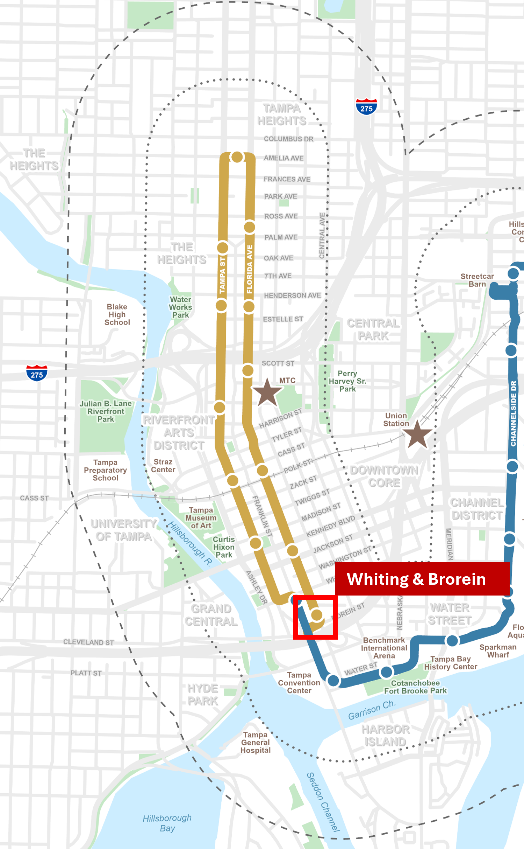
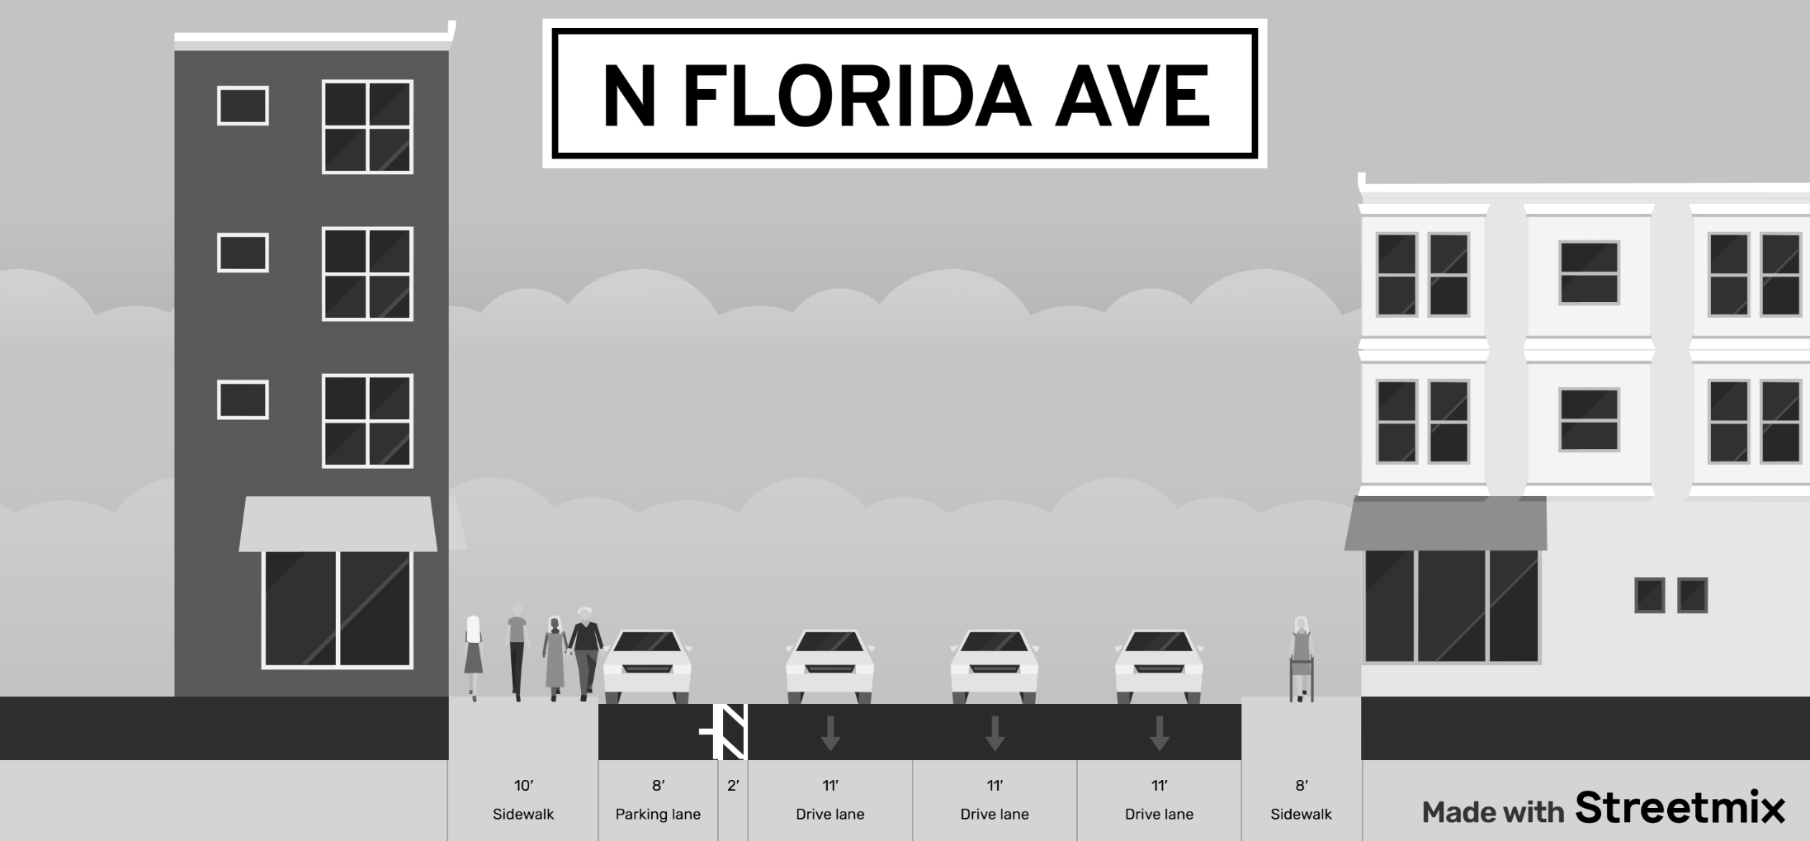
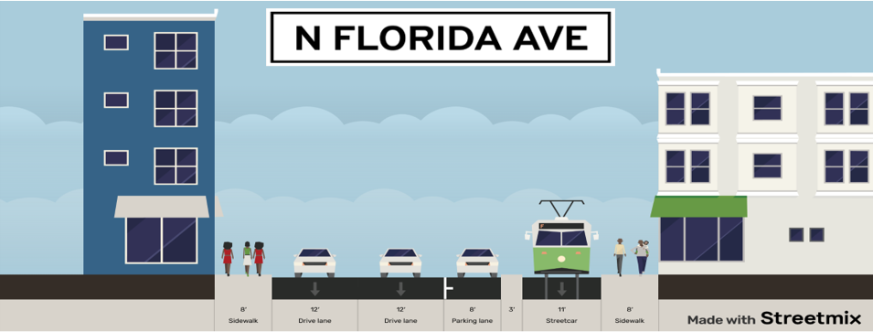
TYPICAL SECTIONS: N Florida Ave (Whiting & Brorein)
EXISTING
PROPOSED

Slide 14
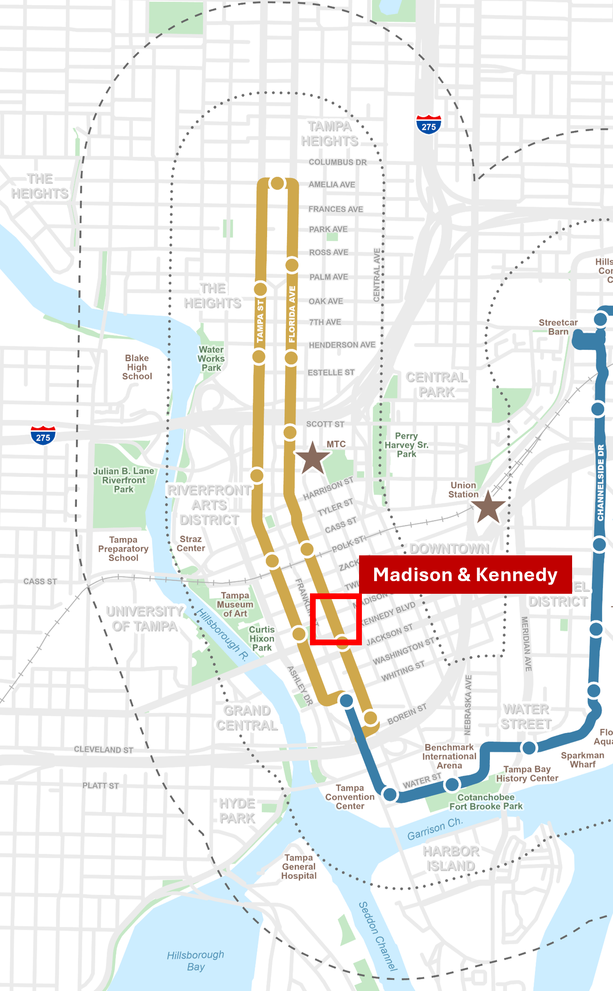
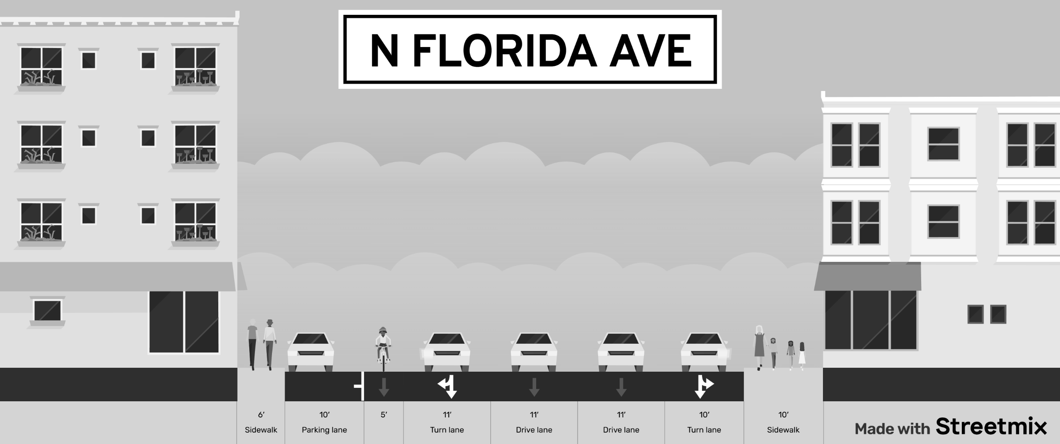
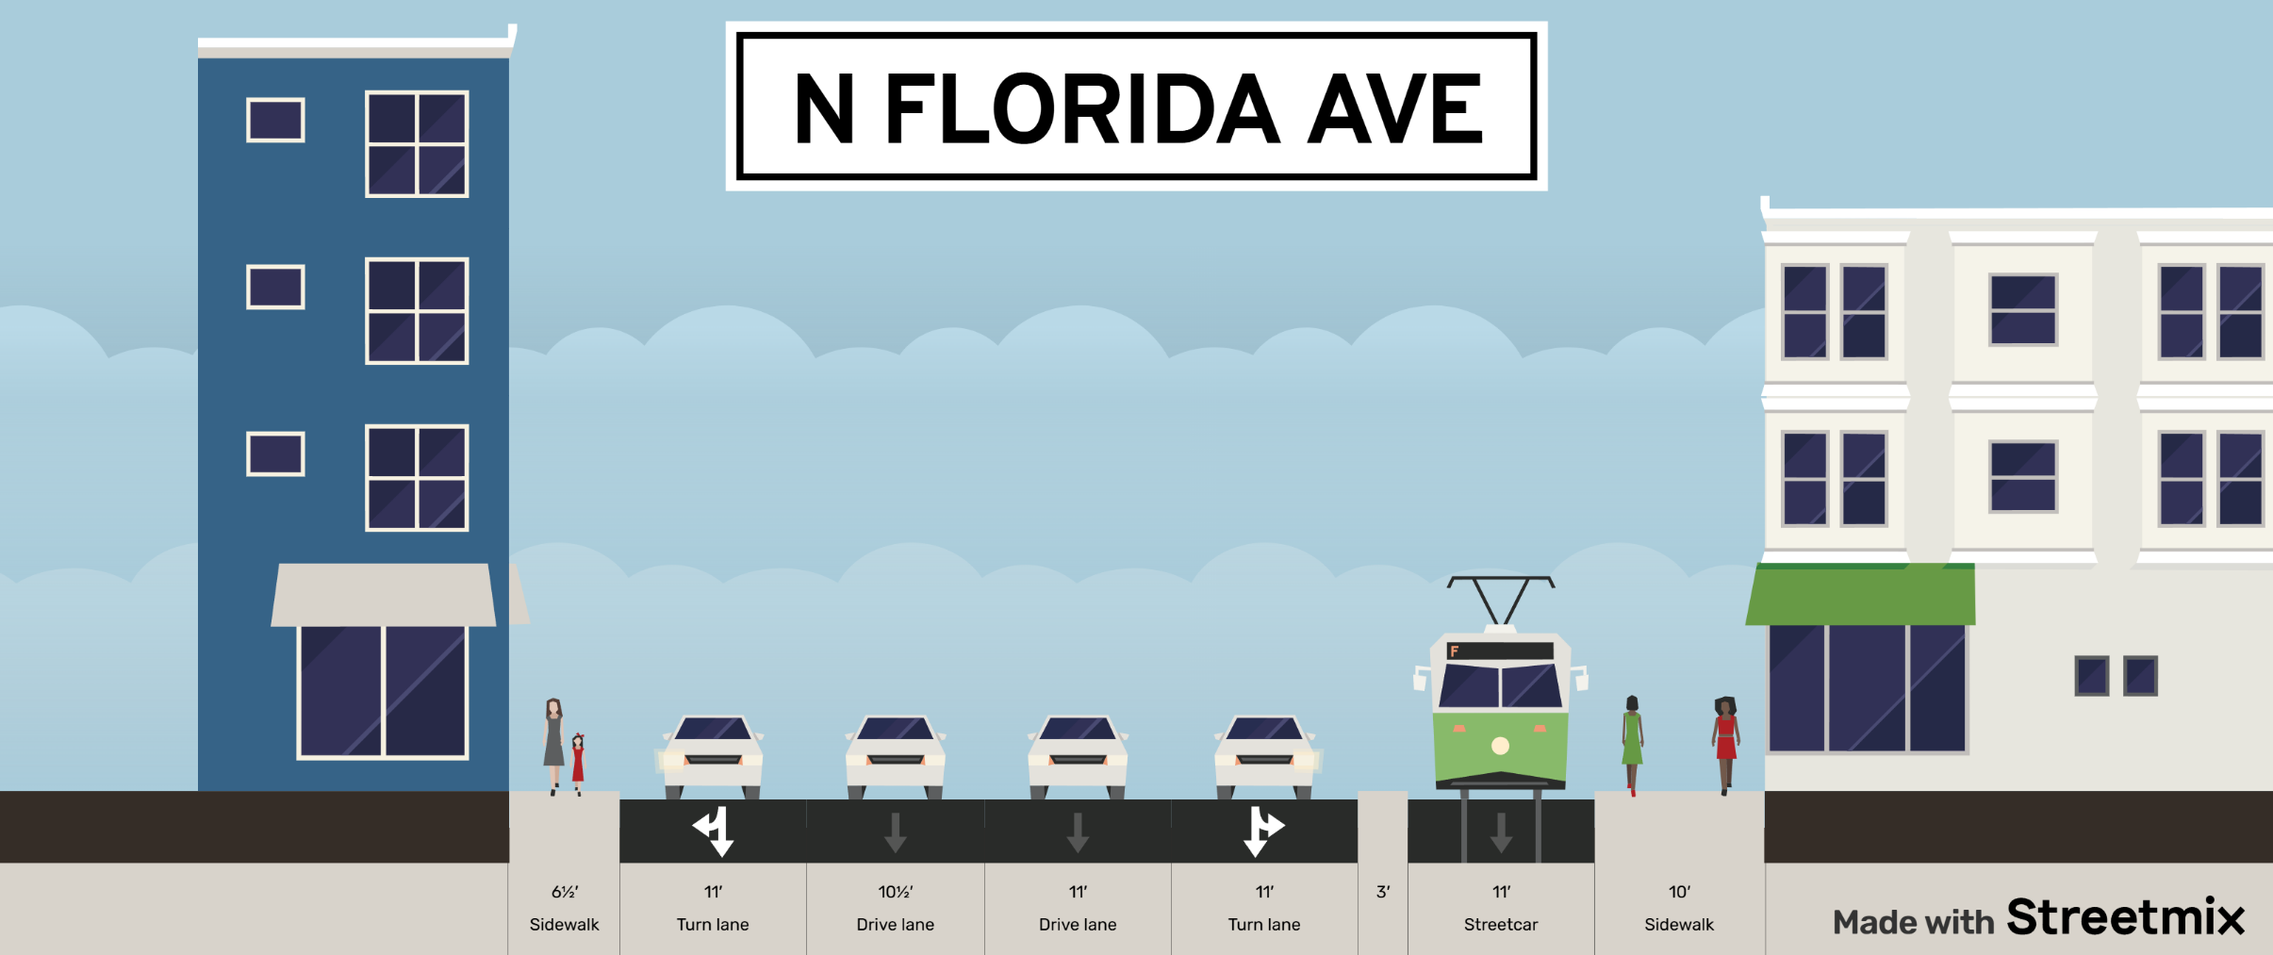
TYPICAL SECTIONS: N Florida Ave (Madison & Kennedy)
EXISTING
PROPOSED

Slide 15
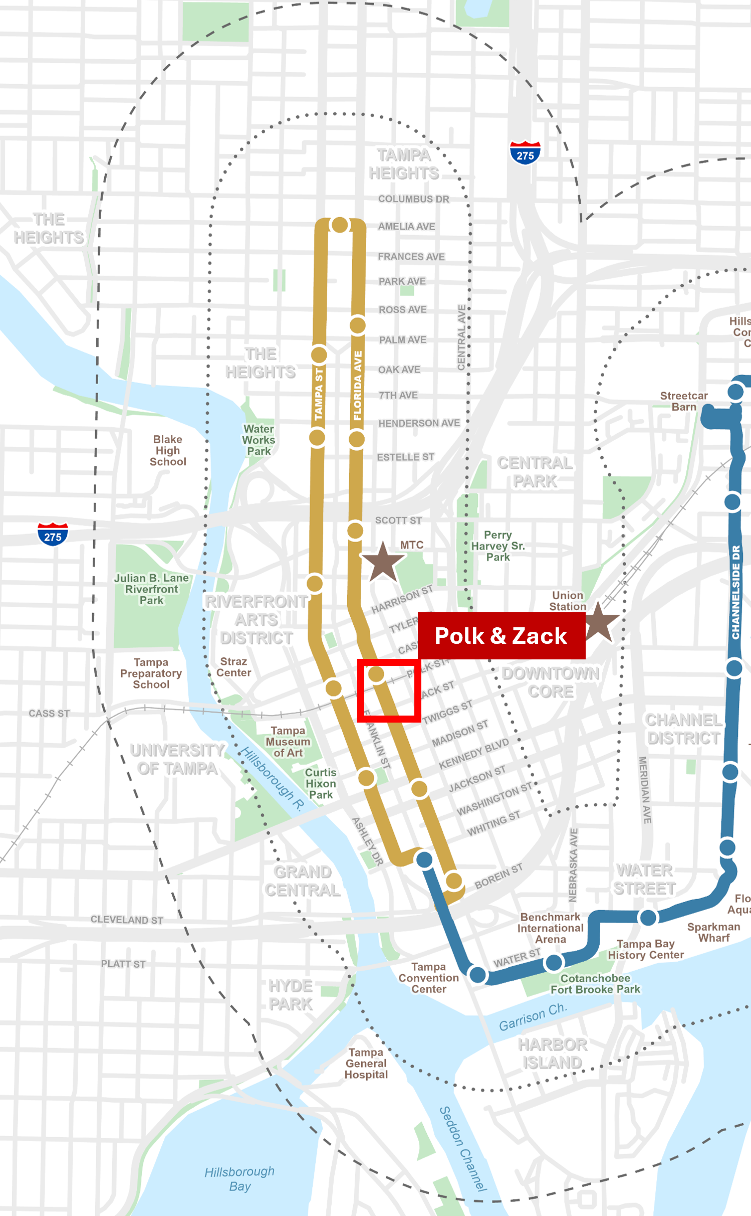

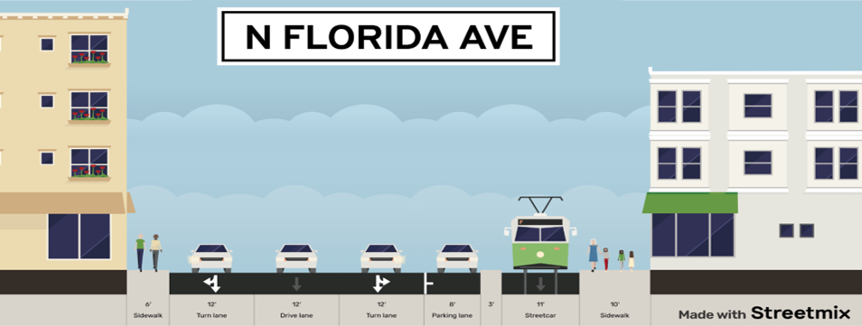
TYPICAL SECTIONS: N Florida Ave (Polk & Zack)
EXISTING
PROPOSED

Slide 16
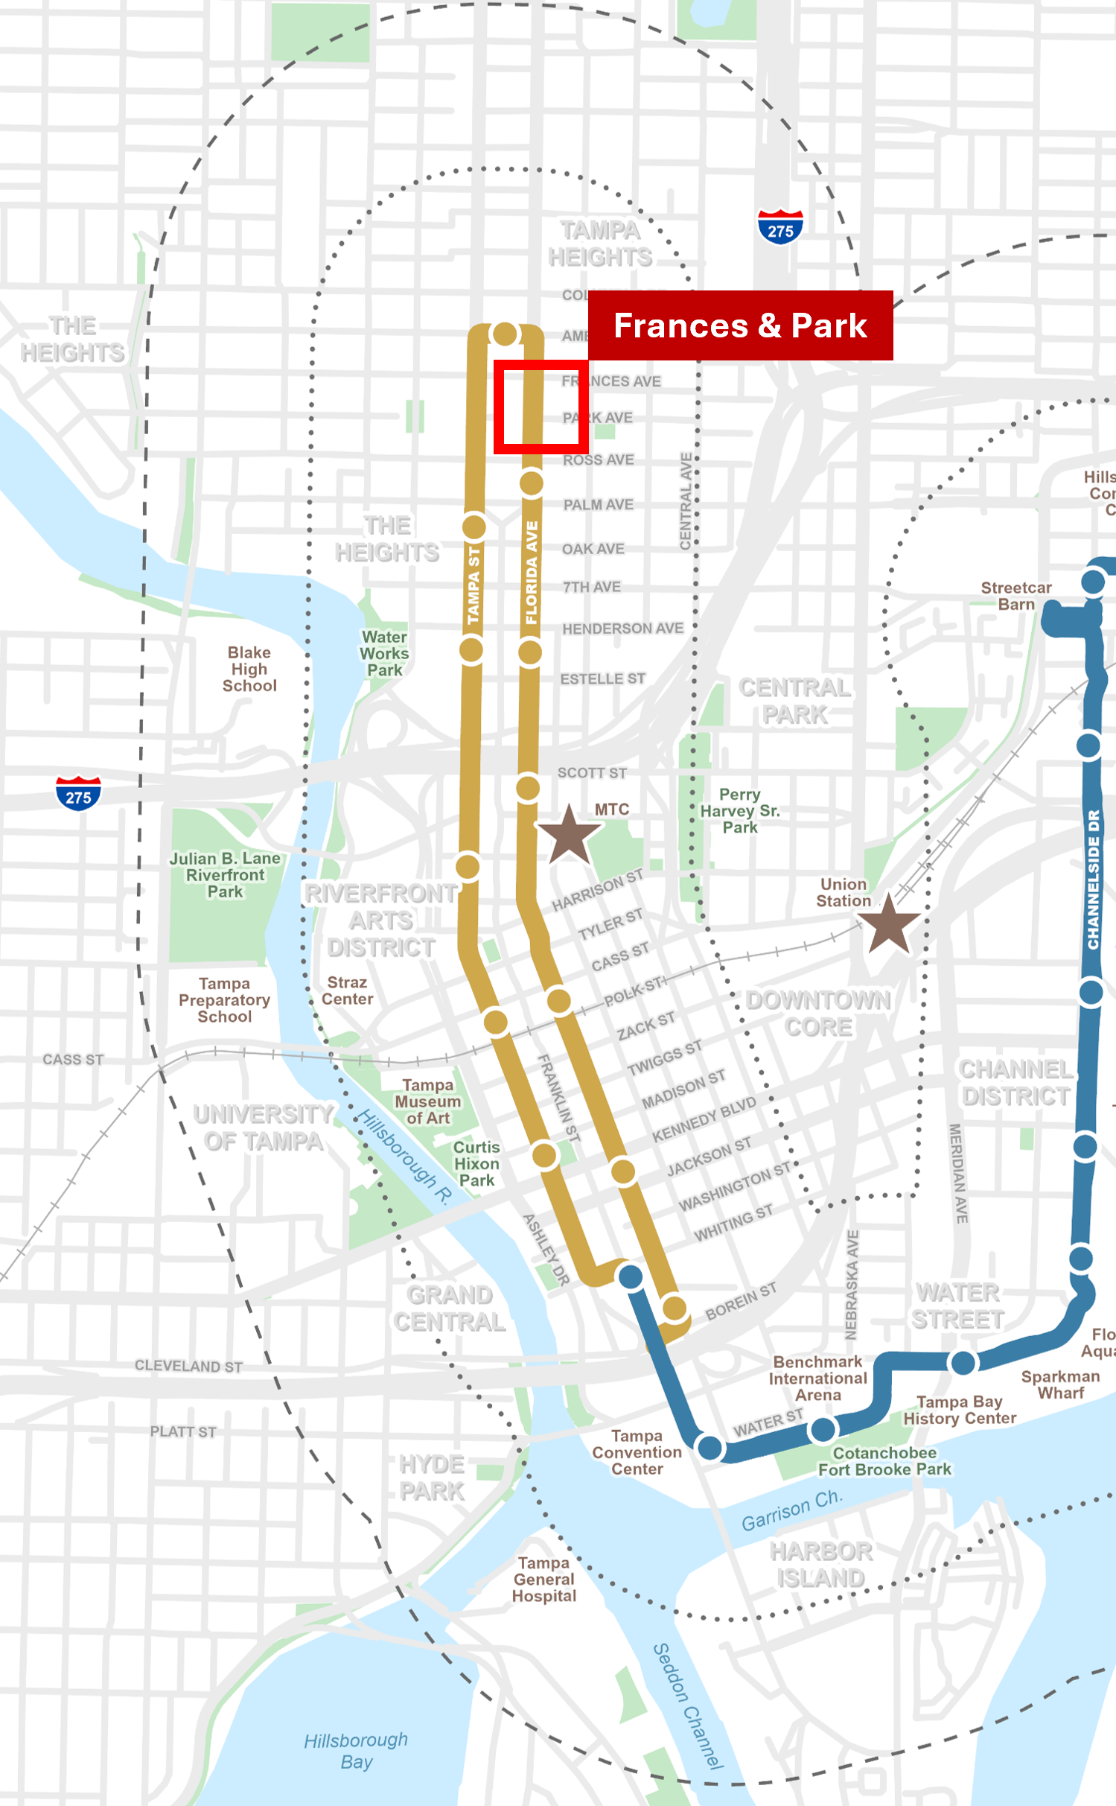
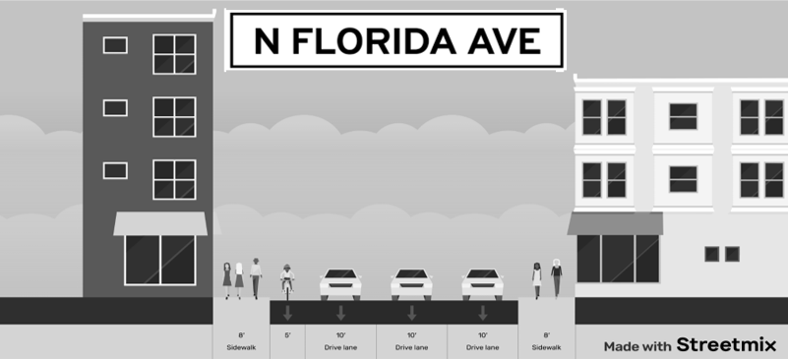
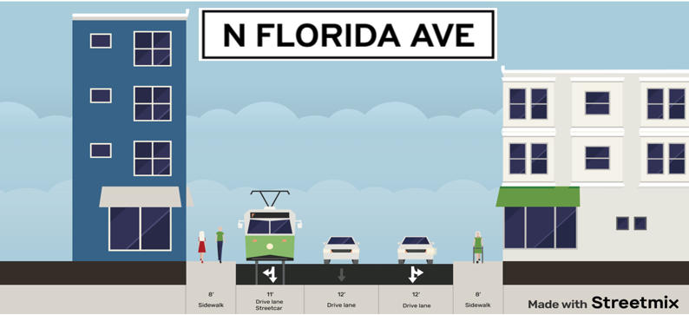
TYPICAL SECTIONS: N Florida Ave (Frances & Park 1)
EXISTING
PROPOSED

Slide 17
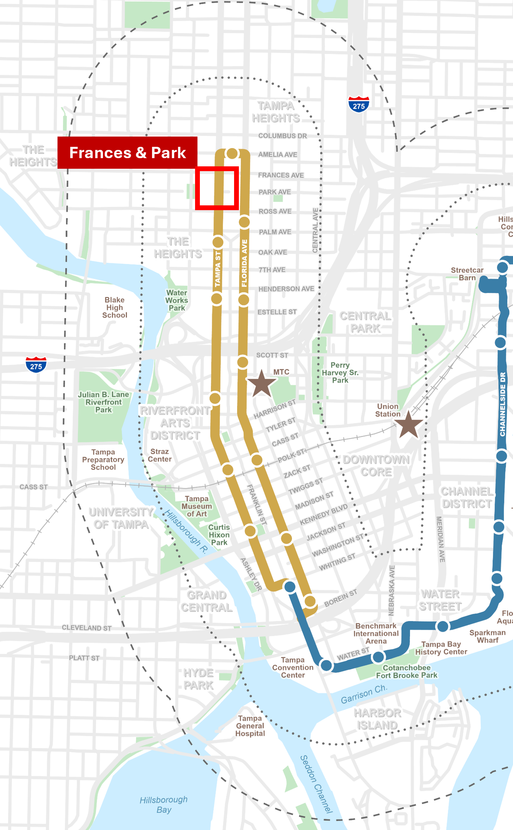
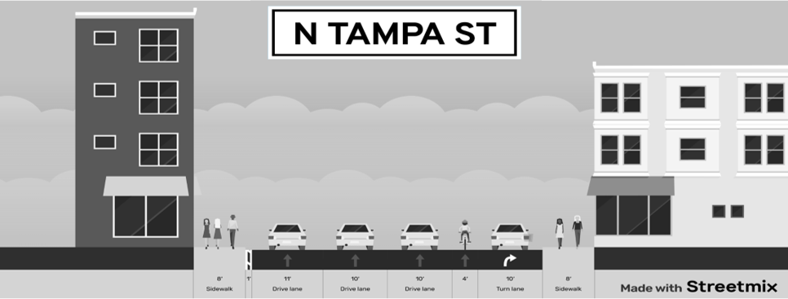
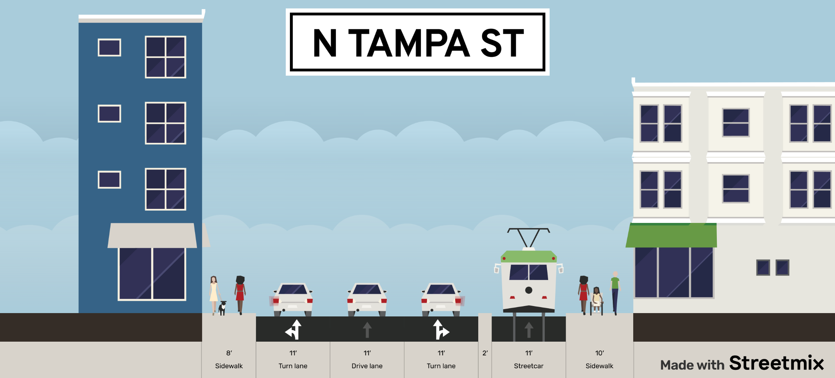
TYPICAL SECTIONS: N Tampa St (Frances & Park 2)
EXISTING
PROPOSED

Slide 18
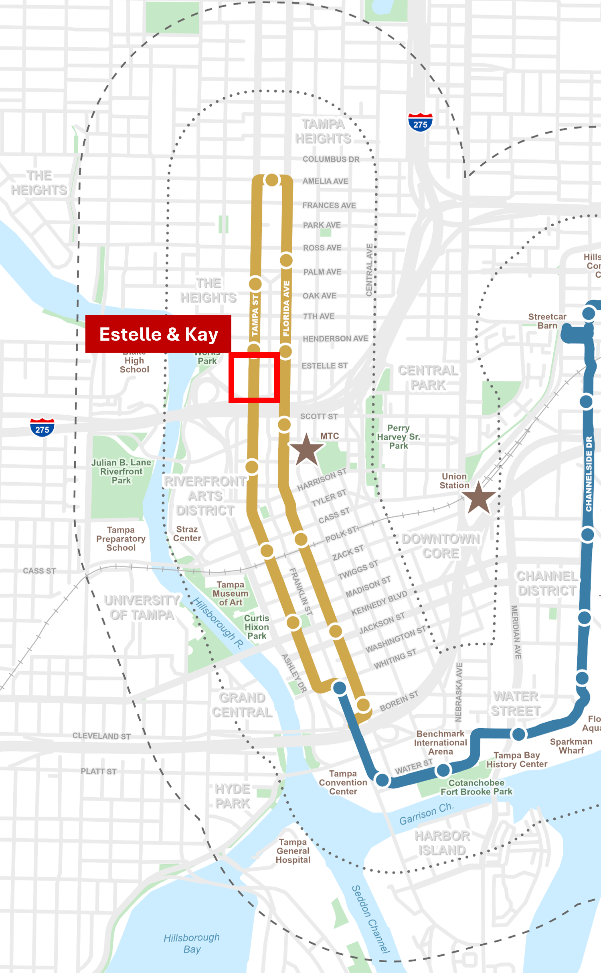

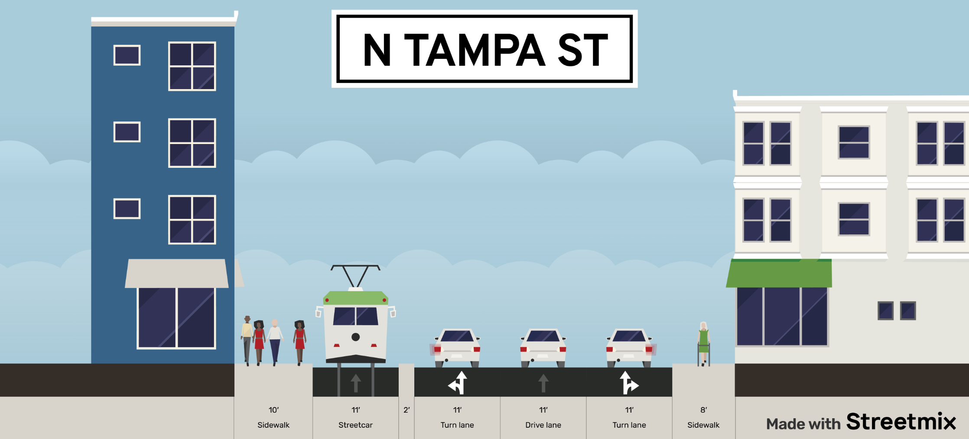
TYPICAL SECTIONS: N Tampa St (Estelle & Kay)
EXISTING
PROPOSED

Slide 19
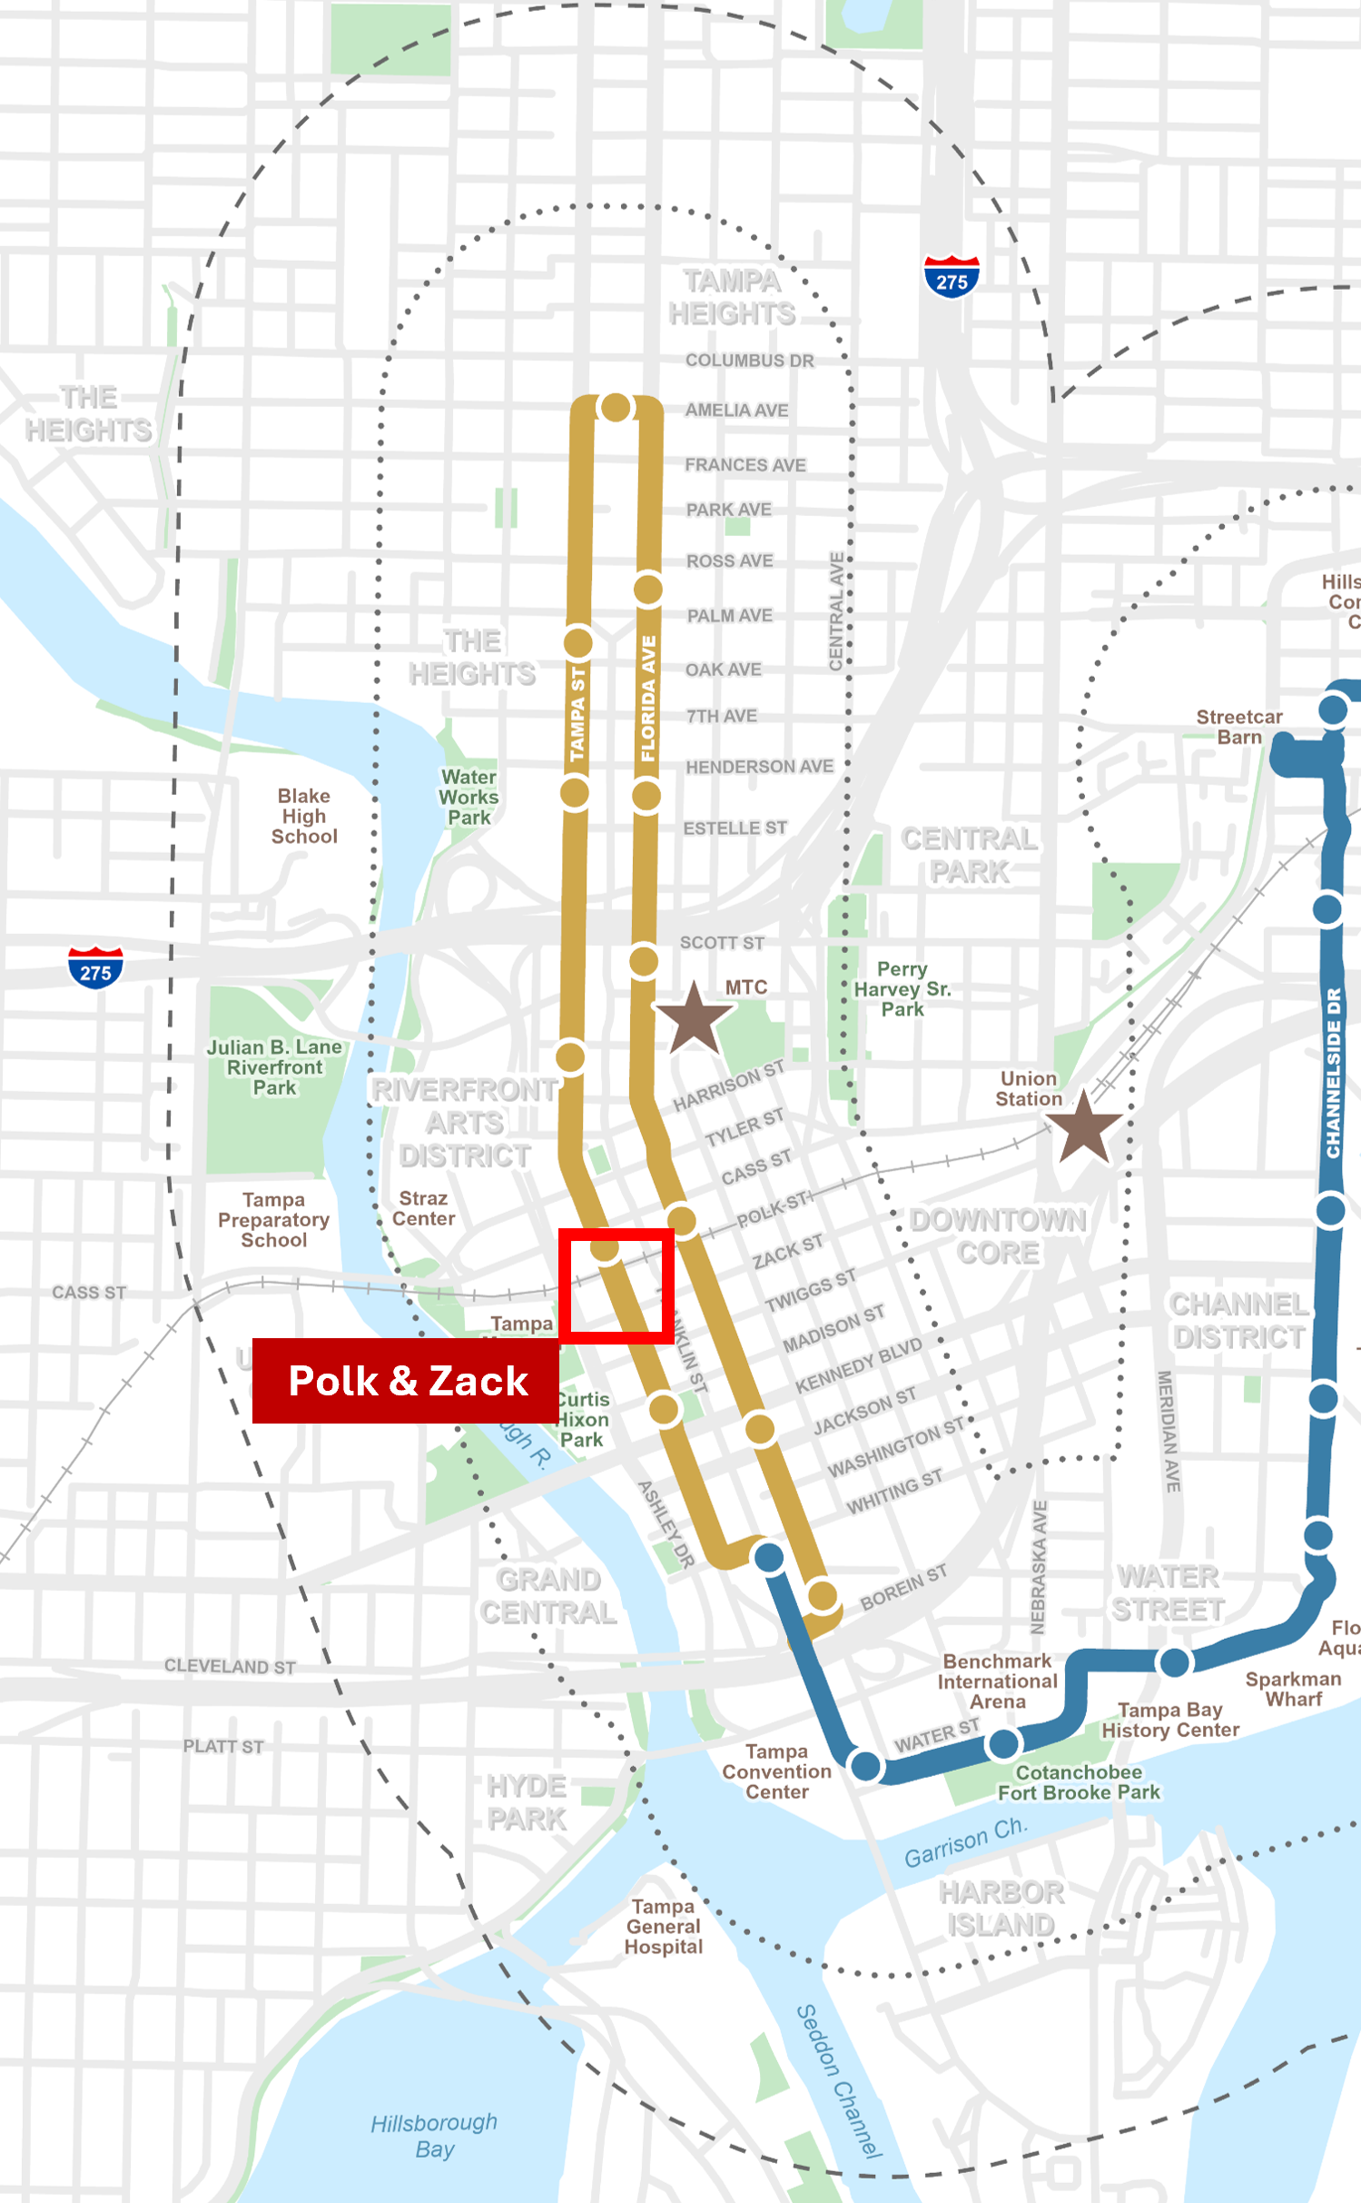
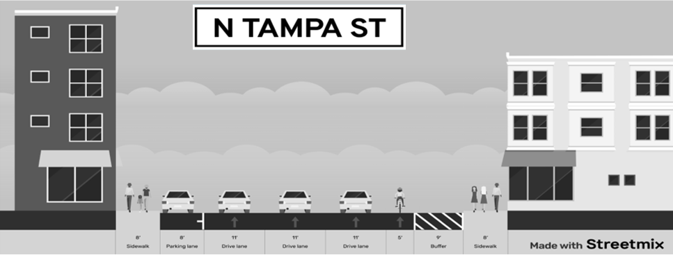
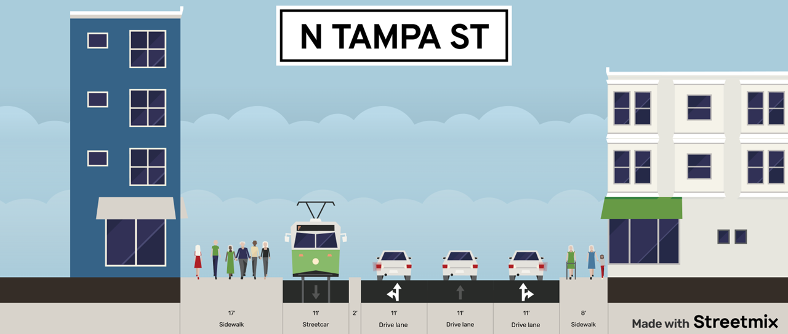
TYPICAL SECTIONS: N Tampa St (Polk & Zack 2)
EXISTING
PROPOSED

Slide 20
ALIGNMENT, GUIDEWAY & STOPS
Stop Concepts
Sites for Concept Development
  Florida Ave at Palm – far side sidewalk
  Florida Ave at Henderson – near side sidewalk
  Florida Ave at Kennedy – near side Island
  Tampa Ave at Cass – far side island
  Design Factors for Discussion
  High block location and operations
  High block lateral offset for sidewalk stops
  Streetcar boarding/alighting
  Shared use (bus and future BRT)
  Standard amenities
  Optimal sidewalk clear zone

Slide 21
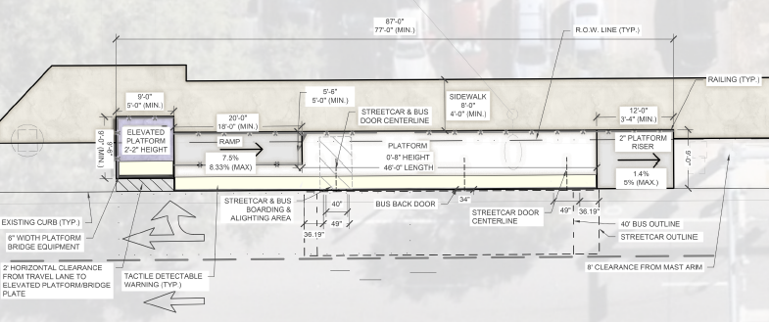
STOP CONCEPTS 1
Sidewalk Stop - Typical

Slide 22
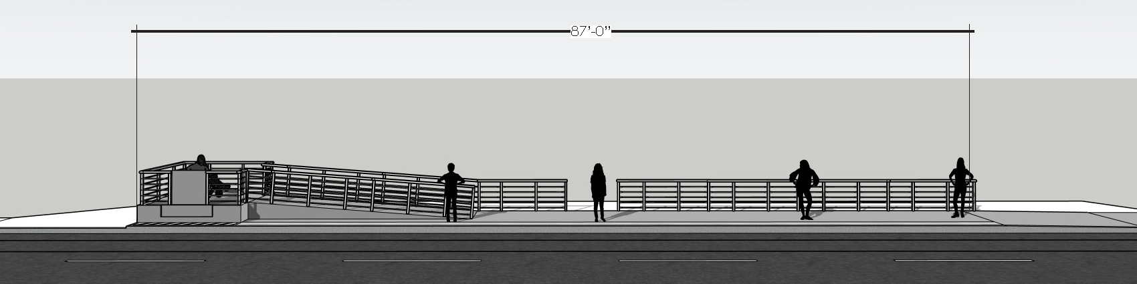
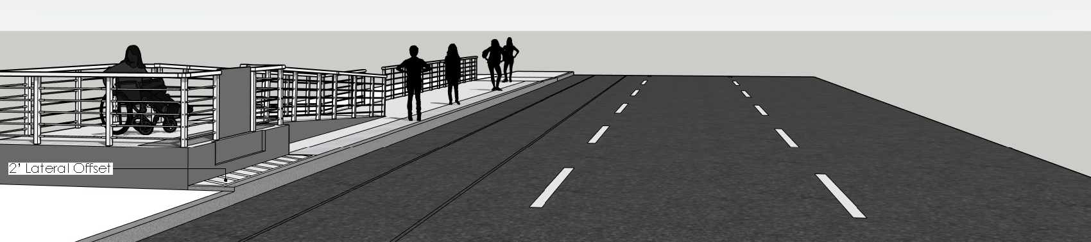
STOP CONCEPTS 2

Slide 23
APPROACH TO TRAFFIC ANALYSIS 1
Traffic Analysis Scope
  Consistent with the FDOT Traffic Analysis Handbook (May 2021)
  Study Area covers 45 intersections on the project alignment
Analysis Scenarios
  Evaluate AM and PM hour peak-hour conditions based on mixed traffic operations, potential turn lane impacts, and proposed signal timing modifications for transit only signal, blank out signs, and/or potential transit signal priority:
    Existing
    Interim 5-year No-Build
    Interim 5-year Build
    Design Year 2050 No-Build
    Design Year 2050 Build

Slide 24
APPROACH TO TRAFFIC ANALYSIS 2
Data Collection
  Peak-hour period TMCs including vehicle classification
  72-hour volume counts including vehicle classification
  Corridor travel time
  Maximum intersection queues
  Volume Development & Balancing
  AADT from TBRPM and calculated AADT
  Growth rate comparisons to 2050 Population & Employment forecasts
  AADT x K x D x TMC% method
  O-D Destination Matrix Estimation (ODME)
  Process
Methodology
FDOT Review & Approval
Existing Volumes & Model Calibration
FDOT Review & Approval
Data Collection
Existing , Interim, & Future Operations Analysis
Traffic Operations Analysis Report
FDOT Review & Approval

Slide 25
Roll Plot Review

Slide 26
Partner Coordination

Slide 27
PARTNER COORDINATION 1
Early Coordination Topics - HART
  Feedback on Alignment/Stops, including Stop Shared Use
  Existing Fleet Data – Age & Reconditioning Status
  Potential Fleet Modifications – On Board Energy Storage & Lifts
  Systems & Maintenance Facility Site Visit
    Communications
    Traction Power System
    Facility
  Station Amenities
  On Board Survey Data Availability/Scheduling
  Timing for Arterial BRT or Other Projects
  Approach to FTA Coordination & Timing PD Reentry
  CSX Agreement and Operations Cost
  Governance Agreement Revisions
    Project Development, Design & Construction
    Project Operations & Asset Ownership

Slide 28
PARTNER COORDINATION 2
Early Coordination Topics - FDOT
  Feedback on Alignment/Stops
  Traffic Modeling Methodology Letter Review (letter in 2-3 weeks)
  Timing of Tampa-Florida RRR
  Status of Downtown Interchange Projects
  Status of State New Starts Funding
  Governance Agreement Revisions (FDOT Role)
    Project Development, Design & Construction
    Maintenance, Utilities, & Ownership

Slide 29
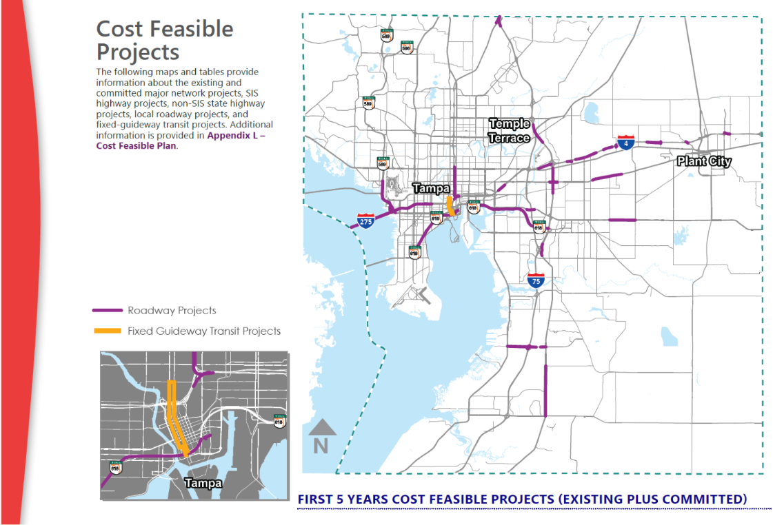
PARTNER COORDINATION 3
Early Coordination Topics – TPO
  Timing for inclusion of revised project/funding in LRTP
  Information and actions required to support update
In 2050 Long Range Transportation Plan & LoPP but not in the draft 2027-31 TIP.

Slide 30
Next Steps

Slide 31
CURRENT PROJECT
WO1 Scope, Schedule & Deliverables
  Alignment & Stop Concepts
  Tech Memos & Design Report
  Project Implementation Strategies & Schedule
    Includes initial collaboration with FDOT and HART staff, and initial public communications about project restart, and presentations to elected officials.

